Slide 1
Large-scale information extraction from textual definitions through deep syntactic and semantic analysis
Andy Zhang

Slide 2
Abstract
Present DEFIE, an approach to largescale Information Extraction (IE) based on a syntactic-semantic analysis of textual definitions.
(textual definitions: short and concise descriptions of a given concept or entity)
Leverage syntactic dependencies to reduce data sparsity
Disambiguate arguments & content words of the relation strings
Use the resulting info to organize the acquired relations hierarchically
Output a knowledge base consisting of several million automatically acquired semantic relations

Slide 3
Shortcomings of previous works
Constrained to small and often pre-specified sets of relations
Rely mostly on dependencies at the level of surface text
Relations strings are bound to surface text, lacking actual semantic content
Require additional processing steps to be used in real applications

Slide 4
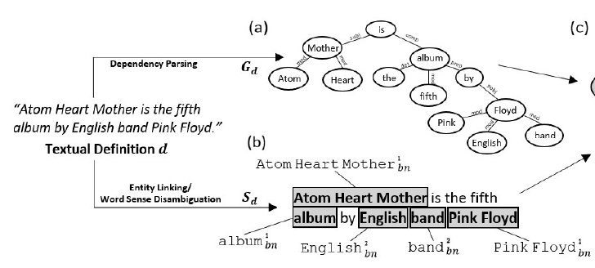
Relation extraction(1)
Textual definition processing
Syntactic analysis -$G_{d}$
Parsing
using C&C (Clark and Curran, 2007), a log-linear parser based on Combinatory Categorial Grammar (CCG).
Semantic analysis -$S_{d}$
Based on Babelfy (Moro et al., 2014)
An approach to entity linking and word sense disambiguation
Semantics draws on BabelNet(Navigli and Ponzetto, 2012)

Slide 5
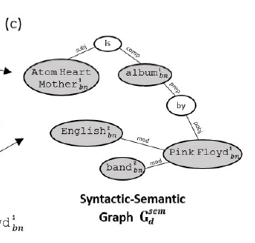
Relation extraction(2)
Syntactic-semantic graph construction
Merge vertices referring to same concept or entity
Incorporate semantic info from sense mapping $S_{d}$ to vertices in dependency graph $G_{d}$
Discard non-disambiguated adjuncts and modifiers

Slide 6
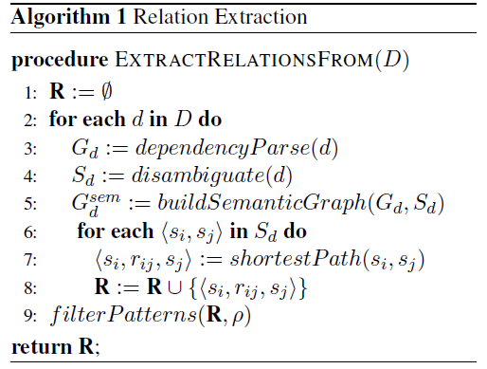
Relation extraction(3)
Relation pattern identification
extract the relation pattern r between two entities and/or concepts as the shortest path between the two corresponding vertices in $G_{d}^{sem}$
Floyd-Warshall algorithm(Floyd, 1962)
One constraint: at least one verb

Slide 7
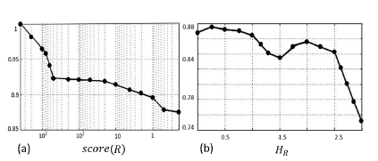
Relation type signatures and scoring
Computing semantic type signatures for each relation
Collect hypernyms(BabelNet) of all the arguments, the one covers the biggest subset of arguments is selected to be the semantic class of the relation
Scoring

Slide 8
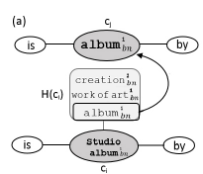
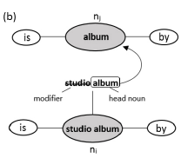
Relation taxonomization
Consider only relations whose patterns are identical except for a single noun node
Hypernym generalization
extract hypernym sets of concepts or entities
check whether one concept belongs to the set of the other
Substring generalization

Slide 9
Experiment(1)
All experiments conducted manually
Assess the quality of relations
whether it represented a meaningful relation
whether the extracted argument pairs were consistent with this relation and the corresponding definitions

Slide 10
Experiment(2)
Assess the coverage of relations
163 manually annotated semantic relations from Wikipedia about musicians, seek for a relation carrying the same semantics
Look for similar relations in DEFIE

Slide 11
Experiment(3)
Quality of relation taxonomization
extracted a random sample of 200 hypernym edges for each generalization procedure
Manually judge whether they are correct or not

