Slide 1
Informational Speech Factorization
by Factorial Discriminative
Normalization Flow
孙浩然

Slide 2
Introduction
Informational speech factorization
Why generative model
Why discriminative normalization flow

Slide 3
VAE and NF
VAE
ELBO
Information loss
NF

Slide 4
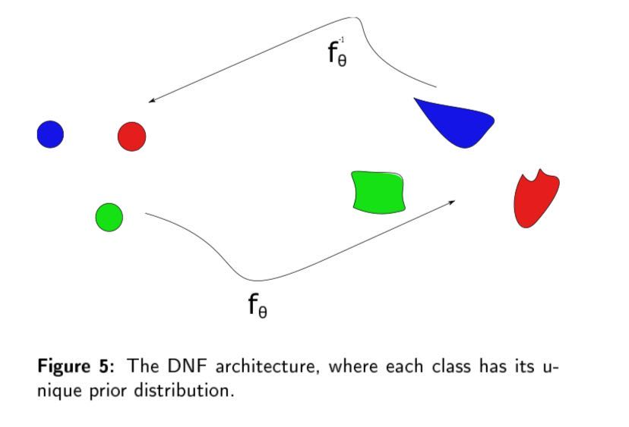
DNF
Supervision

Slide 5
Factorial DNF
Take more than one information factors into consideration. (two factors as example)
split the latent code into two partial codes (different dimensions).
The two codes are independent because of the prior’s diagonal Gaussian.

Slide 6
Factorial DNF

Slide 7
Experimental settings
Data
TIMIT, 462 speakers in training set, the original 58 phones are mapped to 39 phones(using 38 phones without ‘sil’, which is ‘silence’) by Kaldi’s phone mapping tool.
Phone segments with a 200ms duration, guaranteeing that main phones are in the middle of these segments.
4000 dimensions, 20 × 200 time-frequency spectrograms, where 20 is the number of frames in the segment, and 200 is the number of frequency bins.

Slide 8
Experimental settings
Model training
VAE involves three convolutional layers followed by a fully connected layers, and the dimension of the latent space is 128
NF, DNF and f-DNF models follow the RealNVP structure, there are 6 blocks in every model, and each block has a coupling layer and a batch norm layer.
Class means of DNF and f-DNF are initialized by 0-I normal distribution, and within variances are set as 1.0.
Each partial codes of f-DNF has 2000 dimensions.

Slide 9
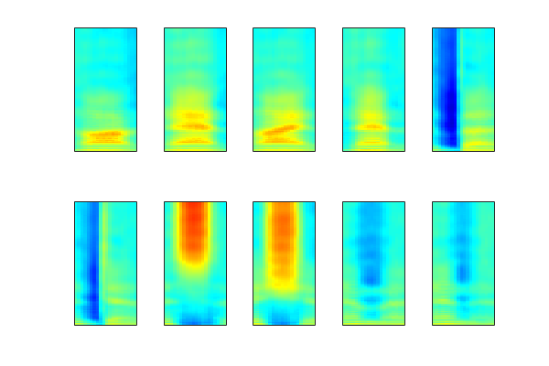
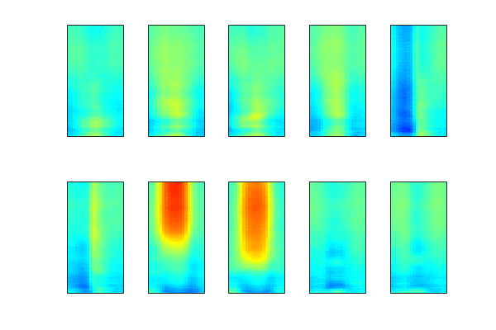
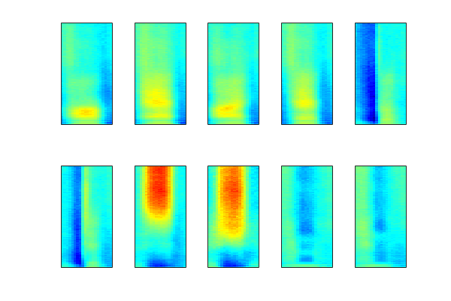
Speech encoding
Phone class means as representations
VEA
NF
DNF

Slide 10
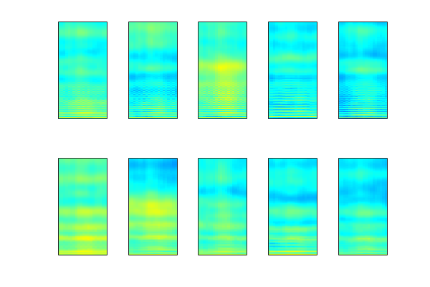
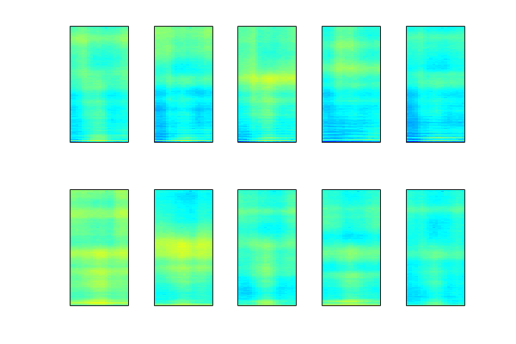
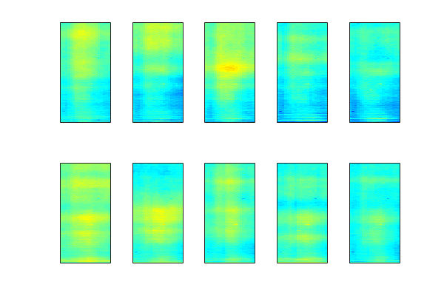
Speech encoding
Speaker class means as representations
VEA
NF
DNF

Slide 11
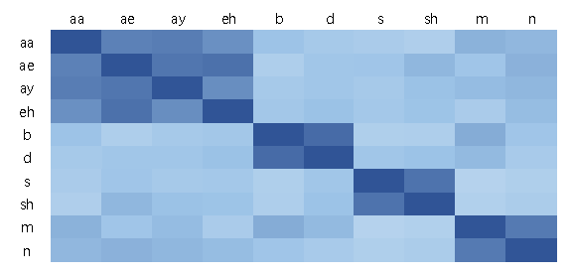
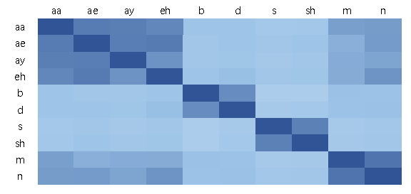
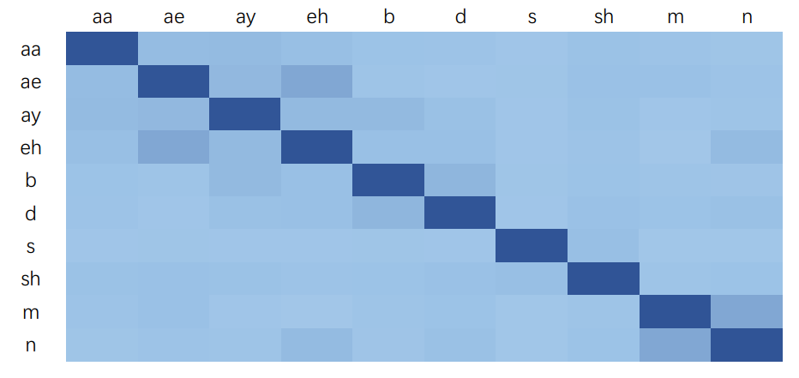
Speech encoding
Phone class mean distance
VEA
NF
DNF

Slide 12
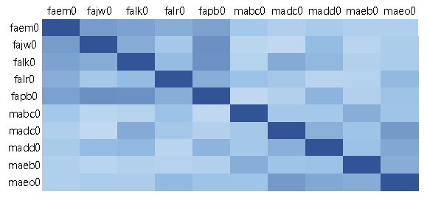
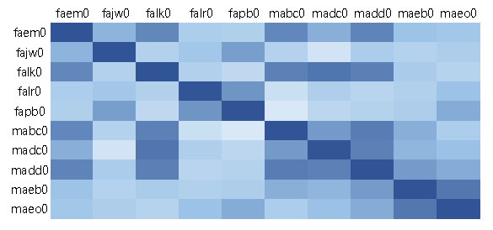
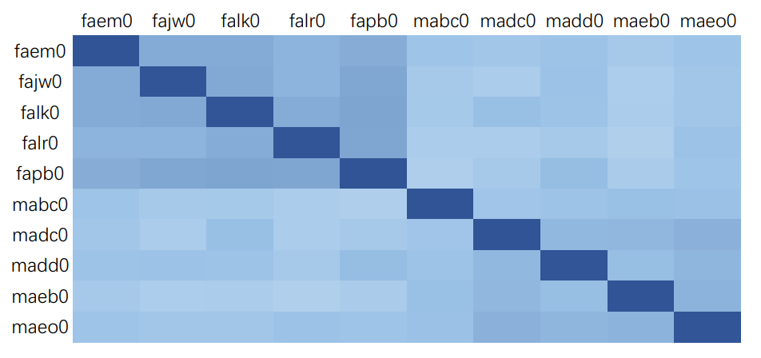
Speech encoding
Speaker class mean distance
VEA
NF
DNF

Slide 13
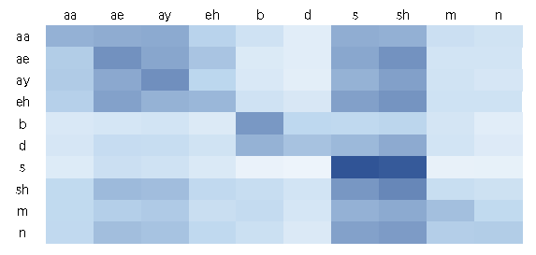
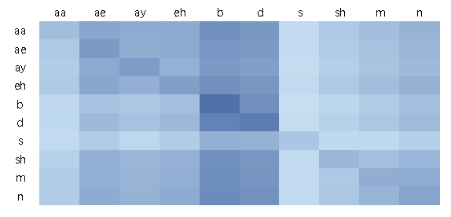
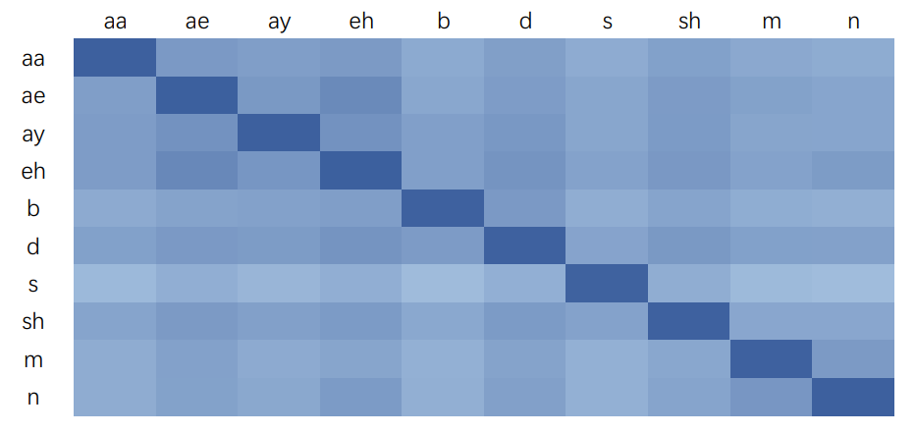
Speech encoding
Phone class likelihood
(Between-class likelihood)
VEA
NF
DNF
Each column represents a class of data, and each row represents a class distribution

Slide 14
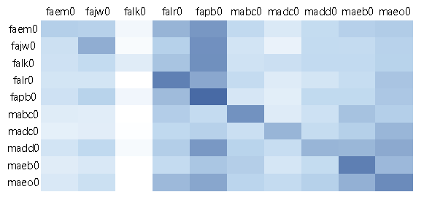
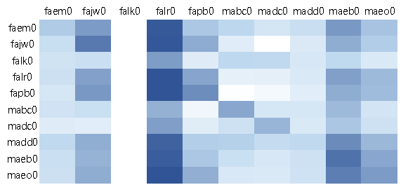
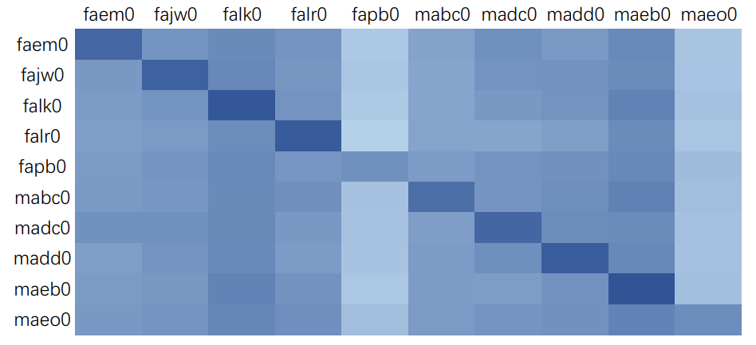
Speech encoding
Speaker class likelihood
(Between-class likelihood)
VEA
NF
DNF

Slide 15
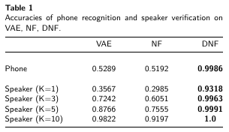
Speech encoding
Recognition
Top-1 log(p(z))
Short-term phone and long-term speaker information bias
Speaker verification based on average likelihood of K sequential segments

Slide 16
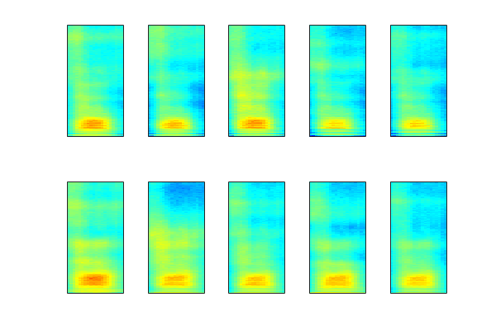
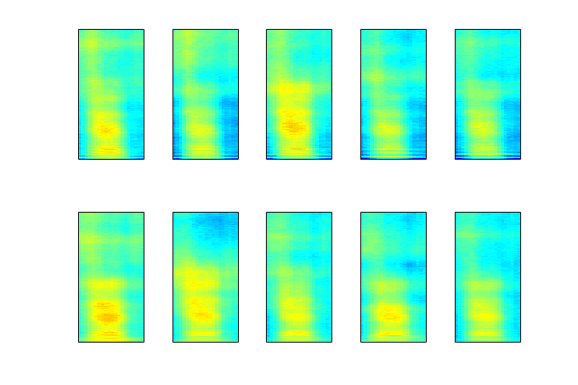
Speech factorization
Class means as representations
Different speakers with /aa/
Different speakers with /iy/

Slide 17
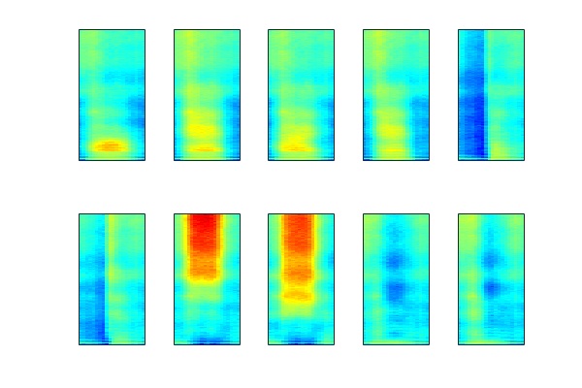
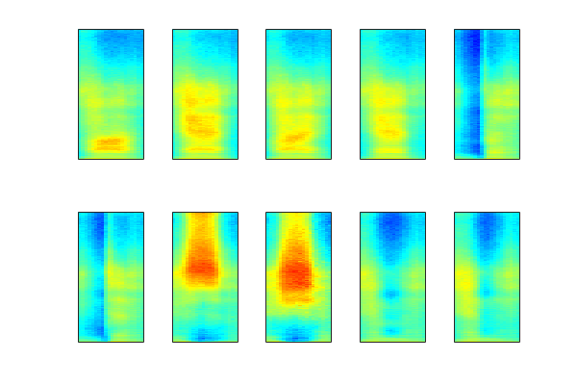
Speech factorization
Class means as representations
Different phones with a female
Different phones with a male

Slide 18
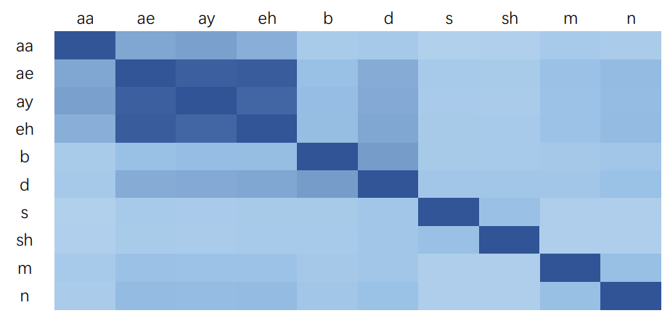
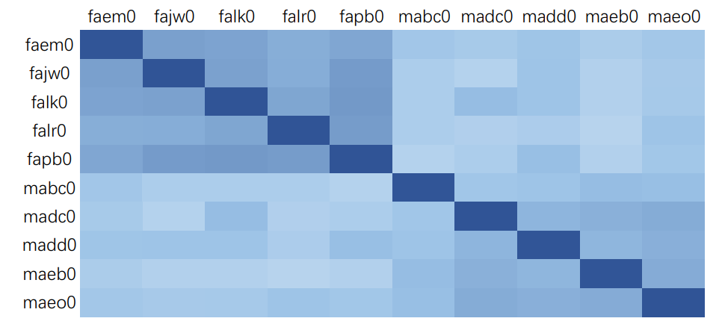
Speech factorization
Class mean distance
Phones
Speakers

Slide 19
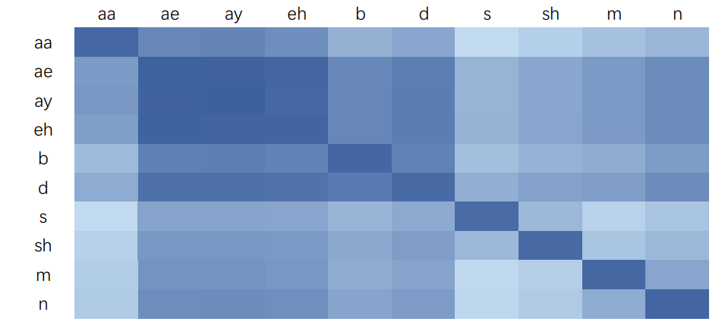
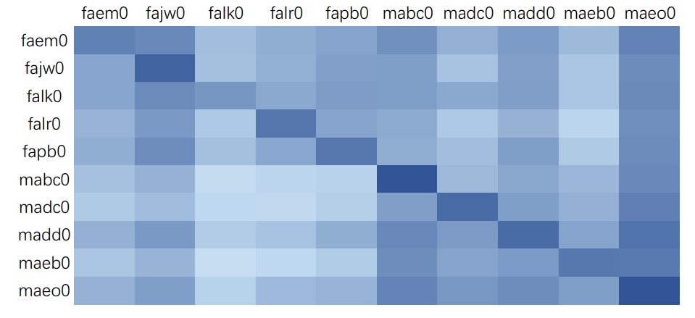
Speech factorization
Class likelihood
Phones
Speakers

Slide 20
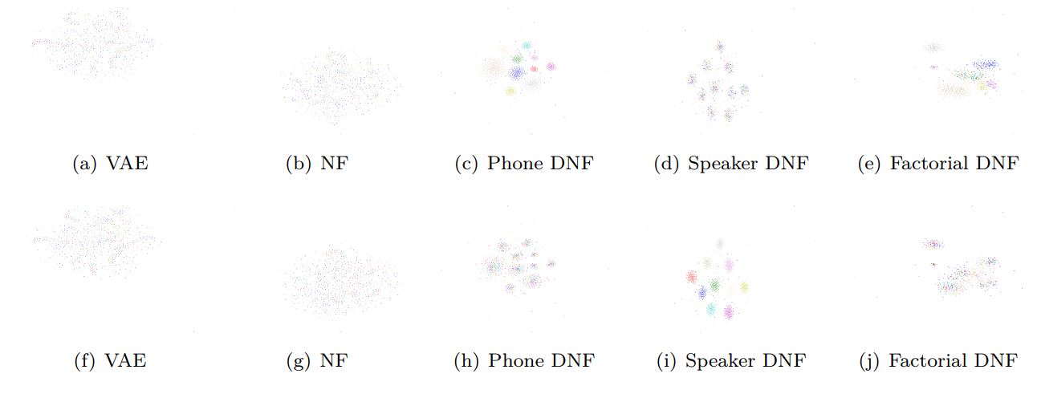
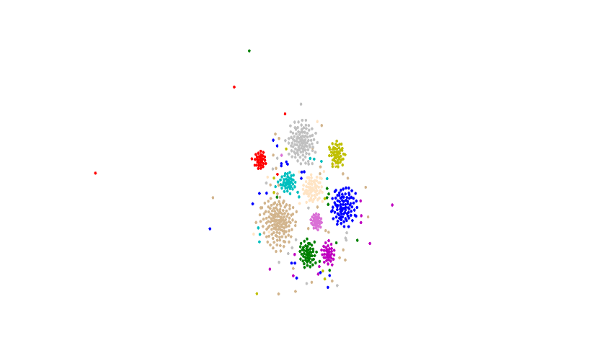
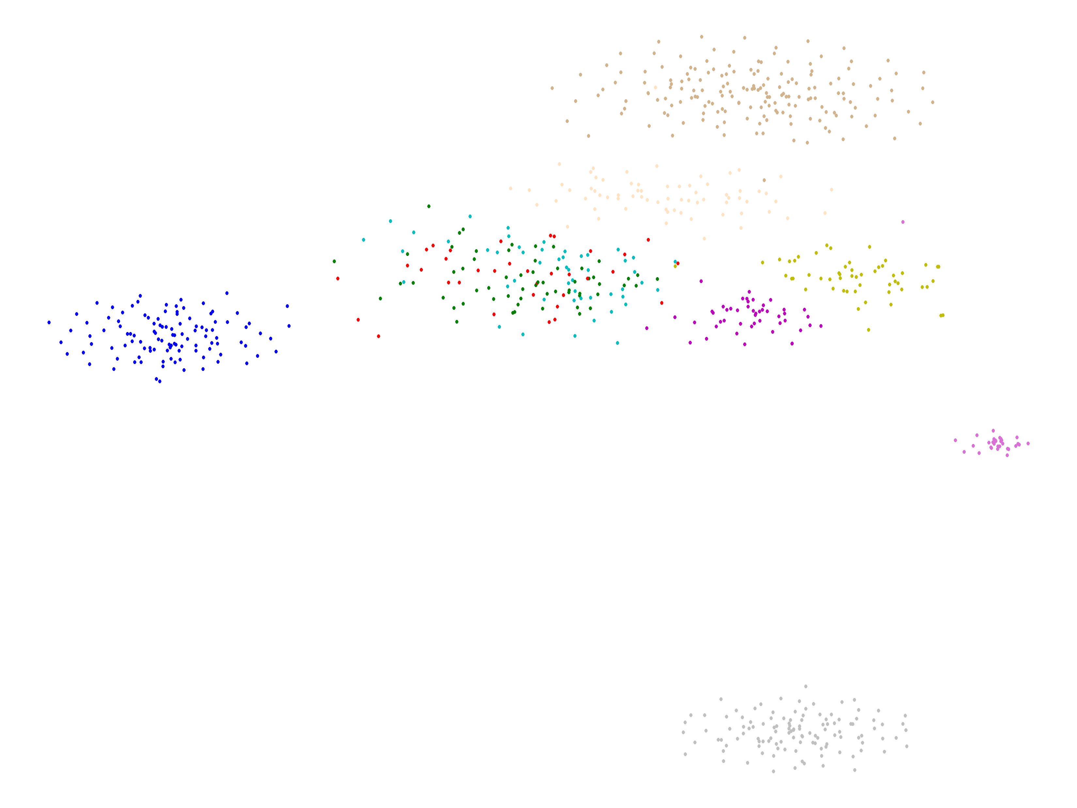
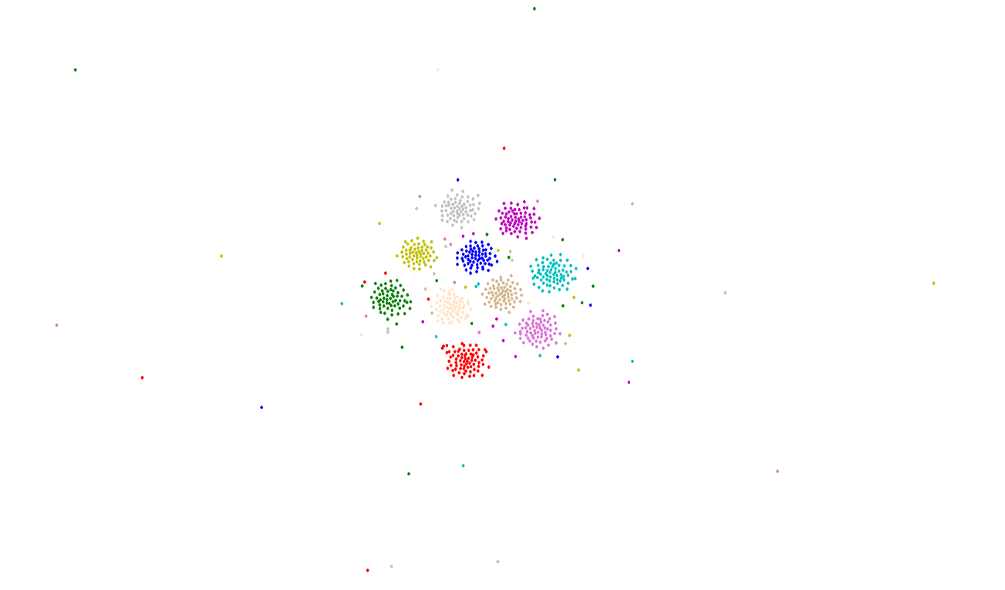
Speech factorization
Class discrimination (tSNE)
40 speakers
40 speakers

Slide 21
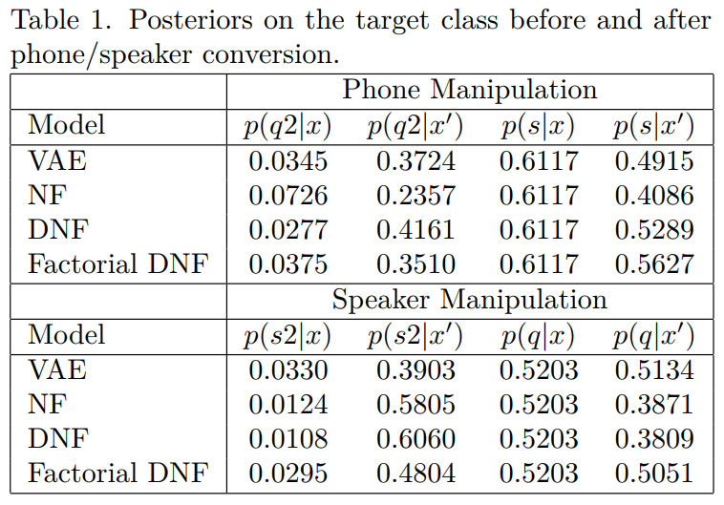
Speech factorization
Phone and speaker conversion
Posteriors from mlp
38 phones & 40 speakers; 4/5 segments for mlp training and 1/5 segments for conversion and mlp test

Slide 22
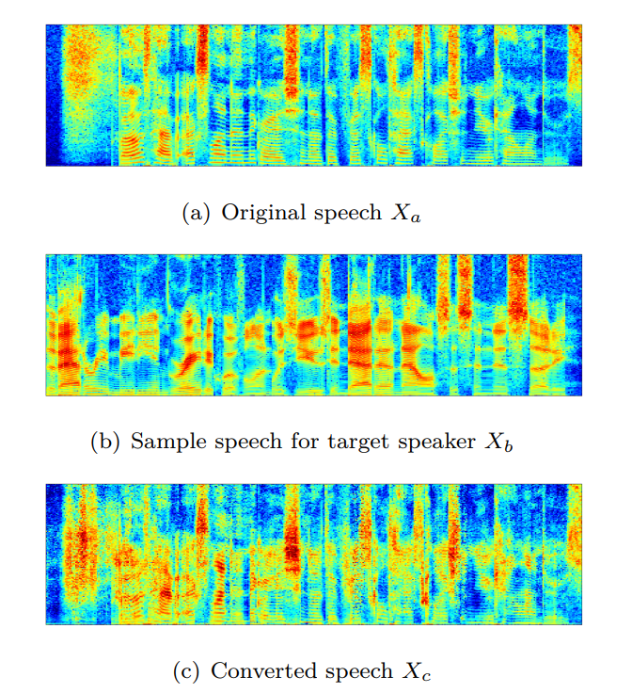
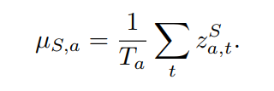
Speech factorization
Speaker conversion example
Converting a Speech Xa spoken by speaker a to Xb which sounds like coming from speaker b.

Slide 23
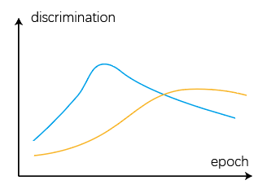
Discussions
The phone factor code and speaker factor code are not fully independent.
Dimension splitting makes differences.
The two codes couldn’t get the best performance at the same time.
Discrimination of each code space is not so good as we hoped.

Slide 24
Summary
Informational speech factorization by factorial DNF is feasible, but there remain some problems to be solved.

