Slide 1
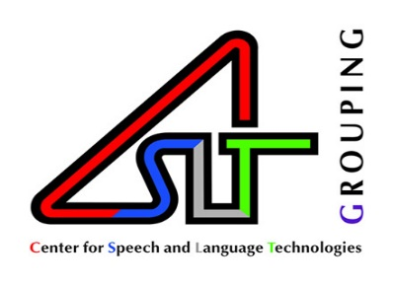
Enhanced Neural Machine Translation by Learning from Draft
Aodong Li
NLP Group, CSLT, Tsinghua University

Slide 2
Route Map
Introduction
Learning from draft
Experiments
Conclusions
Future work

Slide 3
Introduction (1)
Statistical Machine Translation (SMT) is a translation paradigm that focuses on latent feature design.
word alignment
source sentence length
target sentence length
…
Benefit: Its latent structure is explainable.
Shortcomings:
expert designed feature
expert designed translation process
long-distance dependency
…
In recent years, Neural Machine Translation (NMT) has achieved the state-of-the-art results on many language pairs, e.g., English-to-French, English-to-German, Chinese-to-English, etc.

Slide 4
Introduction (2)
Neural Machine Translation usually adopts an encoder-decoder structure to accommodate paired languages.
The decoder acts as a language model which incorporates the left context but ignores the right context.
Is this right context useful?
If it’s useful, how can we use the right context?
I
love
China
decoder
encoder
我
爱
中国

Slide 5
Introduction (3)
Is the right context useful?
Yes!
Sutskever et al. found that the sequence-to-sequence model achieved a promising improvement when reversing the source sentence “a, b, c” to “c, b, a” [1].
A significant improvement could be obtained when using a bi-directional RNN rather than a uni-directional RNN [2].
[1] Ilya Sutskever, Oriol Vinyals, and Quoc V. Le. Sequence to sequence learning with neural networks. In Proc. of NIPS, NIPS’14, pages 3104– 3112, 2014.
[2] Mike Schuster and Kuldip K Paliwal. Bidirectional recurrent neural networks. IEEE Transactions on Signal Processing, 45(11):2673–2681, 1997.

Slide 6
Introduction (4)
How can we use this right context?
Beam search is a way to utilize the right context, but to a limited extent [1][2].
We propose a two-stage translation approach with the idea of drafting-and-refinement to tackle this problem. The draft contains the right context.
Novak et al. proposed a similar iterative translation approach in which they correct the words again and again [3].
[1] Wiseman S, Rush A M. Sequence-to-sequence learning as beam-search optimization[J]. arXiv preprint arXiv:1606.02960, 2016.
[2] Liang Huang. Forest-based algorithms in natural language processing. PhD thesis, University of Pennsylvania, 2008.
[3] Roman Novak, Michael Auli, and David Grangier. Iterative refinement for machine translation. arXiv preprint arXiv:1610.06602, 2016.

Slide 7
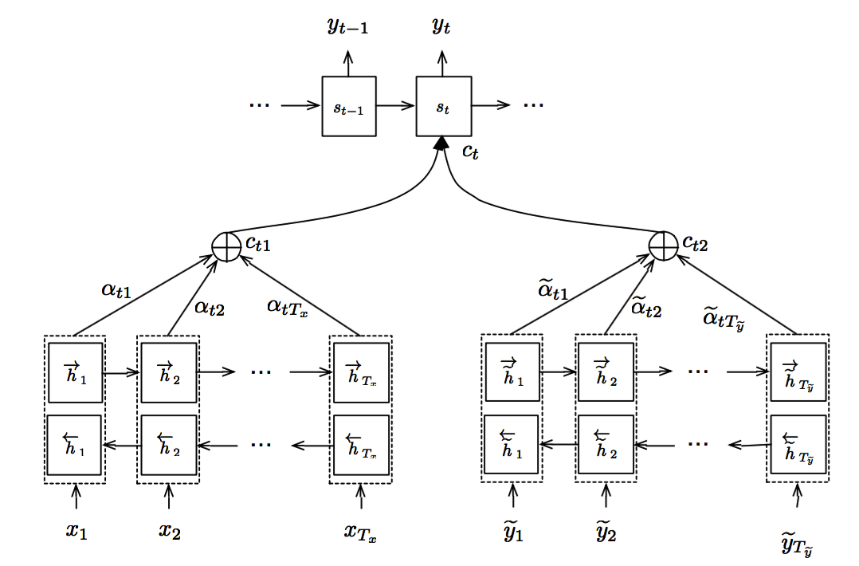
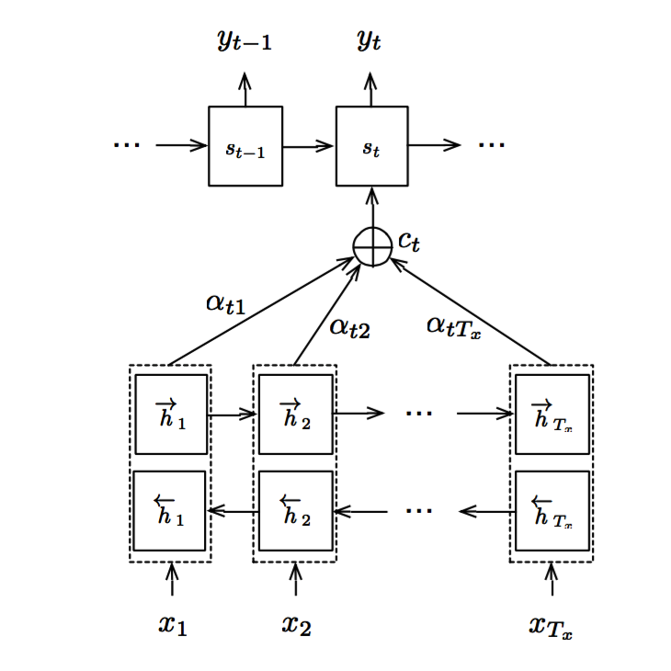
Learning from draft
Two-stage translation approach: drafting-and-refinement.
Drafting: the source sentence X is translated into a draft .
The right context can be obtained from the draft.
Refinement: both the original source sentence and the draft are translated together.

Slide 8
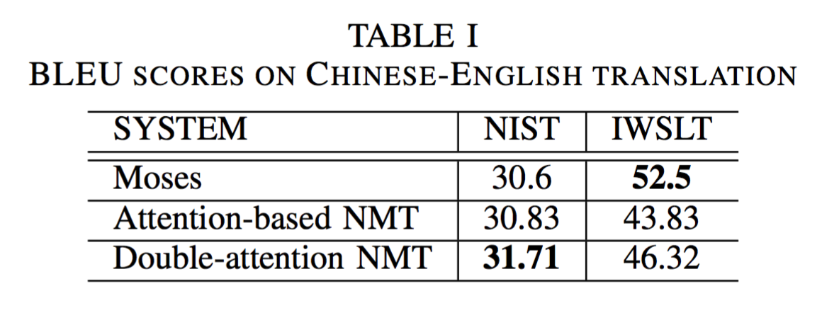
Experiments
Experiments were conducted on two Chinese-English tasks.
Dataset:
large NIST corpora with 1M parallel training data.
small IWSLT corpora with 44K parallel training data.
Comparison systems:
Moses: a widely-used SMT system.
Attention-based NMT: a popular NMT system.
Evaluation metric:
we used the case-insensitive 4-gram NIST BLEU score.

Slide 9
Conclusions
The target sentence’s right context is informative and provides an important regulation for current generated word.
Our two-stage translation approach can utilize the right context to enhance the neural translation model.

Slide 10
Future work
Is the right context more informative than the left context?
Can the model be constructed in a uniform framework so that we don’t have to conduct two separate training processes?
More experiments on different language pairs need to be done to confirm our approach’s effect.

Slide 11
Thanks! Q&A

