Slide 1

BullTrader
A python framework for quantitative trader
Yang Wang

Slide 2
Motivation
We want to define data
We want to use python
We want to use deep learning system
We want to visualize the performance better
We need to develop a toolkit to meet the customized needs.

Slide 3
Architecture
BullTrader
Fetcher
Model
Feed
Analysis
Backtest
Utils

Slide 4
Mechanism
Database
Fetcher
Feed
Model
Data
Analysis
Backtest

Slide 5
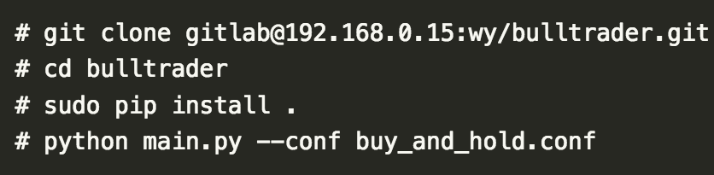
Usage

Slide 6
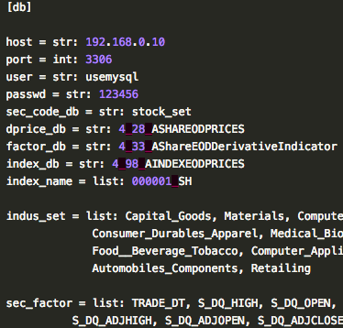
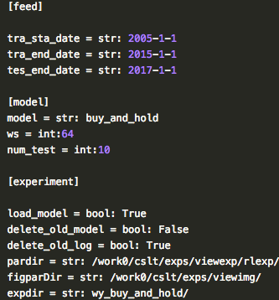
Conf

Slide 7
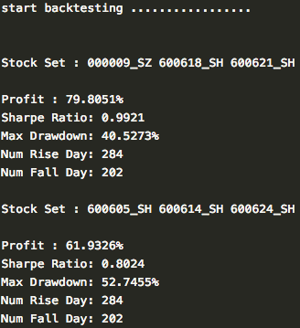
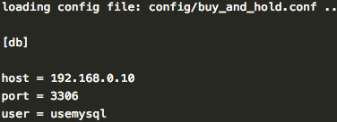
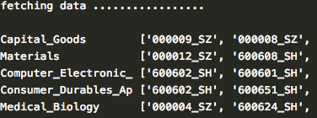
Output

Slide 8
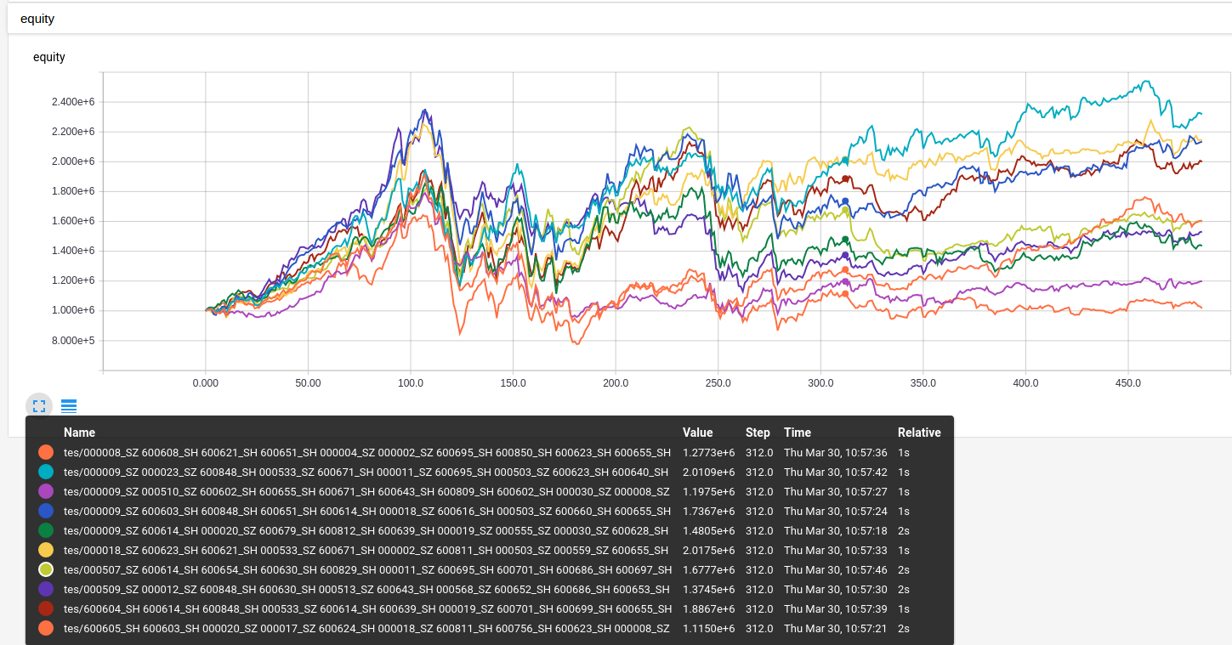
Visualization

Slide 9
BullTrader
Help you focus on strategies !

