Slide 1
CYCLEFLOW: PURIFY INFORMATION FACTORS BY CYCLE LOSS
Haoran Sun

Slide 2
Speech Factorization
A distinct talent of human beings is that we can decompose the information load within speech signals accurately and effectively;
The purpose of speech factorization is just to decompose information factors which is simple for humans to realize, these factors contain enough information to reconstruct original speech signals.
Speaker(timbre)
Content
Rhythm
Emotion
Others

Slide 3
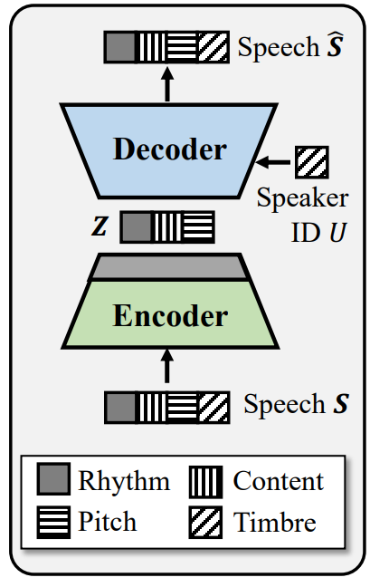
AutoVC
AutoVC is a factorization model for voice conversion, the main architecture of which is a conditional autoencoder (AE) where speaker identity is used as condition;
As the speaker information has been known by the model, the latent code only represents the content, leading to speaker-content decomposition.
Information bottleneck (IB): by designing appropriate IB channels, one can control the type and amount of the information flow.

Slide 4
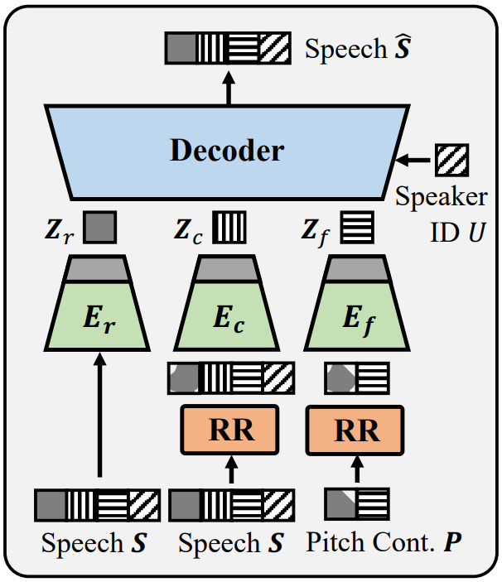
SpeechFlow
SpeechFlow decomposes speech signals into four separate informational factors: rhythm Zr, pitch Zf , content Zc and timbre Zt by four encoders:
The training objective of the model is to reconstruct the original speech S from these information factors:
Special design:
Select appropriate dimensions for the four factors so as to ensure minimum sufficient capacity.
The timbre factor is specified (not need to learn) by a deep speaker vector.
Random resampling operation (RR) shrinks or stretches the duration of the inputs to the pitch and content encoders in order to prevent them from learning rhythm information.

Slide 5
SpeechFlow
The design of the IB(Information bottleneck) channels is difficult, discovering an optimal setting for the model is often a difficult task:
the dimensions of the information factors are difficult to choose;
the random resampling process is also not easy to control.

Slide 6
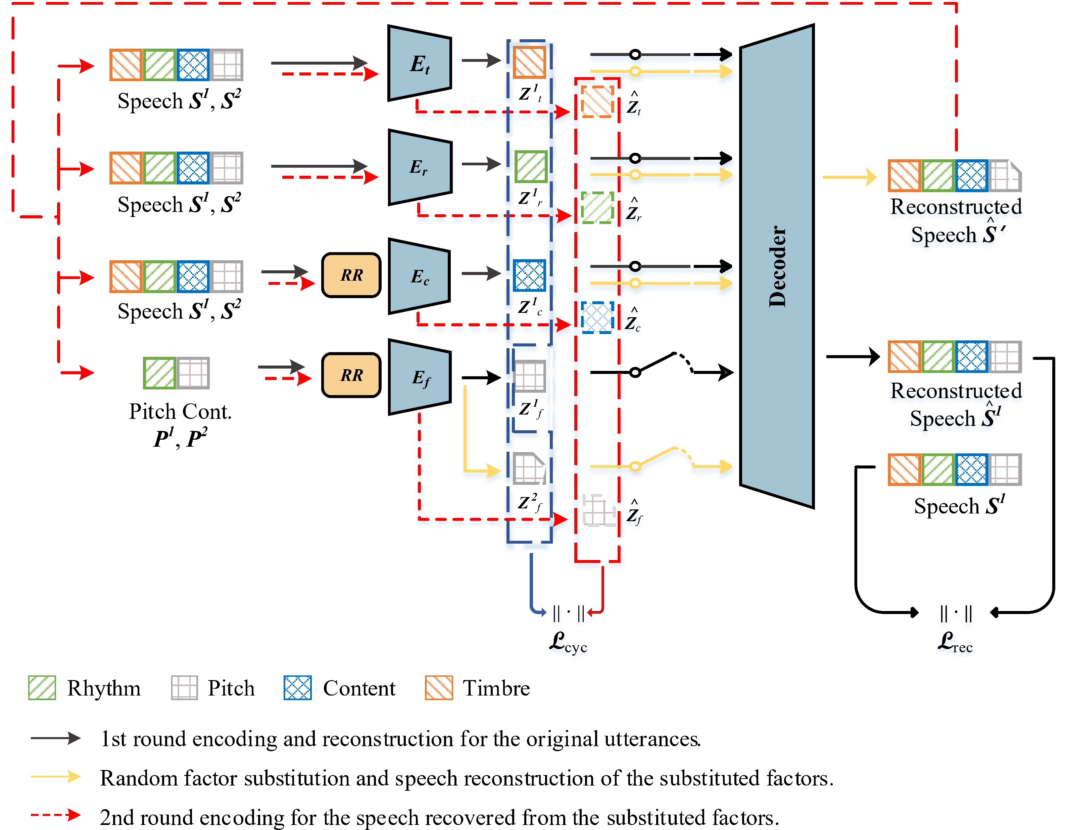
CycleFlow
1st round encoding: Firstly encode S¹ and S², resulting in two sets of factors: Z¹ = {Z_{r}¹, Z_{f}¹, Z_{c}¹, Z_{t}¹} and Z² = {Z_{r}², Z_{f}², Z_{c}², Z_{t}²}.
Random factor substitution (RFS): Randomly choose a factor from Z², and use it to replace the corresponding factor in Z¹. Suppose that the selected factor is Z_{f}² , we get a new factor set Z′ = {Z_{r}¹, Z_{f}², Z_{c}¹, Z_{t}¹}.
Speech reconstruction: Forward Z′ to the decoder and produce the reconstructed speech S′.
2nd round encoding: Encode S′ and obtain Z′ = {Z_{r}′ , Z_{f}′ , Z_{c}′, Z_{t}′}.
ˆ
ˆ
ˆ
ˆ
ˆ
ˆ
ˆ
The cycle loss is computed as:
The final loss:

Slide 7
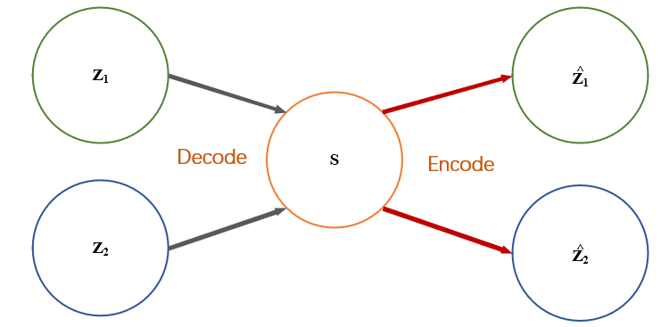
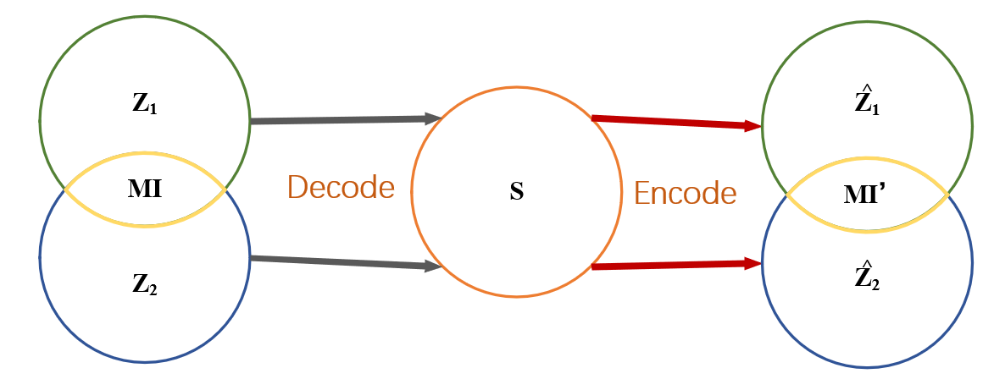
Theoretical analysis
Z₁ and Z₂ are independent
Z₁ and Z₂ are not independent

Slide 8
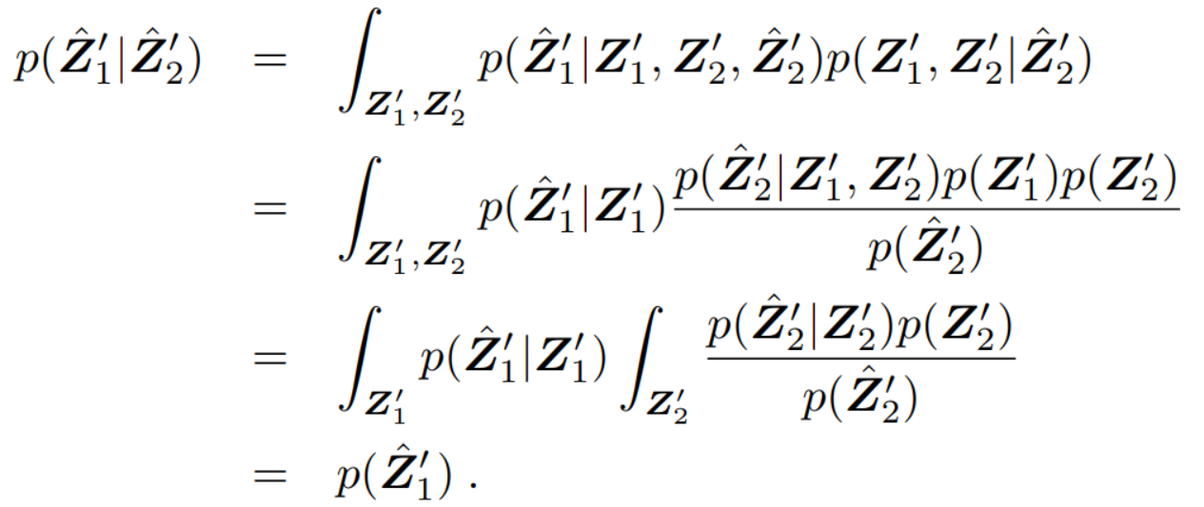
Theoretical analysis
ˆ
ˆ
ˆ
Defining Z′ = {Z₁′ , Z₂′ } the factors after RFS, we can get Z′ = {Z₁′ , Z₂′ } after a cycle process.
Our purpose is to let Z₁′ fully determined by Z₁′ and Z₂′ fully determined by Z₂′.
Assume that the conditional probabilities p(Z₁′ |Z₁′) and p(Z₂′ |Z₂′) are isotropic Gaussian with variation σ, then we have:
In the case :
ˆ
ˆ
ˆ
ˆ

Slide 9
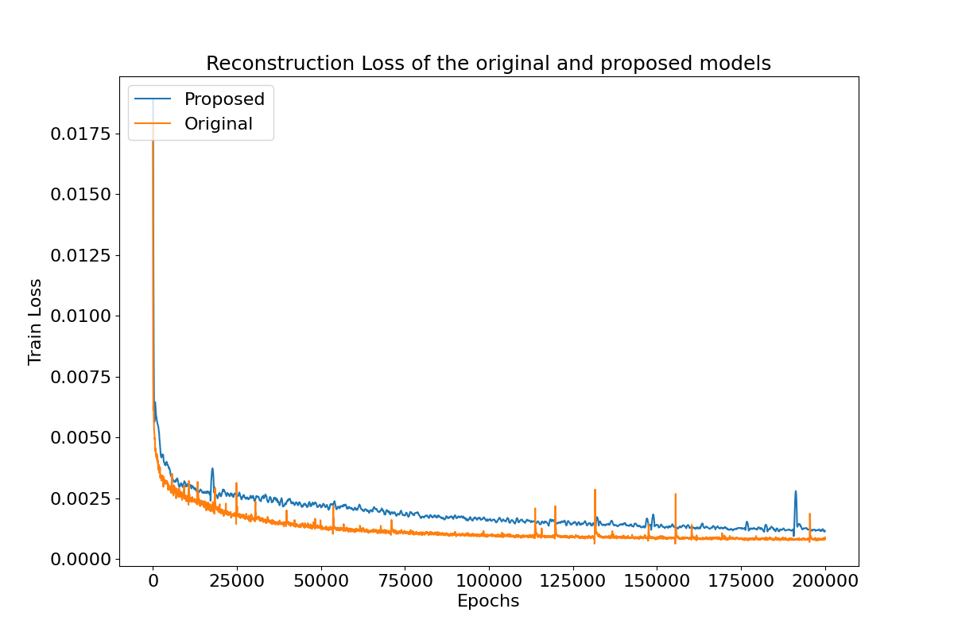
Data and configurations
Training: 100 speakers in the CSTR VCTK corpus;
Test: 8 speakers in the CSTR VCTK corpus;
The speakers and utterances in the training and test sets are not overlapped;
The only major modification was that we changed the input to the timber encoder from one-hot speaker codes to continuous speaker vectors in order to improve generalization capability.

Slide 10
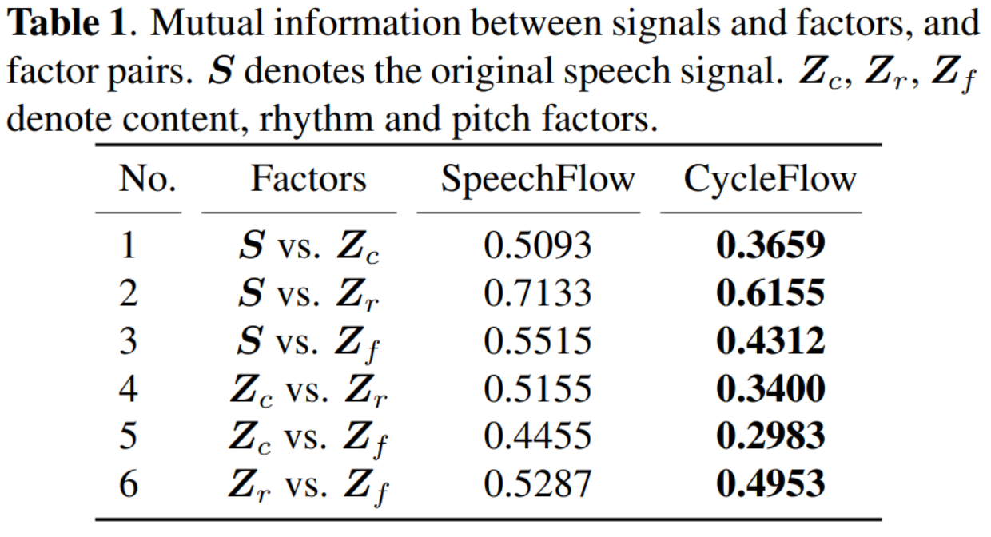
Results
Mutual information:
(1) between the original speech and the encoded factors;
(2) between pairs of factors.

Slide 11
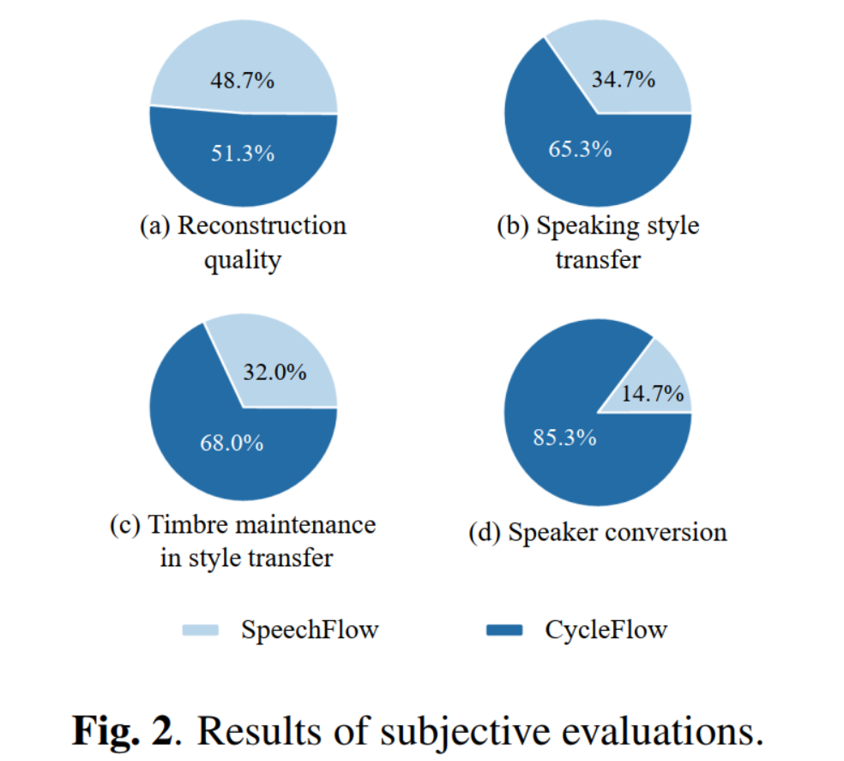
Results
Voice conversion:
(a) reconstruction quality;
(b) speaking style(including pitch and rhythm) transfer;
(c) timber maintenance in style transfer;
(d) speaker conversion with both style and timber transfer.
We demonstrated better independence of speaking style in (b) and (c);
The success of (d) further demonstrated better independence of speaker timber.
Demo

Slide 12
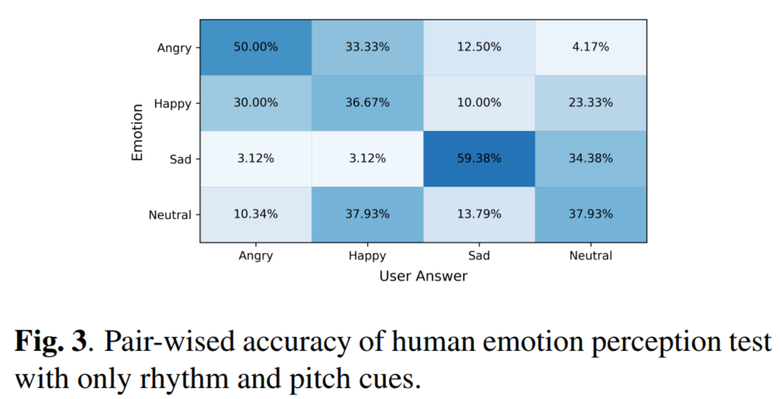
Results
Human emotion perception:
Factorize speech signals by CycleFlow and then set the content and timber factor to be constant, and reconstructed the speech.
As can be seen, only with speaking style, human can tell the emotion of a speech with a good accuracy.
In particular, we seem more excel at identifying angry and sad emotion. This coincides with our daily experience.

Slide 13
Results
We proposed a speech factorization model CycleFlow with a combination of factor substitution and cycle loss.
We demonstrated theoretically and empirically that the proposed technique can significantly reduce mutual information among factors.
Better performance in voice conversion.
This technique is simple and general and can be applied to any factorization model.
Future work:
Unsupervised learning for timbre information
Applying RFS and cycle loss to other factorization models

