Slide 1
MG experiments based on ASV system.
hanjiao

Slide 2
System framework
Experimental design
Experimental results
Summary and perception

Slide 3
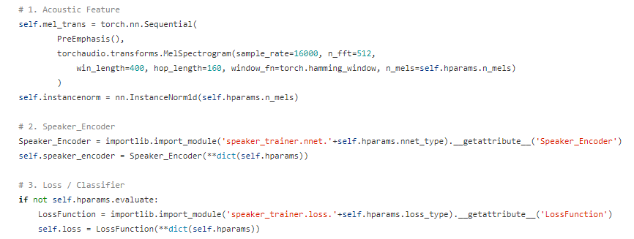
System framework

Slide 4
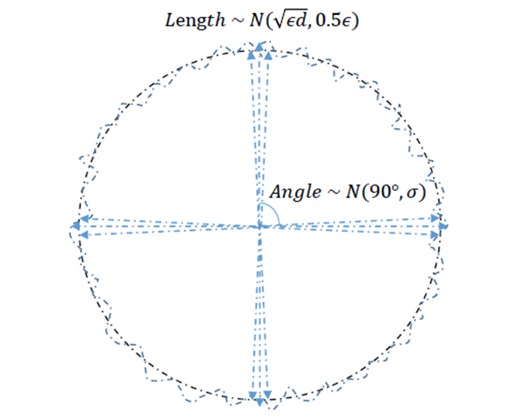
About MG training

Slide 5
System framework
Experimental design
Experimental results
Summary and perception

Slide 6
TDNN+softmax
TDNN+MG
TDNN+softmax+MG
resnet+AAMsoftmax
resnet+MG
resnet+AAMsoftmax+MG

Slide 7
System framework
Experimental design
Experimental results
Summary and perception

Slide 8
settings | TDNN+softmax | TDNN+MG
nnet_type | TDNN | TDNN
pooling_type | TSP (Temporal_Statistics_Pooling) | TSP (Temporal_Statistics_Pooling)
vad | false | false
embedding_dim | 512 | 512
n_mels | 24 | 24
batch_size | 30 | 30
learning_rate | 0.005 | 0.005
Training data | Voxceleb1------ 300speakers*20utts | Voxceleb1------ 300speakers*20utts
test data | Voxceleb1 test | Voxceleb1 test
between_angle | / | 10
between_length | / | 10
within_angle | / | 10
within_length | / | 10

Slide 9
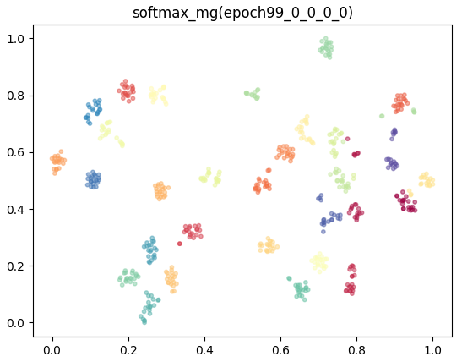
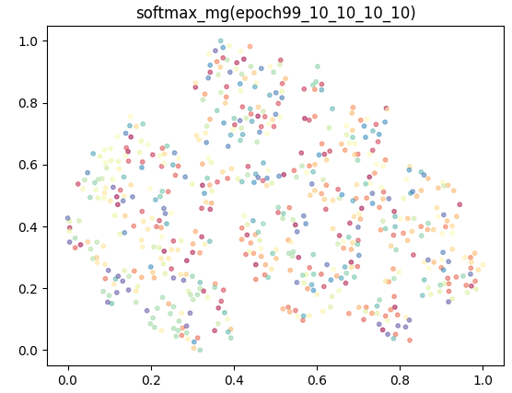
TDNN+softmax
TDNN+MG(10*sb_angle+10*sb_length+10*sw_angle+10*sw_length)
Cosine eer(%)
15.91%
36.58%
T-sne

Slide 10
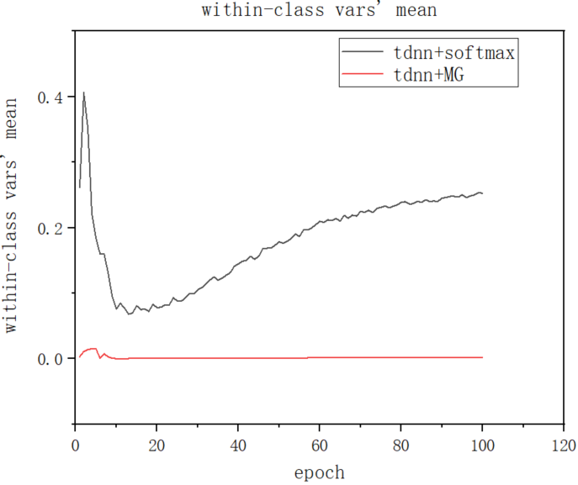
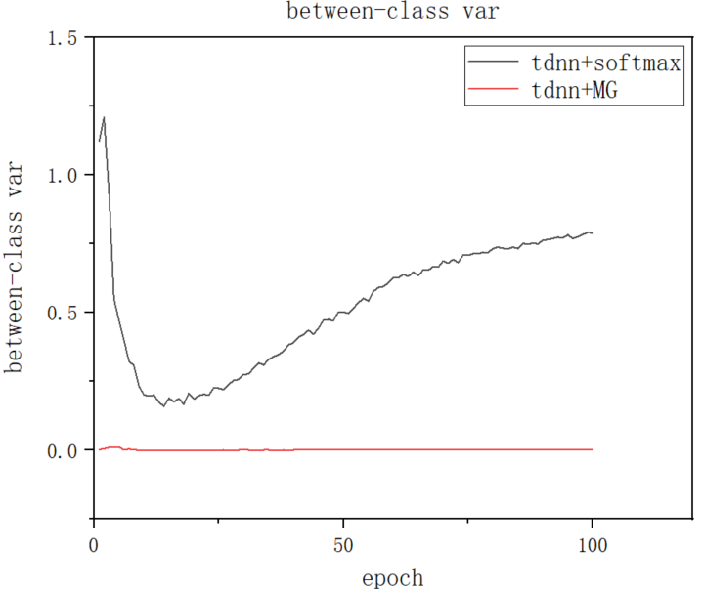
——TDNN+softmax
——TDNN+MG(10*sb_angle+10*sb_length+10*sw_angle+10*sw_length)

Slide 11
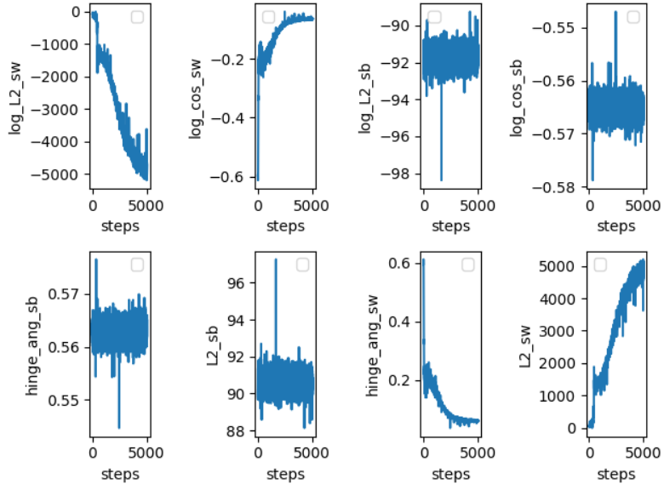
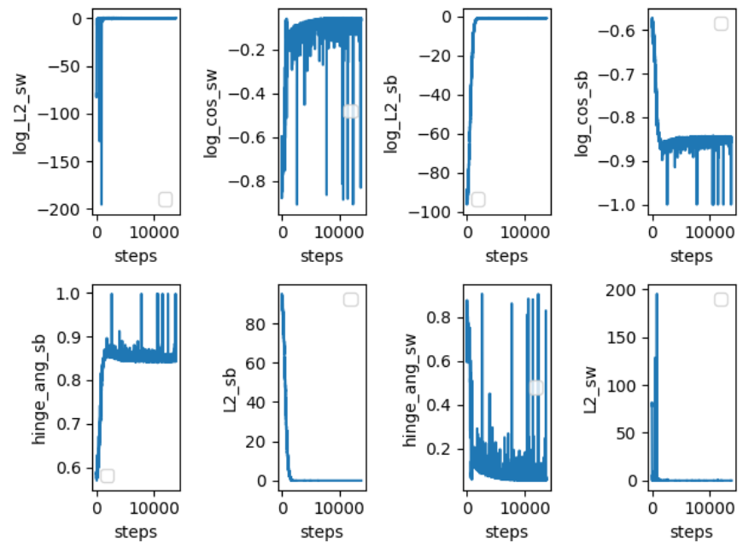
——TDNN+softmax
——TDNN+MG(10*sb_angle+10*sb_length+10*sw_angle+10*sw_length)

Slide 12
settings | TDNN+softmax | TDNN+MG | TDNN+softmax+MG
nnet_type | TDNN | TDNN | TDNN
pooling_type | TSP (Temporal_Statistics_Pooling) | TSP (Temporal_Statistics_Pooling) | TSP (Temporal_Statistics_Pooling)
vad | false | false | false
embedding_dim | 512 | 512 | 512
n_mels | 24 | 24 | 24
batch_size | 30 | 30 | 30
learning_rate | 0.005 | 0.005 | 0.005
Training data | Voxceleb1------ 300speakers*20utts | Voxceleb1------ 300speakers*20utts | Voxceleb1------ 300speakers*20utts
test data | Voxceleb1 test | Voxceleb1 test | Voxceleb1 test
between_angle | / | 10 | *
between_length | / | 10 | 1
within_angle | / | 10 | 1
within_length | / | 10 | 1

Slide 13
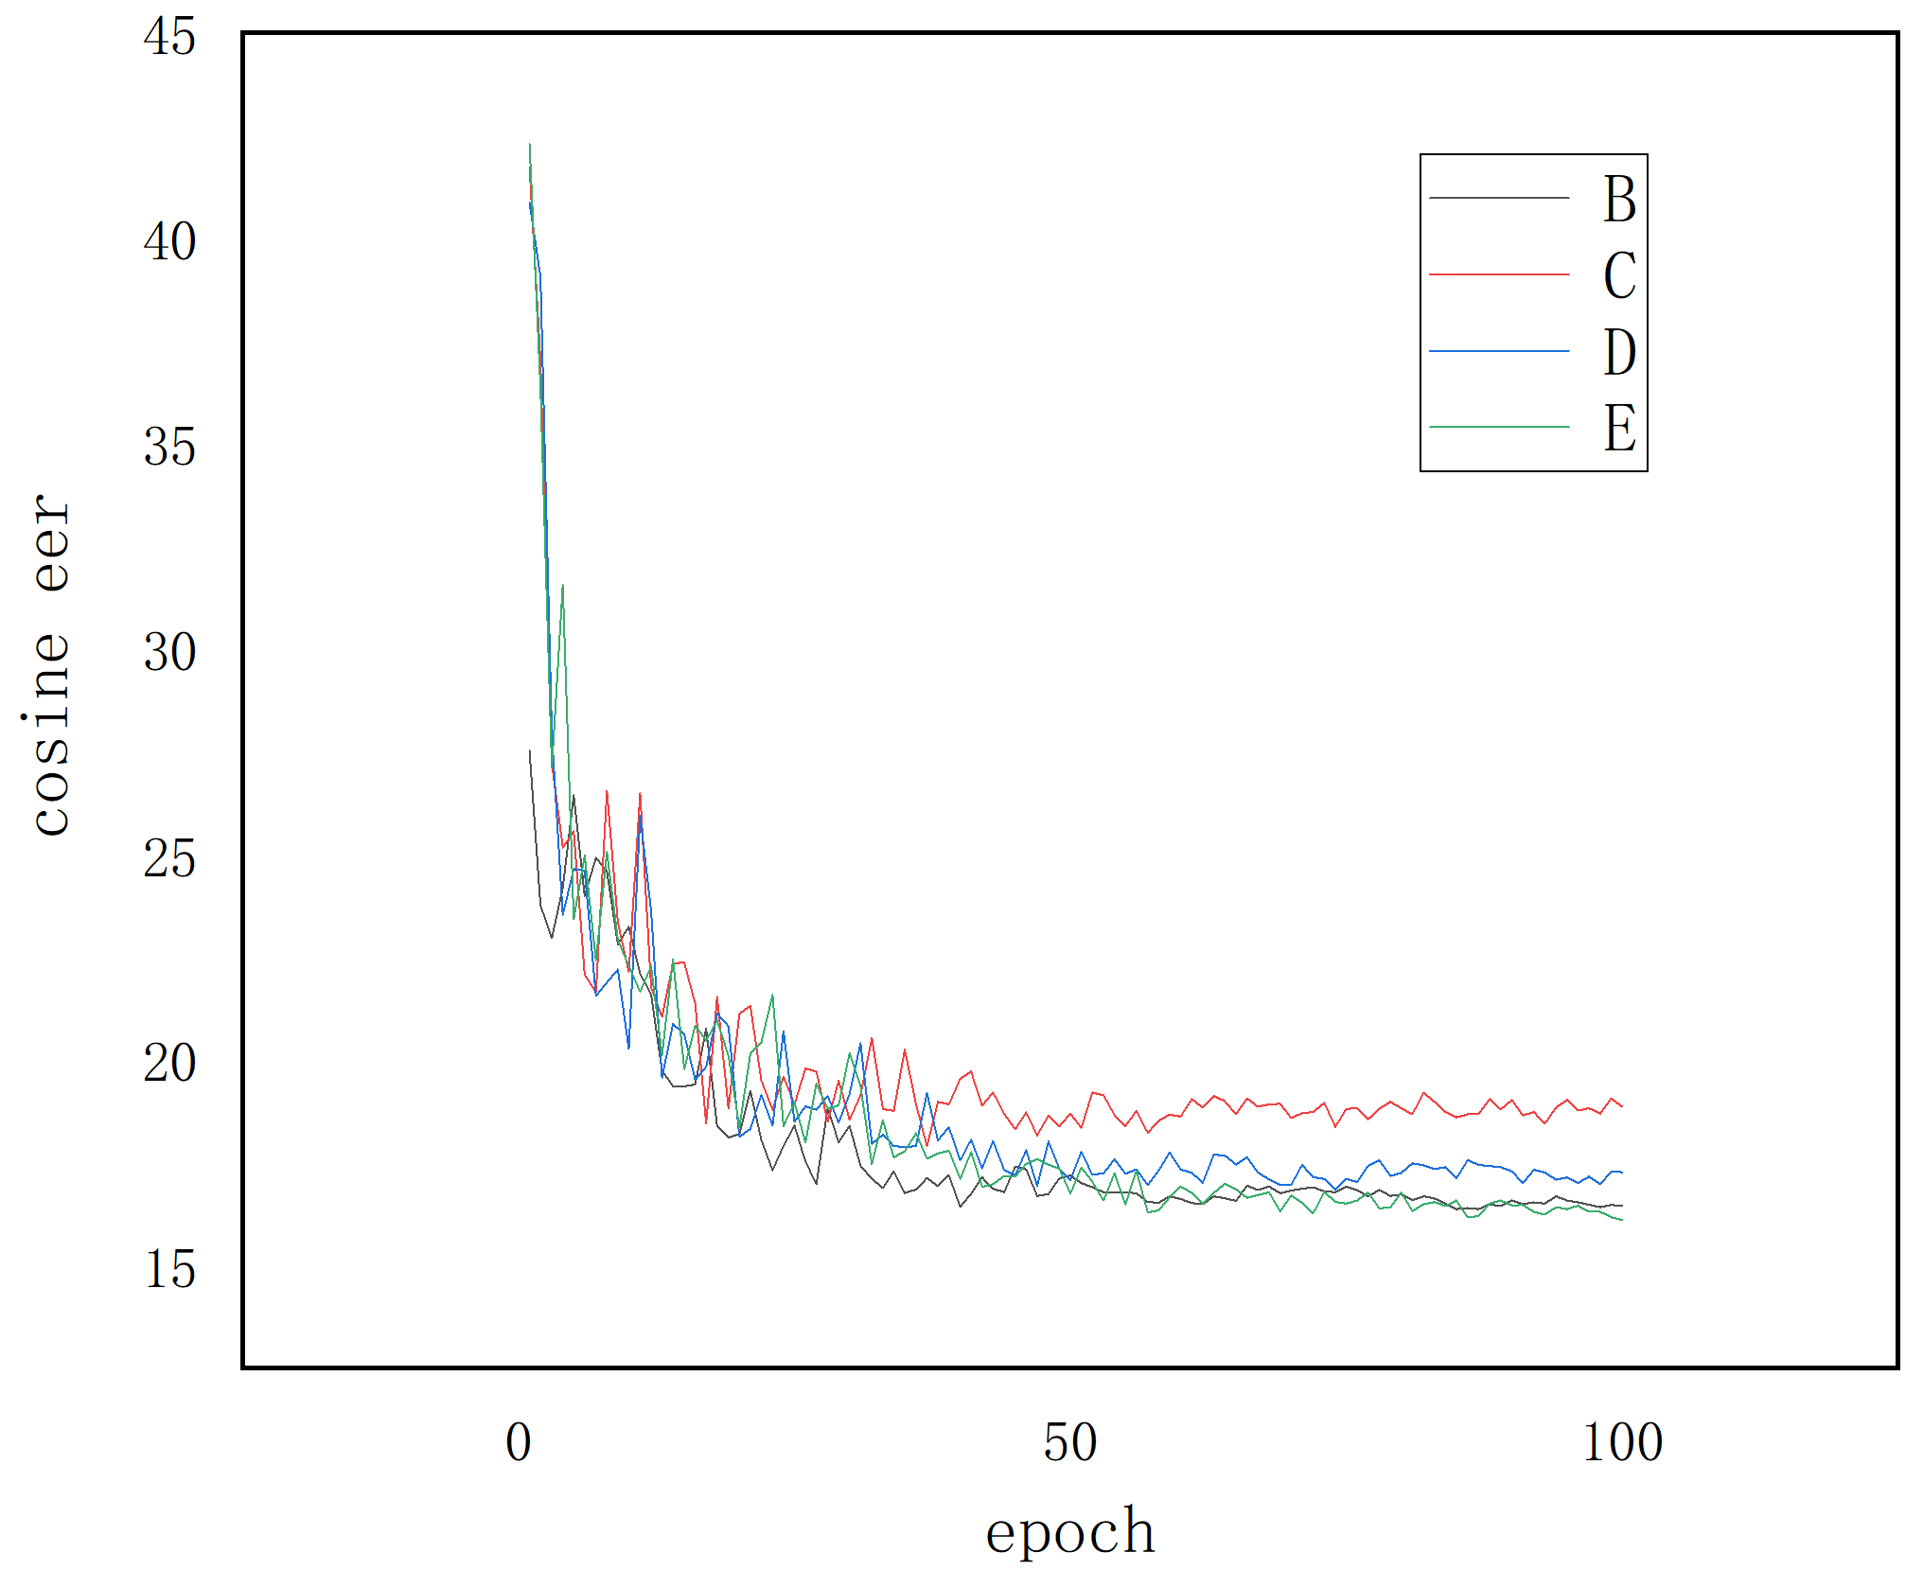
√
——TDNN+softmax
——TDNN+softmax+MG
(100*sb_angle+1*sb_length+1*sw_angle+1*sw_length)
——TDNN+softmax+MG
(500*sb_angle+1*sb_length+1*sw_angle+1*sw_length)
√
——TDNN+softmax+MG
(1000*sb_angle+1*sb_length+1*sw_angle+1*sw_length)

Slide 14
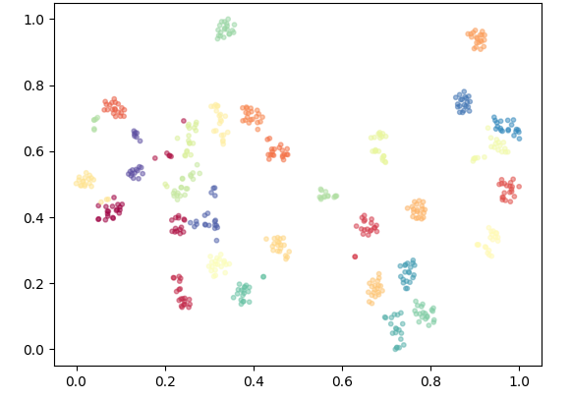
——TDNN+softmax
——TDNN+softmax+MG
(1000*sb_angle+1*sb_length+1*sw_angle+1*sw_length)

Slide 15
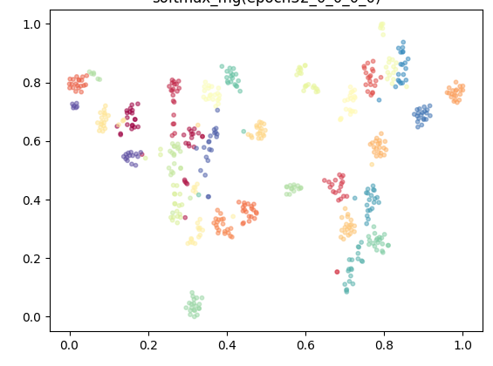
TDNN+softmax
TDNN+softmax+*sb_angle
Cosine eer(%)
15.91%
16.44%
T-sne

Slide 16
System framework
Experimental design
Experimental results
Summary and perception

