Slide 1
Back to Matrix
Dong Wang
2019/10/27

Slide 2
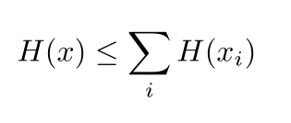
Basic principles of function mapping

Slide 3
Encoding and decoding scheme
Perfect reconstruction, therefore happy to match distribution p(z)
VAE: accumulated posterior matching p(h)
Directed Genreative Auto-encoder, matching p(h)

Slide 4
Two main problems of flows
High dimensionality
No supervision, no intuition

Slide 5
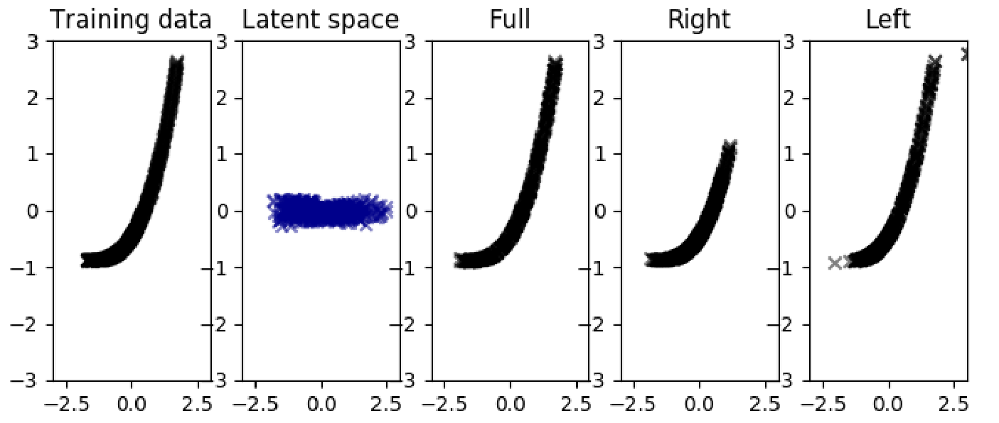
Initial attemp for subspace flow
Control the variance of the output
Failed as no contraint

Slide 6
VP and NVP flow
VP: For feature extraction
NVP: For sampling and generation

Slide 7
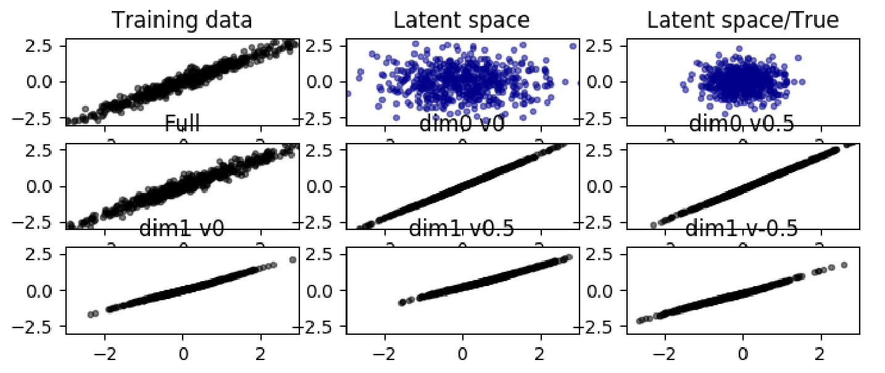
Subspace flow
VP with unconstrained evolution

Slide 8
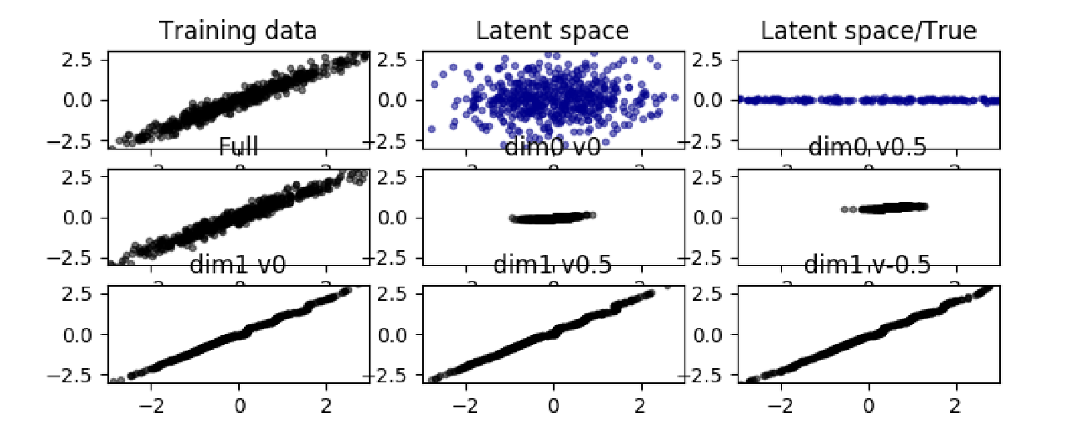
Subspace flow
VP with constraind evolution

Slide 9
Unsupervised learning by Barlow
Information is containd in redundancy; knowledge is represented as mean, variance, and covariance.
Patterns are supervising (Laws of thought, economy of thought)
Minimum entropy
H. Barlow. (1989) Unsupervised Learning. Neural Computation, 1,295-311.
Boole, G., 1854, An investigation of the Laws of Thought
Barlow, H.B., and Foldiak, P. 1989, Adaptation and decorrelation in the cortex. The computing Neuron.

Slide 10
Minimum entropy with VP
Minimizing entropy of the output
Preserving the entropy
A. N. Redlich. (1993) Supervised Factorial Learning. Neural Computation, 5, 750-766.

Slide 11
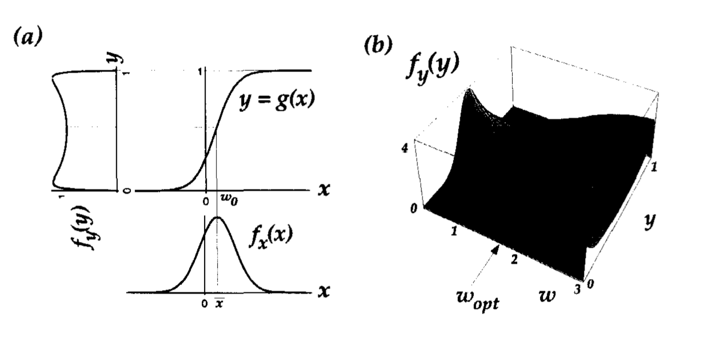
Maximum mutual information with NVP
When inputs are to be passed through a sigmoid function, maximum information transmission can be achieved when the sloping part of the sigmoid is optimally lined up with the highdensity parts of the inputs. As we show, this can be achieved in an adaptive manner, using a stochastic gradient ascent rule.
Note that if two rows/columns in Jacobin, then two outputs seem correlated. This leads to unstable solution.
Anthony J. Bell and Terrence I. Sejnowski , “An Information-Maximization Approach to Blind Separation and Blind Deconvolution”, Neural computation, 1995.

Slide 12
Other ways
Anti-Hebbian synapsese (Barlow, 1989)
Sparse coding
Decorrelation

Slide 13
Unsupervised nonlinear ICA
(1)High-order statistic for non-Gaussian; (2)no-linear for nolinear decorellation
Necessary condition for factorization with high-order statistics
Gustavo Deco , Wilfried Brauer, Higher Order Statistical Decorrelation without Information Loss, NIPS 94

Slide 14
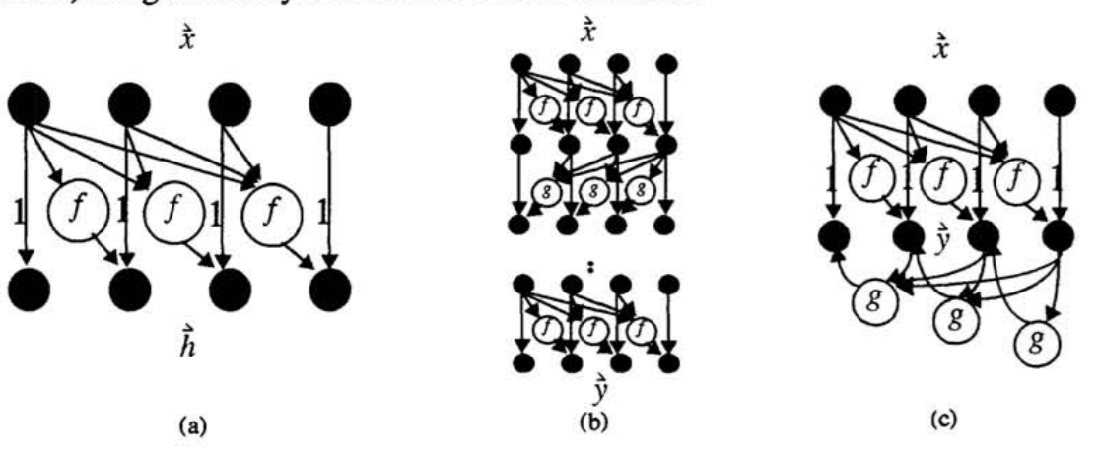
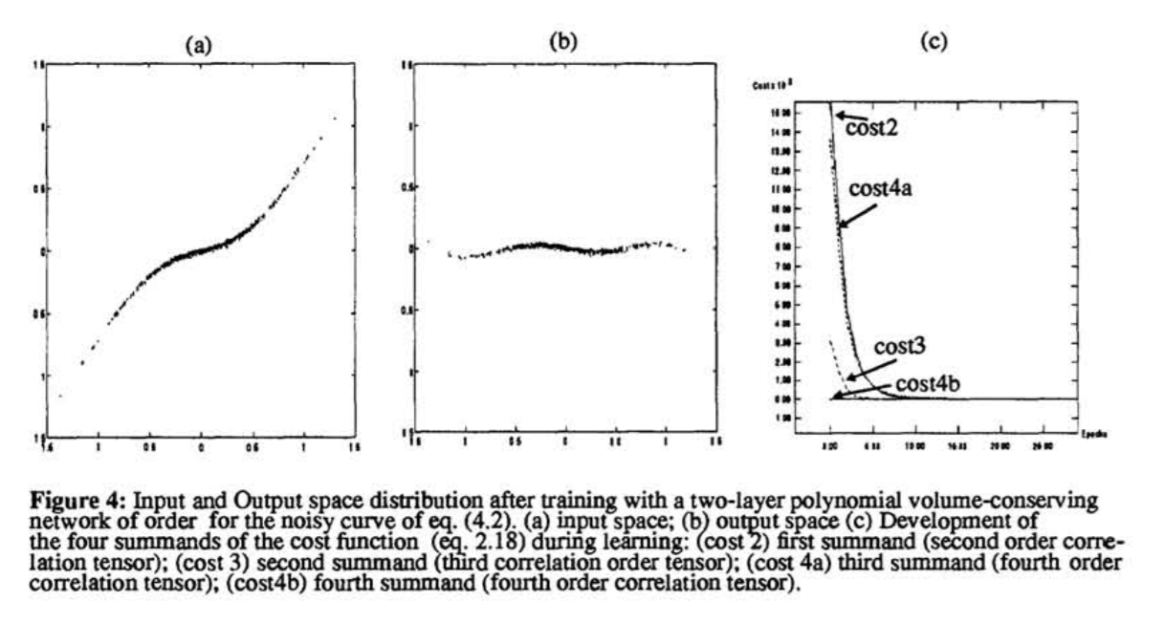
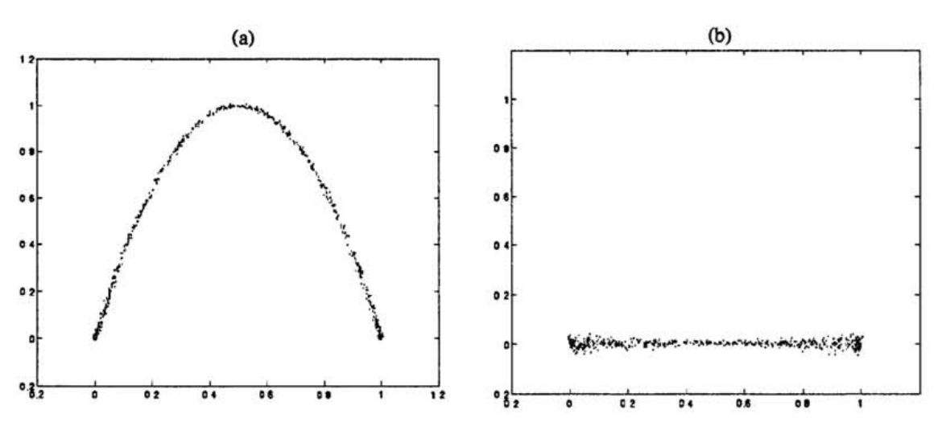
Unsupervised nonlinear ICA
Volume preserving transform
Gustavo Deco , Wilfried Brauer, Higher Order Statistical Decorrelation without Information Loss, NIPS 94

Slide 15
Some interesting things to do
Generation model
Model data directly, as deep Gaussian SID
Data augmentation, data fixing (noise inpainting), data expansion (bandwidth)
Speech conversion
Multimodality models
Channel mapping
Feature learning
Nonlinear LDA, ICA
Anti-attack

Slide 16
Most prominent
Turn over the big data approach, by finding the ‘true’ distribution.
Turn over the blind-training approach, by finding a sensory space in the mind, where things can be explained.
Establish the information-based speech generation framework

