Slide 1
Challenge Summary Qingyang Hong Xiamen University 2022.01.14
OLR 2021 Workshop
Oriental Language Recognition (OLR) 2021

Slide 2
Outline
Challenge Organization
Tasks, Data and Baseline Systems
Popular Technologies
OLR-LID Tasks
OLR-ASR Tasks
Challenge Results
Summary

Slide 3
OLR 2021 Workshop
Challenge Organization

Slide 4
OLR 2021 Workshop
OLR 2021 Challenges
Organization Committee
Qingyang Hong, Xiamen University Lin Li, Xiamen University
Binling Wang, Xiamen University Wenxuan Hu, Xiamen University Jing Li, Xiamen University
Dong Wang, Tsinghua University
Ming Li, Duke-Kunshan University
Xiaolei Zhang, Northwestern Polytechnical University
Ke Li, SpeechOcean Cheng Yang, SpeechOcean
Special thanks to: Qiulin Wang, Yiming Zhi, Feng Wang at XMU Speech Lab

Slide 5
OLR 2021 Workshop
2021
2020
18 languages/dialects
280h+ Training data
Cross domain
Multilingual ASR tasks
Unconstrained tasks
Wild data for test
Real-time leaderboards
2019
16 Languages
+3 Dialects
Short-utterance
Cross-channel
Open-set dialect
Noisy-test
2018
13 languages
+3 languages
Short-utterance
Cross-channel
Zero-resource
2017
10 languages
Short-utterance
Confusing-language
Open-set
2016
10 languages
Transcriptions
Shorter segments
7 languages
Transcriptions
9/9 19/31 17/25 20/45 20/58 19/42
Submitted results/Registered teams

Slide 6
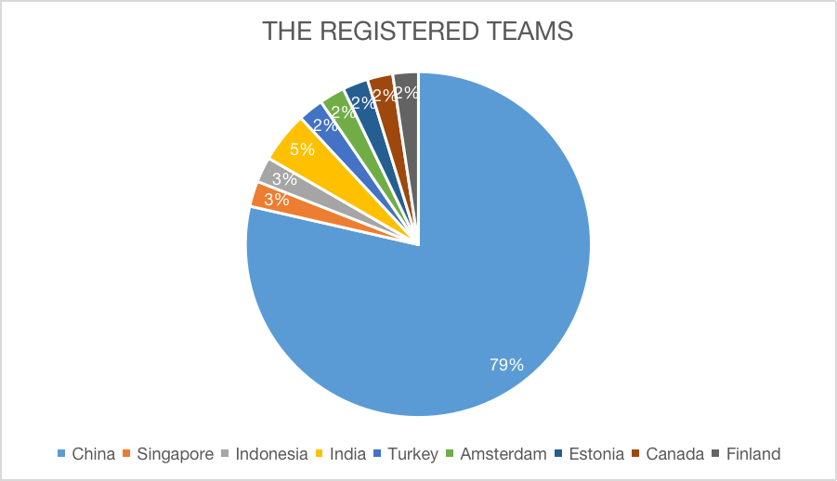
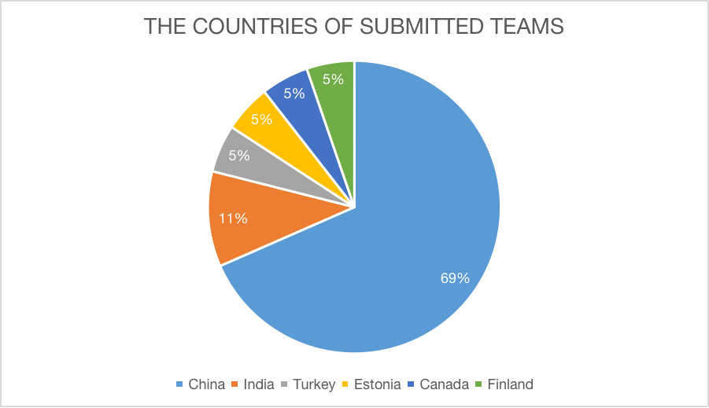
OLR 2021 Workshop

Slide 7
OLR 2021 Workshop
Tasks, Data and Baseline systems

Slide 8
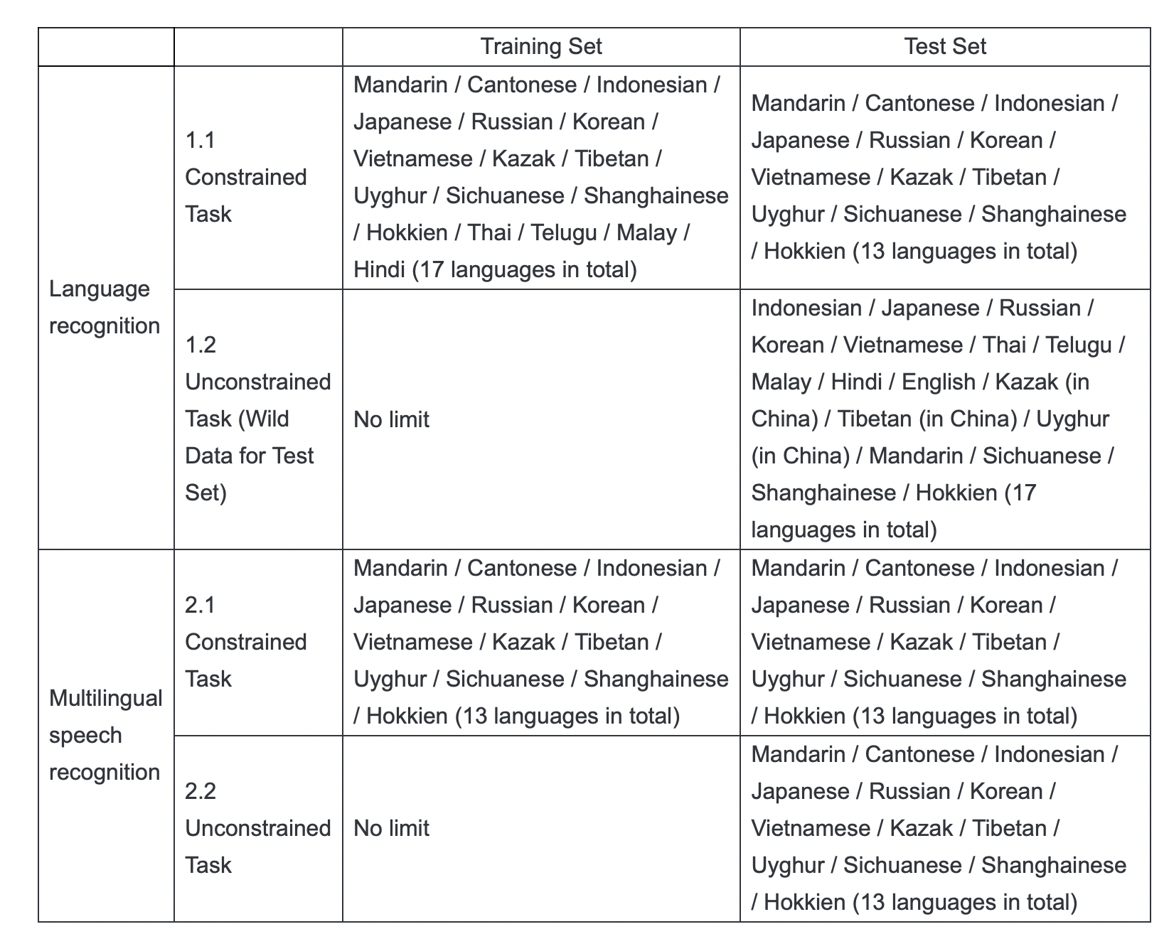
OLR 2021 Workshop
Tasks
OLR-LID Tasks
Task 1: Constrained LID Task
(Cross Domain)
Task 2: Unconstrained LID Task (Wild Data)
OLR-ASR Tasks
Task 1 : Constrained ASR Task
Task 2 : Unconstrained ASR Task
Notes:
﻿The training condition and test condition of the four tasks was shown in the table.
● Constrained LID Task is a close-set identification task, which means the language of each utterance is among the known 13 target languages, but
utterances were recorded in different environments.
In this task, only the data provided by the challenge can be used to build the LID system.
By the way, the use of additional training materials is forbidden,
except non-speech data.
● Unconstrained LID Task is also a close-set identification task,
But the test audios of this task are “wild”, which means utterances are
obtained from real-life environments.
It will be more innovative and challenging.
In this task, we unconstrained training condition. Any data you can access is
allowed to build the system.ASR Tasks focus on multilingual speech recognition. Each utterance
contains only one language and the language ID is hidden.
● In Constrained ASR Task, only the data provided by the challenge can be
used to train the acoustic and language systems.
● In Unconstrained ASR Task, any data is allowed to be used to train
acoustic and language models.
For both tasks, additional text data is permissible for training.

Slide 9
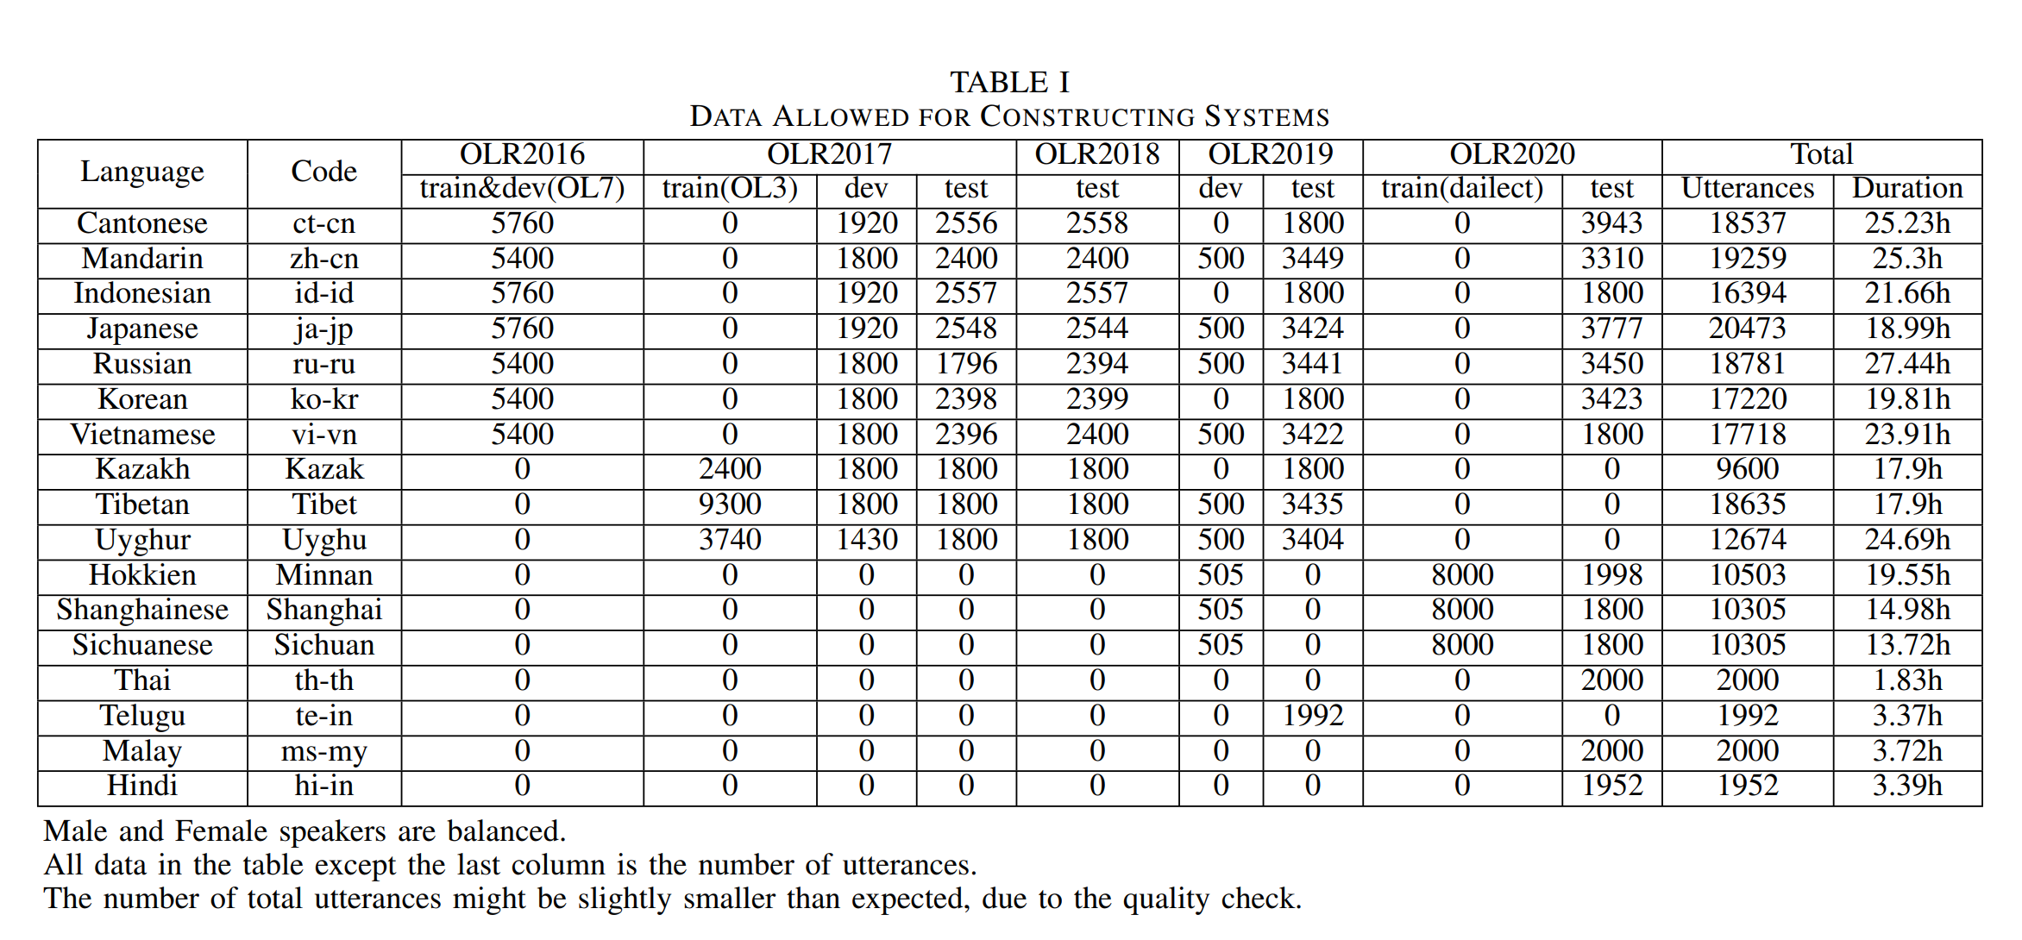
OLR 2021 Workshop
Data: Official Data
Training Data Released up to 280h.

Slide 10
OLR 2021 Workshop
Data: Official Data
Two standard test sets for the OLR 2021 challenge.
Test set for Task1, Task3, Task4;
Contains 13 languages;
Test set for Task2;
Contains 17 languages;
﻿For the OLR 2021 Challenge, the trials of the four tasks are divided into two subsets respectively:
a progress subset (30%), and an evaluation subset (70%).
Notes:
﻿For the OLR 2021 Challenge, the trials of the four tasks will be divided into
two subsets respectively: a progress subset, and a test subset.
The progress subset will comprise 30% of the trials and will be used to
monitor progress in the leaderboard.
The remaining 70% of the trials will form the test subset, and will be used to
generate the official results which are the base of the final ranking.
We prepared two standard test sets for the OLR 2021 challenge: the OLR21-
cross-domain-test and the OLR21-wild-test.
The OLR21-cross-domain-test is designed for three tasks: the constrained
LID task, the constrained ASR task, and the unconstrained ASR task. It
contains 13 languages, and was recorded by different equipments in various
environments.
The OLR21-wild-test is designed for the unconstrained LID task. It contains
17 languages. Utterances in this subset are obtained from real-life
environments.In OLR 2021, The speech segments of each task should be
processed independently. Knowledge from other test segments
is not allowed to use.
Listening to any speech segments is not allowed.
Information of speakers is not allowed to use.
All the trials should be processed

Slide 11
OLR 2021 Workshop

Slide 12
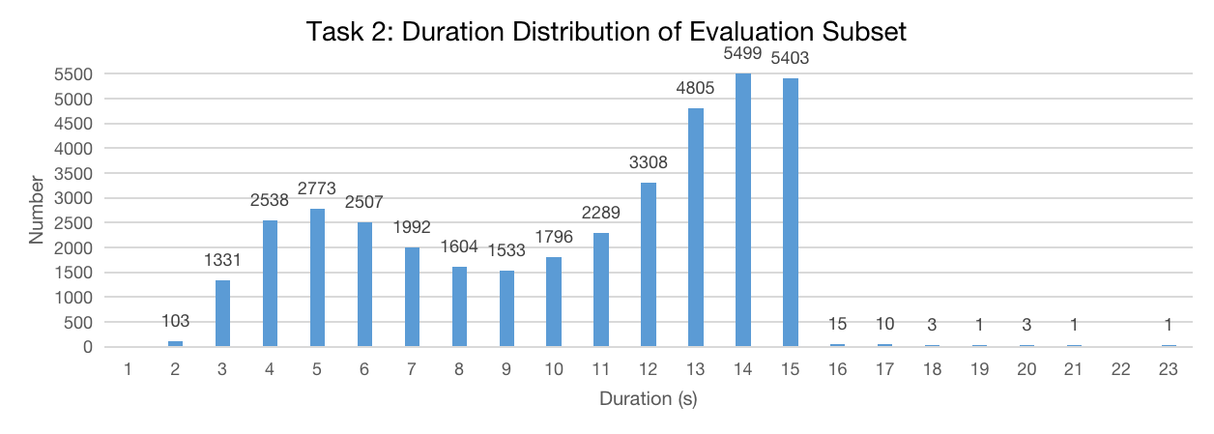
OLR 2021 Workshop

Slide 13
OLR 2021 Workshop
Data: Additional Data (publicly available)
Data Name | Download Link
VoxLingua107 | http://bark.phon.ioc.ee/voxlingua107/
OpenSLR 22/28/40/63/66/97/102/103 | http://www.openslr.org/
Common Voice | https://commonvoice.mozilla.org/zh-CN/datasets
Librispeech | http://www.openslr.org/12/
WenetSpeech | https://wenet-e2e.github.io/WenetSpeech/
GigaSpeech | https://github.com/SpeechColab/GigaSpeech

Slide 14
OLR 2021 Workshop
Baseline System*
LID system
An extended TDNN x-vector model, constructed with ASV-Subtools.
The back-ends were conducted with Kaldi.
*https://github.com/Snowdar/asv-subtools#3-olr-challenge-2021-baseline-recipe-language-identification
B. Wang, W. Hu, J. Li, Y. Zhi, Z. Li, Q. Hong, L. Li, D. Wang, L. Song, and C. Yang, “Olr 2021 challenge: Datasets, rules and baselines,” arXiv preprint arXiv:2107.11113, 2021.

Slide 15
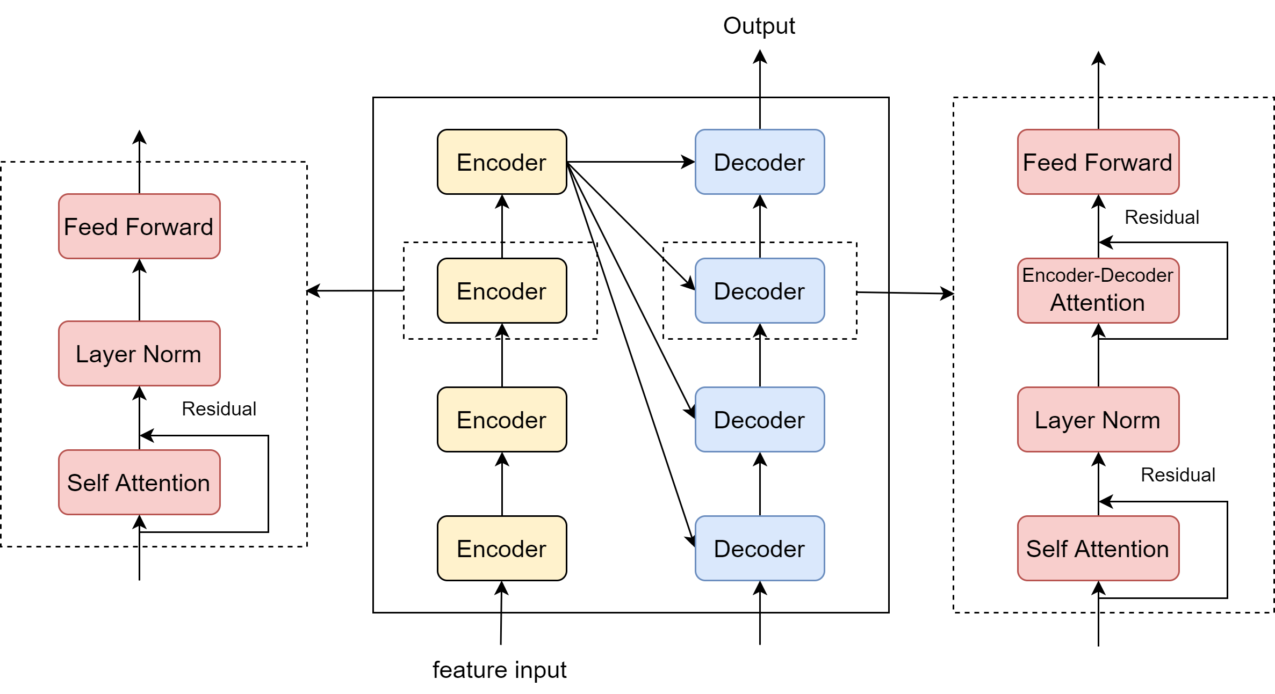
OLR 2021 Workshop
Baseline System
ASR system
Built with ESPnet
Transformer-based end-to-end model
Language-independent architecture
Characters based

Slide 16
OLR 2021 Workshop
Popular Technologies
OLR-LID Tasks

Slide 17
OLR 2021 Workshop
Popular technologies
Feature
MFCC, FBank, PLP, Spectrum, BNFs ...
Augmentation
SpecAugment, speed/volume perturbations, noise from training data, white noise, gaussian noise, nonspeech, random artificial band-pass filters, mp3/mp4a codec ...
Structure/Optimization
VAD, no-VAD, TDNN, E-TDNN, F-TDNN, ECAPA-TDNN, ResNet, CNN, SE,
ASR(conformer-transformer), Wav2vec2.0, E2E, multi-task,
attention, attention-based fusion of features (PLP/MFCC),
attentive pooling, multi-head attention pooling, global multi-head attention pooling ...
Loss
CE, AM, AAM, KL ...
Auxiliary task/multi-task
Phonetic aware, CTC ...
Scoring backend
Cosine, LDA, Logistic Regression (LR), PLDA ...
Model fusion
average fusion, greedy fusion …
Platform
Kaldi, PyTorch, ASV-Subtools(PyTorch), ESPnet, ESPNet2, Wenet, SpeechBrain ...

Slide 18
OLR 2021 Workshop
Technical highlights
ASR Structure
Encoder-conformer + Decoder-transformer
Wav2vec2.0
Language Structure
Encoder-conformer + Pooling Layer + Classifier
1st: ASR encoder+ attentive statistical pooling + a linear layer (batch normalization and nonlinear activation) + softmax classifier + LDA (language categories - 1)
2nd: ASR encoder + pooling layer (3) + 2 FC + classifier + no LDA
Wav2vec-encoder + Statistics Pooling Layer + FC + Classifier
Finetuned on different data set
Encoder
Decoder
ASR model
Finetune
Linear Layer
or
FC Layer(s)
Encoder
Pooling Layer
LID Classifier
LID model

Slide 19
OLR 2021 Workshop
Popular Technologies
OLR-ASR Tasks

Slide 20
OLR 2021 Workshop
Popular technologies
Label
Language token was added to the beginning of the text transcripts, text transcripts
Feature
FBank + Pitch，MFCC + Pitch ...
Augmentation
SpecAugment, speed/volume perturbations, noise from other datasets or corpus, white noise, gaussian noise ...
Structure/Optimization
E2E Multilingual ASR, Hybrid Monolingual ASR
E2E: Conformer(most) or Transformer, Wav2vec2.0,
Multi-task ,
Chain(LF-MMI) ...
Loss / Evaluate
CE, CTC, CE + CTC, Edit distance ...
LM(Language Model)
Add LM to E2E to improve performance...
Method
Model fusion: Use LID to identify language, then perform speech recognition,
Pre-train and Finetune…
Platform
Wenet, ESPnet, ESPnet2, Kaldi, ...

Slide 21
OLR 2021 Workshop
Technical highlights
ASR Structure
Hybrid Monolingual ASR
Wav2vec2.0
Method
Model fusion: LID + ASR
Use LID model to identify language, then perform speech recognition system
Model fusion: Multi ASR
Based on ROVER, implement a "voting" or re-scoring process
Use pre-trained Wav2vec2.0 model
XLSR-53
Finetuned on different data set
LID
select
LM
add
ASR
LID
select
Monolingual models
Combination and Prediction
Wenet Multilingual ASR

Slide 22
OLR 2021 Workshop
Challenge Results

Slide 23
OLR 2021 Workshop
Task1: Constrained LID Task
Ranking | Team Name | Institute | Country | Cavg | EER%
1 | X-Voice | Machine Intelligence Department, Security BG, Ant Group | China | 0.0025 | 0.2708
2 | TalTech | Tallinn University of Technology | Estonia | 0.0079 | 0.8642
3 | funspeech | Beijing Live Data speech | China | 0.0083 | 0.9311
4 | Anonymous | - | China | 0.0114 | 1.184
5 | Huawei_AMS | Huawei Amsterdam Research Center | China | 0.0144 | 1.461
6 | nisp_speech | Yidun AI lab, Netease(Hangzhou) Network Co., Ltd. China. | China | 0.0155 | 1.698
7 | RoyalFlush | Hithink RoyalFlush AI Research Institute, Zhejiang | China | 0.0209 | 2.55
8 | OLR_BIT | Beijing Institute of Technology | China | 0.0248 | 2.653
9 | Anonymous | - | Canada | 0.0643 | 7.513
10 | Anonymous | - | China | 0.0646 | 7.066
11 | Wind_Talker | SpeakIn Technologies Co.,Ltd. | China | 0.0795 | 8.405
# | Baseline | - | - | 0.0817 | 8.977
12 | XMU-Automation | Automation Department, School of Aeronautics and Astronautics, Xiamen University | China | 0.0863 | 9.357
13 | SpeechGroup@MANAS_Lab | Indian Institute of Technology Mandi, Himachal Pradesh, India | Indian | 0.1557 | 15.67
14 | Anonymous | - | China | 0.1633 | 17.76
15 | IITDH-IIITDH-Armsofttech-Speechgroup | IIT Dharwad, IIIT Dharwad and Armsoftech.air, India | Indian | 0.2699 | 27.52
16 | Anonymous | - | Turkey | 0.3214 | 32.84

Slide 24
OLR 2021 Workshop

Slide 25
OLR 2021 Workshop
Task2: Unconstrained LID Task
Ranking | Team Name | Institute | Country | Cavg | EER%
1 | X-Voice | Machine Intelligence Department, Security BG, Ant Group | China | 0.0039 | 0.4212
2 | TalTech | Tallinn University of Technology | Estonia | 0.0122 | 0.9383
3 | nisp_speech | Yidun AI lab, Netease(Hangzhou) Network Co., Ltd. China. | China | 0.0316 | 3.228
4 | funspeech | Beijing Live Data speech | China | 0.097 | 8.229
5 | Anonymous | - | China | 0.1751 | 13.34
6 | RoyalFlush | Hithink RoyalFlush AI Research Institute, Zhejiang | China | 0.1788 | 26.05
7 | XMU-Automation | Automation Department, School of Aeronautics and Astronautics, Xiamen University | China | 0.1835 | 33.14
8 | SUKI | The University of Helsinki | Finland | 0.3342 | 62.64

Slide 26
OLR 2021 Workshop

Slide 27
OLR 2021 Workshop
Task3: Constrained ASR Task
Ranking | Team Name | Institute | Country | Total CER%
1 | CCDL | NetEase Games AI Lab | China | 13.1
2 | OLR_BIT | Beijing Institute of Technology | China | 18.2
3 | RoyalFlush | Hithink RoyalFlush AI Research Institute | China | 18.5
4 | Huawei_AMS | Huawei Amsterdam Research Center | China | 19.8
5 | nisp_speech | Yidun AI lab, Netease(Hangzhou) Network Co., Ltd. | China | 26.5
6 | funspeech | Beijing Live Data speech | China | 36.5
# | baseline | - | - | 39.1
7 | BIIC | National Tsing Hua University | China | 55.2

Slide 28
OLR 2021 Workshop

Slide 29
OLR 2021 Workshop
Task4: Unconstrained ASR Task
Ranking | Team Name | Institute | Country | Total CER%
1 | CCDL | NetEase Games AI Lab | China | 12.6
2 | Huawei_AMS | Huawei Amsterdam Research Center | China | 18.1
3 | OLR_BIT | Beijing Institute of Technology | China | 18.2
4 | RoyalFlush | Hithink RoyalFlush AI Research Institute | China | 18.5
5 | nisp_speech | Yidun AI lab, Netease(Hangzhou) Network Co., Ltd. | China | 20.3
# | baseline | - | - | 39.1
6 | IITDH-IIITDH-Armsofttech-Speechgroup | IIT Dharwad, IIIT Dharwad and Armsoftech.air | India | 68.9

Slide 30
OLR 2021 Workshop

Slide 31
OLR 2021 Workshop
Summary

Slide 32
Summary
This year’s challenges add new tasks of wild LID and multilingual ASR.
The best systems of LID have achieved great improvements compared with the baseline systems, e.g. EER of constrained LID was reduced from 8.977% to 0.2708%. And wild LID also achieved very low EER of 0.4212%. More evaluation of top systems in real-world applications is desired.
The best systems of ASR have achieved much improvements compared with the baseline systems, the CER was reduced from 39.1% to 13.1% in constrained ASR, and to 12.6% in unconstrained ASR.
Most teams used LID model to identify language, and then perform speech recognition. Meanwhile, many teams used partial information on ASR systems to identify the categories of languages, especially adopted ASR encoder to boost the performance of LID.
We can conclude that LID and multilingual ASR complement each other, and hope to see more studies in the future.

Slide 33
OLR 2020 Workshop
OLR 2022 Challenges
Looking forward to seeing you!

