Slide 1
Bi-weekly Report on Neural Networks Compression
07.04-07.17
-Hang, Luo
-CSLT, THU
-2016.07.18
Notes:
主要看的是压缩神经网络相关的论文

Slide 2
Content
Introduction
SVD Decomposition
Tensor Decomposition
Related work
Experiments on kaldi
Future work
Notes:
非常简短的介绍一下神经网络压缩

Slide 3
Introduction
What is compression ?
Reduce neural network memory with any kinds of approaches.
Why need compression ?
Memory and computationally intensive
Parameters redundancy
Large percent parameters in full-connected layer and many of them are redundancy.
Notes:
在speech recognition中输出target很多时，最末层参数占50%
在CNN中全连接层占总参数90%

Slide 4
Introduction
What can compression do?
Memory saving.
Speed up in test time, and in training time sometimes.
Make deployment in mobile acceptable.
Real-time work like self-driving car.

Slide 5
SVD Decomposition
For full-connected layer, considering the hidden layer units is m and the output target is n. Then the weight matrix is m*n
If we only consider k biggest singular value

Slide 6
SVD Decomposition
According to SVD, the weight matrix can be represented by two matrix.
Advantages:
Original m*n parameters reduces to m*k + n*k
Accelerates the matrix-vector multiplication time from O(m*n) to O(m*k+ n*k)
Very suitable for low-rank matrix

Slide 7
Implementation of SVD Decomposition
Approach 1
Using SVD after normal train and get the original weight matrix. Fine-tune then.
Experiments
576 input features, 2048 hidden units,5 layers, 5976 output target.
Using SVD on last layer.
e.g Keep the biggest ¼ singular, then the parameter reduces from 2048*5976=12M to 2048*512+512*5976 =4M
Notes:
如果每个参数是32bit 的float类型，节省32MB的空间

Slide 8
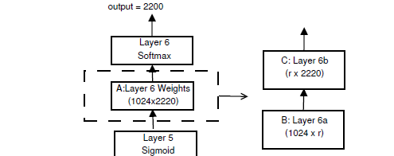
Implementation of SVD Decomposition
Approach 2
Using SVD when training the network.
Fine-tune
Experiments
Notes:
使用cross-entropy training and Hessian-Free Sequence training

Slide 9
Results
Results
Reduce the parameters by 30%-80% when using SVD to some layers. The compress rate depends on the rank r
The accuracy nearly decrease after fine-tune
Accelerate test time, while only approach 2 can accelerate train time
Notes:
压缩比率比较大时，SVD出来的效果很差，但基本能fine-tune回来

Slide 10
Tensor Decomposition
SVD Decomposition searches for a low-rank approximation of the weight matrix.
Tensor Decomposition treat the matrix as a tensor, and apply the tensor decomposition algorithm. (e.g Tensor Train Decomposition)
Notes:
现在用的比较多的是Tensor Train Decomposition

Slide 11
Traditional Tensor Decomposition
Tucker decomposition
For n-d tensor, Tucker-decomposition memory
Not suitable when d is large
CP-decomposition
For n-d tensor, CP-decomposition memory O(ndr)
NP hard
Notes:
Tucker分解类似于高维SVD
CP分解为若干秩为1的张量

Slide 12
Tensor-Train Decomposition
Tensor-Train format(TT-format) to represent the dense weight matrix of the fully-connected layers.
For every matrix Gk[jk] , size is
Gk[jk] is a three-dimensions array
By restrict TT-rank, the parameter can be reduced, the memory is
Notes:
约定r0=rd=1,所以相乘能保证是实数
以索引方式来写的话，那个其实是三维张量

Slide 13
Tensor-Train Decomposition
Vector and matrix can transform to tensor.
Y= W x + b
Reduce memory and speed up. (TT-SVD)

Slide 14
Related work
Dark knowledge
Structured matrix
Hashing tricks
2016 Best ICLR Paper
Notes:
了解了compression的相关技术

Slide 15
Dark Knowledge
Learn a small model from a cumbersome model , also called “distilling”
Use the class probabilities produced by the cumbersome model as “soft target” for training the small model
Notes:
Ensemble / bad at test time

Slide 16
Dark Knowledge
In softmax regression, the cost function is:
While in Dark knowledge, we learn a soft target, replace the original hard target by this.
Notes:
Ensemble / bad at test time

Slide 17
Structured matrix
Use circulant matrix to represent weight matrix, which can save memory and speed up with FFTs
If C is a circulant matrix, then y=Cx can be computed in ‘FFT speed’ because
Fn is a Fourer matrix, FnC is eigenvalue,Fn* is egienvector
Notes:
一站式&icrm推词策略
推荐关键词，提升用户消费
优惠券相关工作
优惠促销，提升客户消费
流量折扣拍卖器
提供定向优质折扣流量，促进百度与客户双赢
客户企业群分布策略研究及其应用
利用工商大数据精准定位客户，指导销售

Slide 18
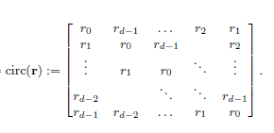
Circulant matrix
Notes:
一站式&icrm推词策略
推荐关键词，提升用户消费
优惠券相关工作
优惠促销，提升客户消费
流量折扣拍卖器
提供定向优质折扣流量，促进百度与客户双赢
客户企业群分布策略研究及其应用
利用工商大数据精准定位客户，指导销售

Slide 19
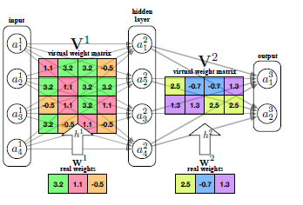
Hashing tricks
Use a hash function to share weights randomly.
Notes:
Weight sharing vs feature hashing

Slide 20
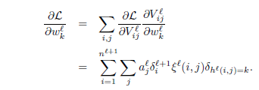
Hashing tricks
Forward pass
Gradient over parameters
Notes:
一站式&icrm推词策略
推荐关键词，提升用户消费
优惠券相关工作
优惠促销，提升客户消费
流量折扣拍卖器
提供定向优质折扣流量，促进百度与客户双赢
客户企业群分布策略研究及其应用
利用工商大数据精准定位客户，指导销售

Slide 21
2016 ICLR Best Paper
Hashing tricks determine weight sharing before the networks see any training data
There is another way to determine after the network is fully trained.
How to do it?
K-means !
Notes:
一站式&icrm推词策略
推荐关键词，提升用户消费
优惠券相关工作
优惠促销，提升客户消费
流量折扣拍卖器
提供定向优质折扣流量，促进百度与客户双赢
客户企业群分布策略研究及其应用
利用工商大数据精准定位客户，指导销售

Slide 22
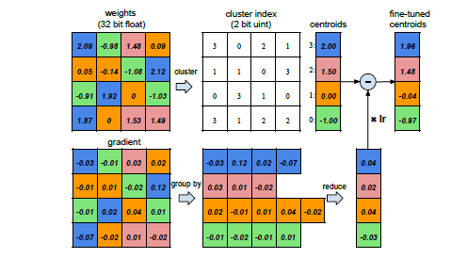
Weight sharing using K-means
Partition n original weights into k clusters, the forward pass and gradient computations likes what hashing tricks do.
Notes:
一站式&icrm推词策略
推荐关键词，提升用户消费
优惠券相关工作
优惠促销，提升客户消费
流量折扣拍卖器
提供定向优质折扣流量，促进百度与客户双赢
客户企业群分布策略研究及其应用
利用工商大数据精准定位客户，指导销售

Slide 23
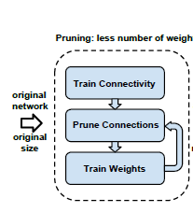
Other tricks used in the paper
Pruning
Removing the weights below a threshold (Also can compress NN by remove weight randomly, there are papers about this approach)
Notes:
一站式&icrm推词策略
推荐关键词，提升用户消费
优惠券相关工作
优惠促销，提升客户消费
流量折扣拍卖器
提供定向优质折扣流量，促进百度与客户双赢
客户企业群分布策略研究及其应用
利用工商大数据精准定位客户，指导销售

Slide 24
Huffman coding
Huffman coding
In AlexNet, the weights and the sparse matrix index are both biased, which is suitable for huffman coding.
Notes:
一站式&icrm推词策略
推荐关键词，提升用户消费
优惠券相关工作
优惠促销，提升客户消费
流量折扣拍卖器
提供定向优质折扣流量，促进百度与客户双赢
客户企业群分布策略研究及其应用
利用工商大数据精准定位客户，指导销售

Slide 25
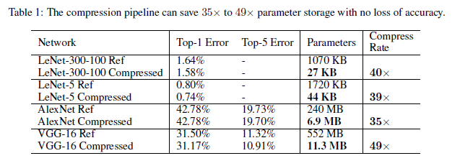
Results
Notes:
一站式&icrm推词策略
推荐关键词，提升用户消费
优惠券相关工作
优惠促销，提升客户消费
流量折扣拍卖器
提供定向优质折扣流量，促进百度与客户双赢
客户企业群分布策略研究及其应用
利用工商大数据精准定位客户，指导销售

Slide 26
Experiments on kaldi
Run the wsj example
With the limit of memory, change the original 6 -layer network to 4-layer, use 1000 hidden units and ReLU function, the results are very close to the given results.
Notes:
一站式&icrm推词策略
推荐关键词，提升用户消费
优惠券相关工作
优惠促销，提升客户消费
流量折扣拍卖器
提供定向优质折扣流量，促进百度与客户双赢
客户企业群分布策略研究及其应用
利用工商大数据精准定位客户，指导销售

Slide 27
Experiments on kaldi
RUN TDNN3
TEST | Original network WER | 4-layer network WER
Decode_bd_tgpr_dev93 | 7.19 | 7.24
Decode_bd_tgpr_eva192 | 3.93 | 4.38
Decode_tgpr_dev93 | 9.57 | 9.98
Decode_tgpr_eva192 | 6.86 | 6.73
Notes:
一站式&icrm推词策略
推荐关键词，提升用户消费
优惠券相关工作
优惠促销，提升客户消费
流量折扣拍卖器
提供定向优质折扣流量，促进百度与客户双赢
客户企业群分布策略研究及其应用
利用工商大数据精准定位客户，指导销售

Slide 28
Future Work
Papers Experiments Background
Keeping read papers about neural network compression
。
Exploring proper compression approach on ASR, by experiments on wsj, starting from SVD
Study automatic speech recognition
& deep learning systematically
Notes:
一站式&icrm推词策略
推荐关键词，提升用户消费
优惠券相关工作
优惠促销，提升客户消费
流量折扣拍卖器
提供定向优质折扣流量，促进百度与客户双赢
客户企业群分布策略研究及其应用
利用工商大数据精准定位客户，指导销售

Slide 29
Thanks~

Slide 30
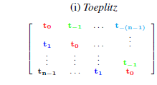
Structured matrix
Structured matrix can save memory and speed up, suppose the weight matrix is a Toeplitz matrix, only need O(nlogn) time to do matrix-vector multiplication.
Notes:
一站式&icrm推词策略
推荐关键词，提升用户消费
优惠券相关工作
优惠促销，提升客户消费
流量折扣拍卖器
提供定向优质折扣流量，促进百度与客户双赢
客户企业群分布策略研究及其应用
利用工商大数据精准定位客户，指导销售

Slide 31
Structured matrix
Stein displacement M,A,B,L(M) are all n*n matrix
Krylov Decomposition
Notes:
一站式&icrm推词策略
推荐关键词，提升用户消费
优惠券相关工作
优惠促销，提升客户消费
流量折扣拍卖器
提供定向优质折扣流量，促进百度与客户双赢
客户企业群分布策略研究及其应用
利用工商大数据精准定位客户，指导销售

