Slide 1
Tensorflow Basic
CSLT NLP

Slide 2
Tensorflow Basic
Google had published tensorflow, their deep learning structure.
For our team as we had already learned theano, for easily starting and seek for fast speed, we want to change our mainly deep learning toolkit from theano to tensorflow.

Slide 3
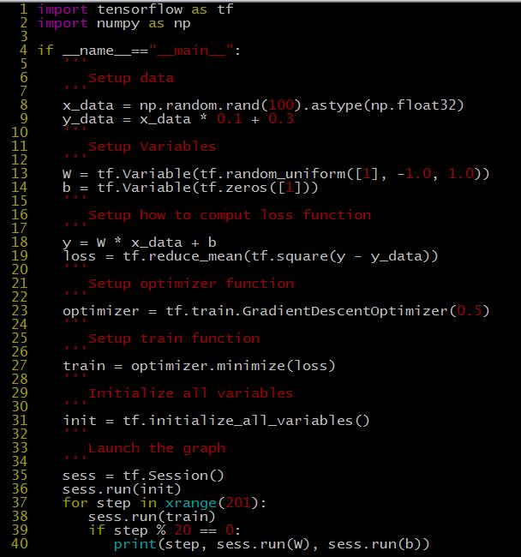
Tensorflow Basic
Start:

Slide 4
Tensorflow Basic
Result:

Slide 5
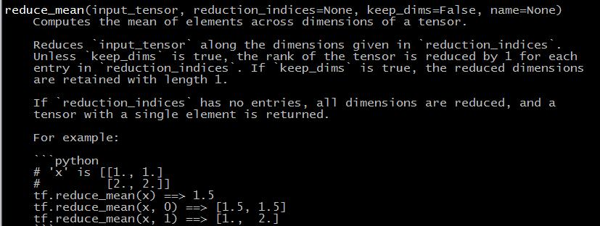
Tensorflow Basic
Reduce Mean

Slide 6
Tensorflow Basic
tf.train has 9 child classes.
Optimizers
Optimizer
GradientDescentOptimizer
AdagradOptimizer
MomentumOptimizer
AdamOptimizer
FtrlOptimizer
RMSPropOptimizer

Slide 7
Tensorflow Basic
tf.train has 9 child classes.
Gradient Computation
gradients
AggregationMethod
stop_gradient

Slide 8
Tensorflow Basic
tf.train has 9 child classes.
Gradient Clipping
clip_by_value
clip_by_norm
clip_by_average_norm
clip_by_global_norm
global_norm

Slide 9
Tensorflow Basic
tf.train has 9 child classes.
Decaying the learning rate
exponential_decay

Slide 10
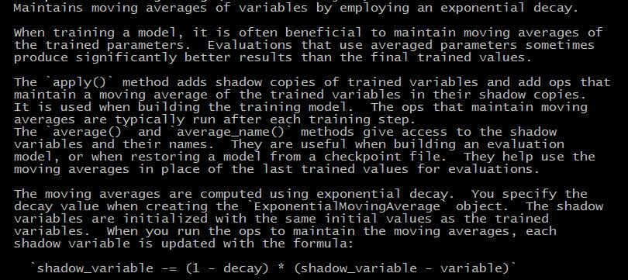
Tensorflow Basic
tf.train has 9 child classes.
Moving Averages
ExponentialMovingAverage

Slide 11
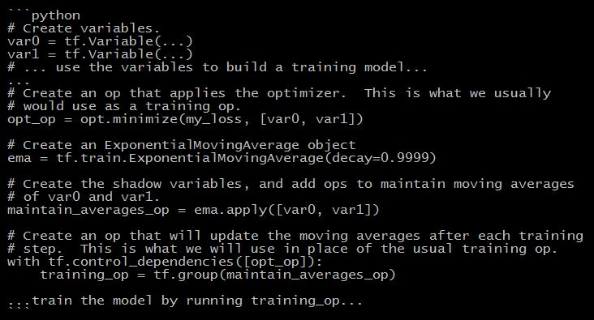
Tensorflow Basic
tf.train has 9 child classes.
Moving Averages
ExponentialMovingAverage

Slide 12
Tensorflow Basic
tf.train has 9 child classes.
Coordinator and QueueRunner (sequence run)
Coordinator
QueueRunner
add_queue_runner
start_queue_runners

Slide 13
Tensorflow Basic
tf.train has 9 child classes.
Summary Operations (to show your model)
scalar_summary
image_summary
histogram_summary
zero_fraction
merge_summary
merge_all_summaries

Slide 14
Tensorflow Basic
tf.train has 9 child classes.
Adding Summaries to Event Files (Also to show your model)
SummaryWriter
summary_iterator

Slide 15
Tensorflow Basic
tf.train has 9 child classes.
Training utilities (training trick)
global_step
write_graph

Slide 16
Tensorflow Basic
tf.train. GradientDescentOptimizer
apply_gradients
compute_gradients
get_slot (adam, Momentum need additional variables)
get_slot_names (adam, Momentum need additional variables)
minimize (equal to apply_gradients + compute_gradients)

Slide 17
Home Work
Write a dnn code in tensorflow.

