Slide 1
An Overview of LSTM,GRU,
RBM
-Jiyuan, Zhang
-CSLT, THU
-2016.08.
Notes:
主要看的是压缩神经网络相关的论文

Slide 2
Content
LSTM
GRU
Comparison between LSTM and GRU
RBM
Notes:
非常简短的介绍一下神经网络压缩

Slide 3
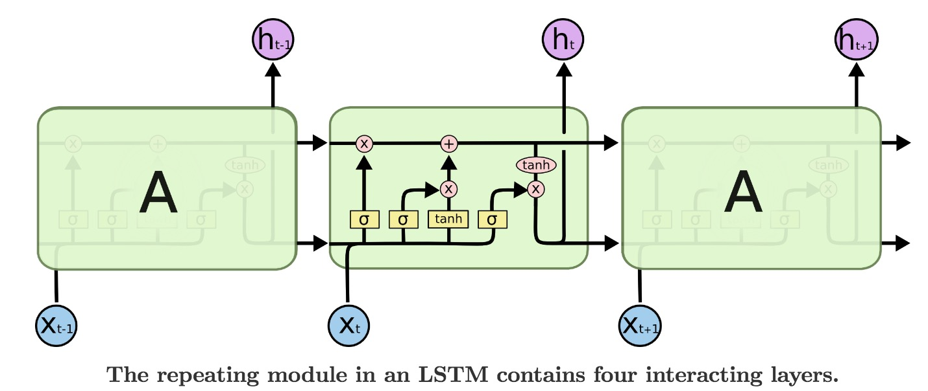
LSTM
Long Short Term Memory networks – usually just called ”LSTMs” – are a special kind of RNN, capable of learning long-term dependencies.
Notes:
在speech recognition中输出target很多时，最末层参数占50%
在CNN中全连接层占总参数90%

Slide 4
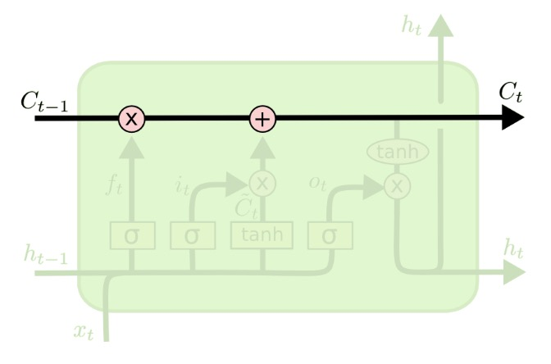
The Core Idea Behind LSTMs
The key to LSTMs is the cell state, the horizontal line running through the top of the diagram.
The LSTM does the ability to remove or add information to the cell state, carefully regulated by structures called gates.

Slide 5
Step-by-step LSTM Walk Through
The first step in our LSTM is to decide what information we’re going to throw away from the cell state. This decision is made by a sigmoid layer called the “forget gate layer”.

Slide 6
Step-by-step LSTM Walk Through
The next step is to decide what new information we’re going to store in the cell state.

Slide 7
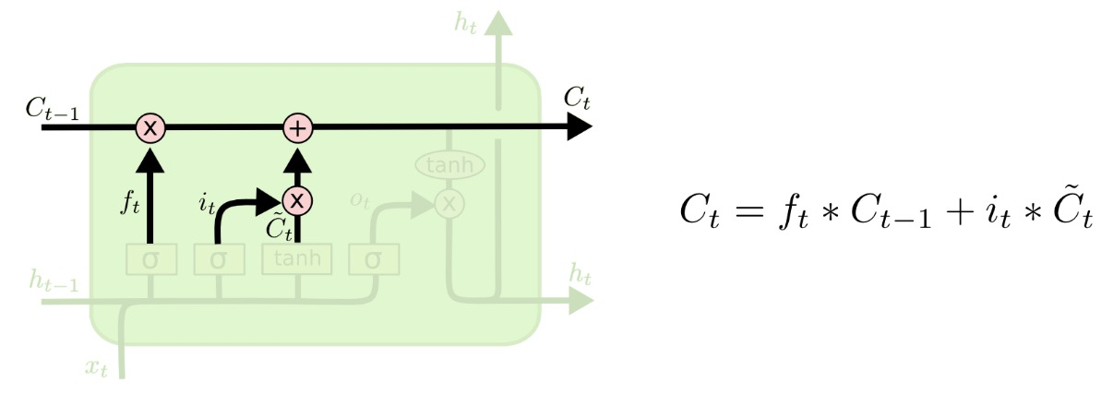
Step-by-step LSTM Walk Through
It’s now time to update the old cell state, C_{t-1} into the new cell state C_{t}. The previous steps already decided what to do, we just need to do it.
Notes:
如果每个参数是32bit 的float类型，节省32MB的空间

Slide 8
Step-by-step LSTM Walk Through
Finally, we need to decide what we’re going to output. This output will be based on our cell state, but will be a filtered version.
Notes:
使用cross-entropy training and Hessian-Free Sequence training

Slide 9
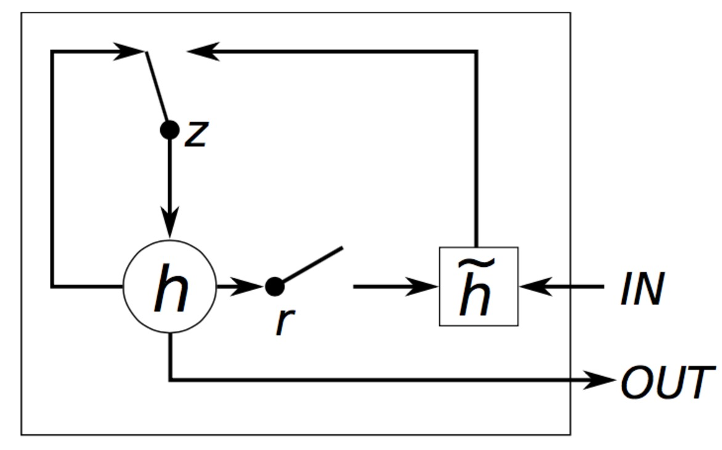
GRU
The idea behind a GRU layer is quite similar to that of a LSTM layer. A GRU has two gates, a reset gate r, and an update gate z.
Notes:
压缩比率比较大时，SVD出来的效果很差，但基本能fine-tune回来

Slide 10
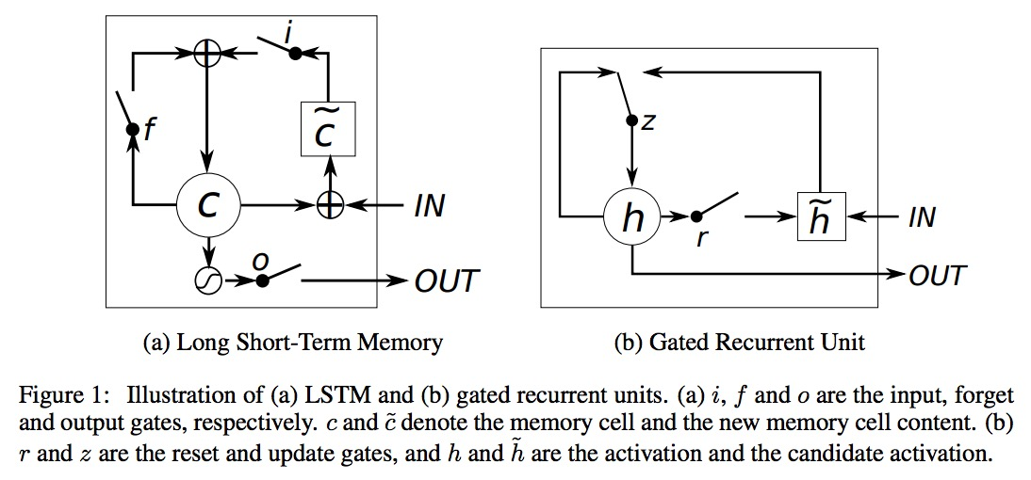
Comparison between LSTM and GRU
LSTM and GRU
Notes:
现在用的比较多的是Tensor Train Decomposition

Slide 11
Comparison between LSTM and GRU
Both LSTM unit and GRU keep the existing content and add the new content.
easy for each unit to remember the existence of a specific feature in the input stream for a long series of step.
allow the error to be back-propagated easily without too quickly vanishing
Notes:
现在用的比较多的是Tensor Train Decomposition

Slide 12
Comparison between LSTM and GRU
LSTM and GRU have a number of differences as well.
In the LSTM unit,the amount of the memory content is controlled by the output gate. However, the GRU exposes its full content without any control.
Another difference is in the location of the input gate, or the corresponding reset gate.
Notes:
Tucker分解类似于高维SVD
CP分解为若干秩为1的张量

Slide 13
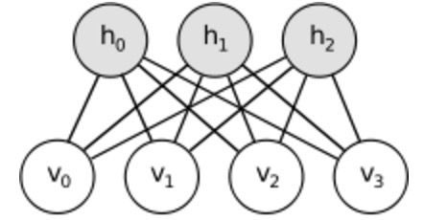
RBM
Restricted Boltzmann machine (RBM) is a generative stochastic artificial neural network that can learn a probability distribution over its set of inputs.
Boltzmann Machines are a particular form of log-linear Markov Random Field(MRF),restricted Boltzmann Machines restrict BMs to those without visible-visible and hidden-hidden connections.
Notes:
约定r0=rd=1,所以相乘能保证是实数
以索引方式来写的话，那个其实是三维张量

Slide 14
RBM
Energy-based probabilistic models define a probability distribution through an energy function, as follows：
The notation of free energy, defined as follows:
Notes:
Tucker分解类似于高维SVD
CP分解为若干秩为1的张量

Slide 15
RBM
The gradient of the negative log-likelihood of an input vector v^{(l)} involves two opposing terms, called the positive and negative phase:
The second term can be estimated by a single sample:
Notes:
了解了compression的相关技术

Slide 16
RBM
An RBM is an energy-based model where the joint probability of a given configuration of the visible vector v (inputs) and the hidden vector h is:
When the vector v is given, the hidden units h_{i} are conditionally independent of one another, and vice versa:

Slide 17
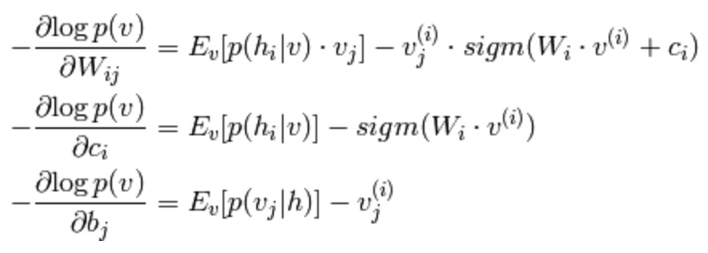
RBM
P(v) is:
the following log-likelihood gradient for an RBM with binary units:
Notes:
了解了compression的相关技术

Slide 18
RBM
P(v) is:
the following log-likelihood gradient for an RBM with binary units:
Notes:
了解了compression的相关技术

Slide 19
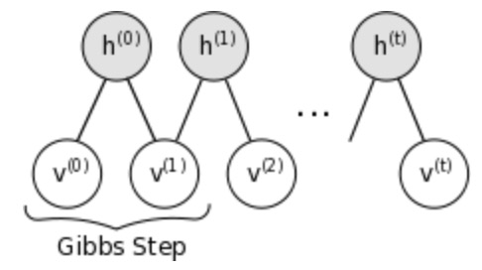
Sampling in an RBM
Samples of p(x) can be obtained by running a Markov chain to convergence, using Gibbs sampling as the transition operator.
Gibbs sampling of the joint of N random variables
is done through a sequence of N sampling sub-steps of the form where
contains the N-1 other random variables in excluding
Notes:
了解了compression的相关技术

Slide 20
Contrastive Divergence(CD-k)
Contrastive Divergence uses two tricks to speed up the sampling process:
Since we eventually want ,we initialize the Markov chain with a training example
CD does not wait for the chain to converge. Samples are obtained after only k-steps of Gibbs sampling.
Notes:
了解了compression的相关技术

Slide 21
Applications of RBM
Dimensionality reduction
Classification
Collaborative filtering
Feature learning
Topic modeling
Notes:
了解了compression的相关技术

