Slide 1
Biweekly report
Aodong Li

Slide 2
Gains
Basic knowledge about NLP
Neural Network Language Model (NNLM)
Long Short Term Memory networks (LSTMs)
Attention based model
Theano
Sequence to sequence model
Keyword to sequence model

Slide 3
Basic Knowledge about NLP
Relying on Coursera
Basic text processing
Language modeling
Named entity recognition
Parsing
Information retrieval
Sentimental analysis
Question Answering

Slide 4
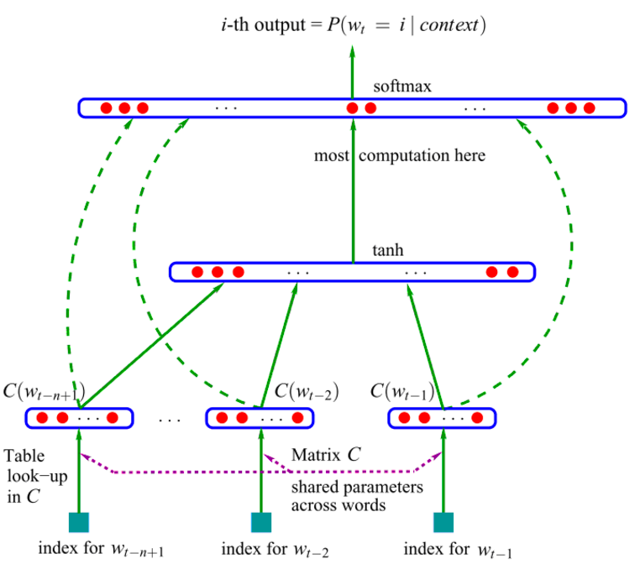
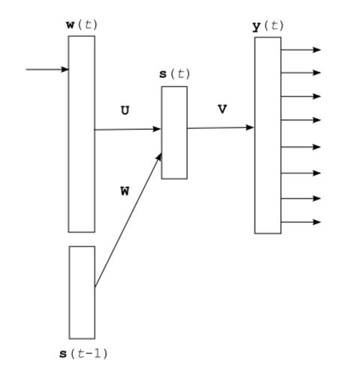
Neural Network Language Model (1)
Based on word embedding
Feed Forward Neural Network
Time Delayed Neural Network

Slide 5
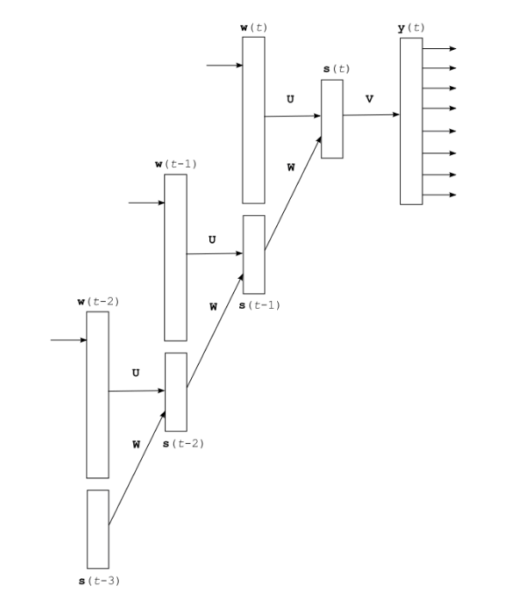
Neural Network Language Model (2)
Time Delayed Neural Network
Unrolled Recurrent Neural Network

Slide 6
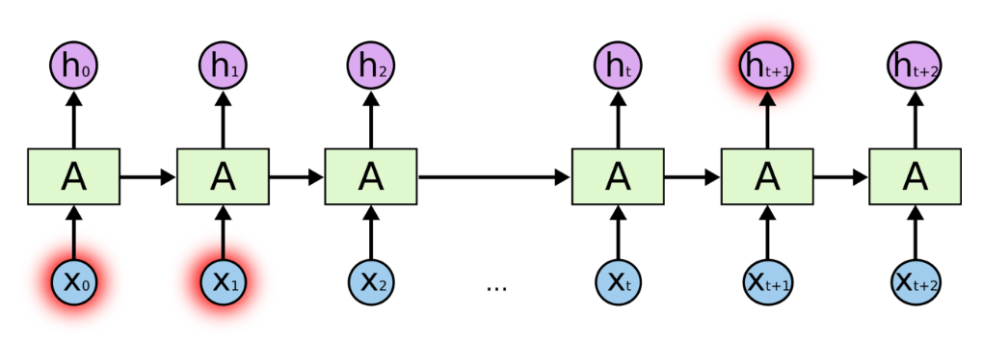
Long Short Term Memory networks (1)
When the gap is small, RNNs can learn to use the past information.
However, as the gap grows, RNNs become unable to connect the information.

Slide 7
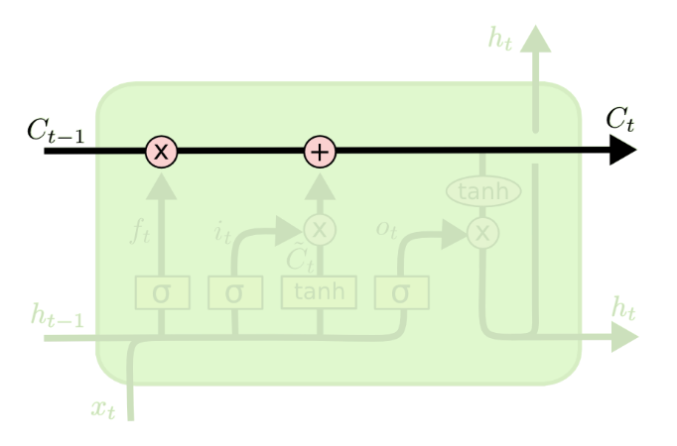
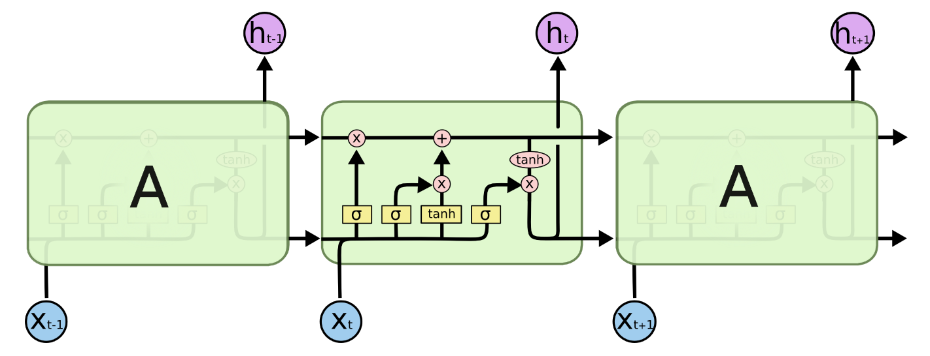
Long Short Term Memory networks (2)

Slide 8
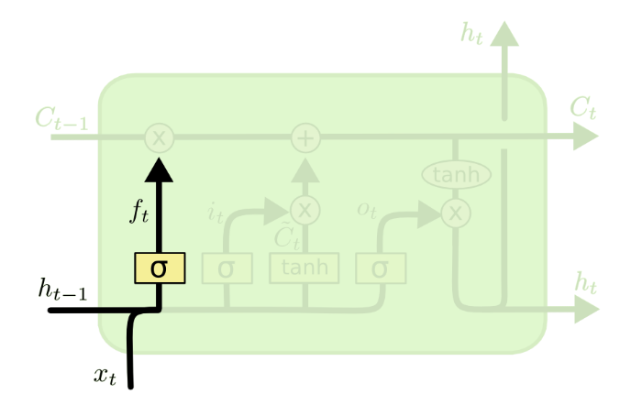
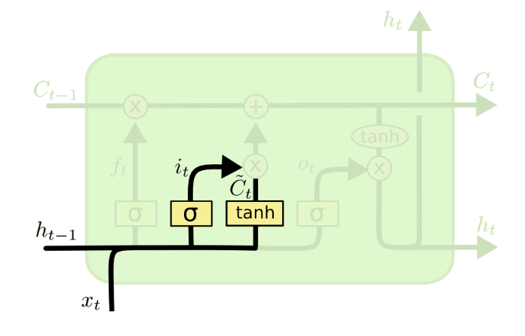
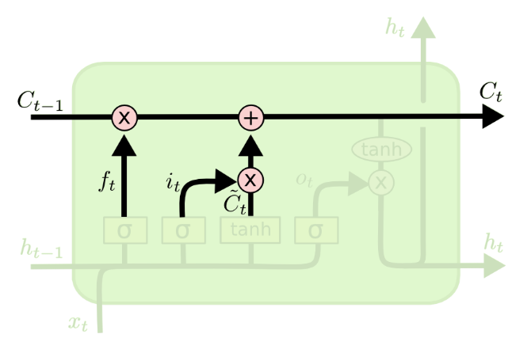
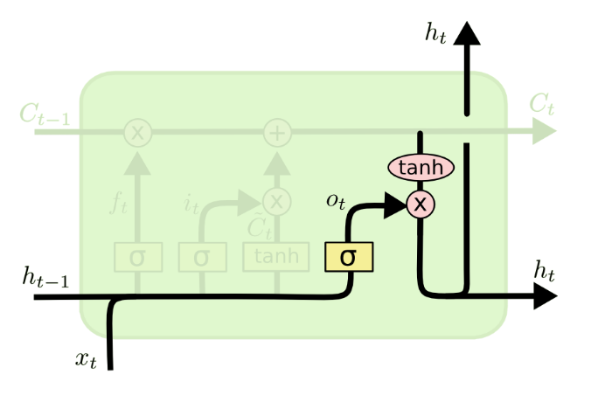
Long Short Term Memory networks (2)

Slide 9
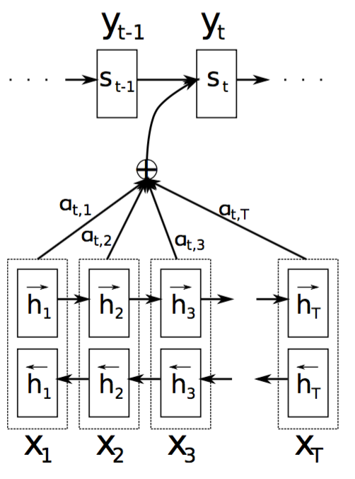
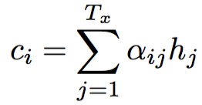
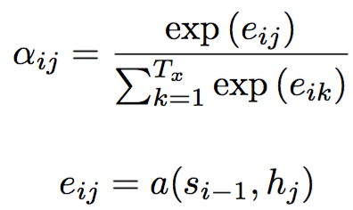
Attention based model

Slide 10
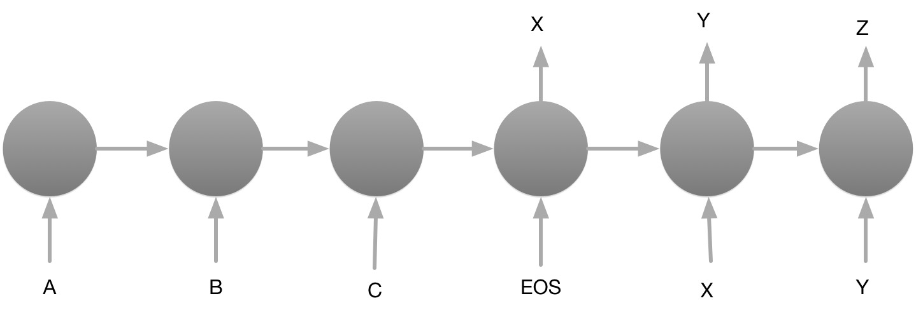
Sequence to sequence model

Slide 11
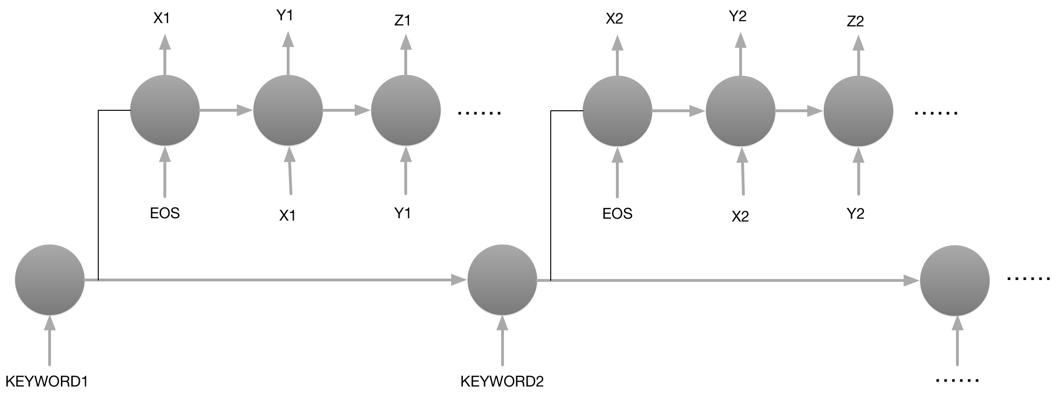
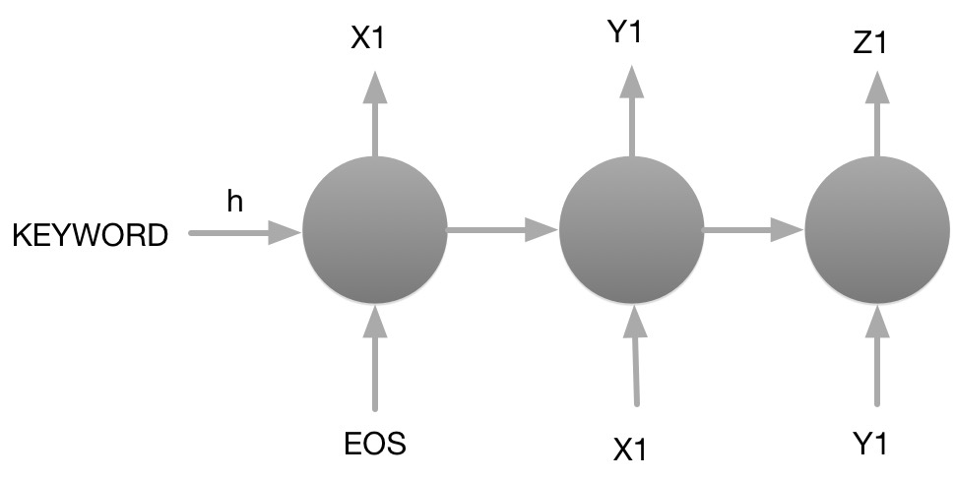
Keyword to sequence model

Slide 12
Reference
[1] Bengio Y, Schwenk H, Senécal J S, et al. Neural probabilistic language models[M]//Innovations in Machine Learning. Springer Berlin Heidelberg, 2006: 137-186.
[2] Mikolov T, Chen K, Corrado G, et al. Efficient estimation of word representations in vector space[J]. arXiv preprint arXiv:1301.3781, 2013.
[3] Sutskever I, Vinyals O, Le Q V. Sequence to sequence learning with neural networks[C]//Advances in neural information processing systems. 2014: 3104-3112.
[4] Graves A. Generating sequences with recurrent neural networks[J]. arXiv preprint arXiv:1308.0850, 2013.
[5] Bahdanau D, Cho K, Bengio Y. Neural machine translation by jointly learning to align and translate[J]. arXiv preprint arXiv:1409.0473, 2014.
[6] http://colah.github.io/posts/2015-08-Understanding-LSTMs/
[7] http://www.flickering.cn/nlp/2015/03/

