Slide 1
A clustering time series model for the optimal hedge ratio decision making
wangyd
2017/6/1

Slide 2
Optimal hedge ratio with OLS
Under the criterion of minimum-variance

Slide 3
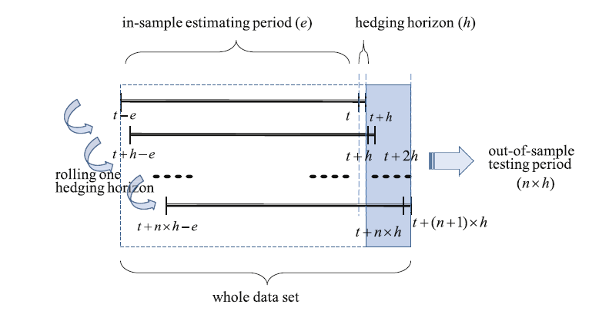
Optimal hedge ratio with OLS
Rolling window

Slide 4
Problem
Hedge horizon
the frequency of data must match the hedging horizon. So for a long
hedge horizon ,the data sample will reduce.
Error term lead to the inaccurate estimation
the assumption of a unit root process is unsuitable for many commodities markets
Weight of observations
ols put zero weight beyond the estimation period.
garch place too much weight on extreme observations when the
distribution of data is leptokurtic and fat-tailed.

Slide 5
Main sections of cluster based approach

Slide 6
Main sections of cluster based approach
extract features
variance
Covariance
Price spread (difference of spot and futures)

Slide 7
Main sections of cluster based approach
Ghsom(growing hierarchical self-organizing map ) cluster
som (competitive learning )
SOM is a kind of neural networks based on unsupervised learning techniques
topology
two layers
input layer output layer (competitive layer )
Calculate the distance of x and output neurons
Flow the rule of winner–take-all
Update the weight

Slide 8
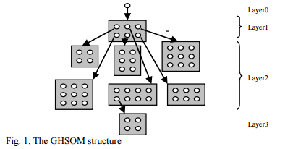
Main sections of cluster based approach
Ghsom(growing hierarchical self-organizing map ) cluster
GHSOM is a kind of neural network which has the hierarchical structure
Initialize layer 0
the weight vector is initialized as the expected value of all input data. Calculate the mean quantization error of Layer 0( MQE0 ).
2) Train each individual map
3)Grow each individual map horizontally: T m is the horizontal parameter which is used to control the map size of SOM. Compute the mean quantization error of input data in layer
4) Extend or terminate the hierarchical structure: T u is the longitudinal parameter used to control the depth of GHSOM structure. If the formula below is satisfied, one 2*2 SOM map will be formed, otherwise, the hierarchical structure will be terminated.

Slide 9
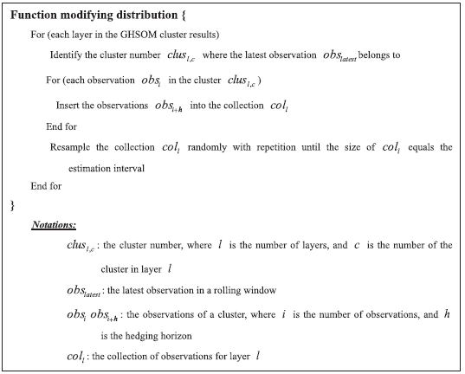
Main sections of cluster based approach
resample data and modify the distribution

Slide 10
Main sections of cluster based approach
Estimate optimal hedge ratio with OLS

