Slide 1
Intrinsic Subspace Evaluation of Word Embedding Representations
Yadollah Yaghoobzadeh and Hinrich Schu ̈tze
Center for Information and Language Processing University of Munich,
Germany yadollah@cis.lmu.de
Aiting Liu

Slide 2
Motivation
Current intrinsic evaluations:
based on the overall similarity or full-space similarity of words (point-based)
New intrinsic evaluation :
identify four fundamental criteria based on the characteristics of natural language that pose difficulties to NLP systems;
develop tests that directly show whether or not representations contain the subspaces necessary to satisfy these criteria.

Slide 3
Introduction
We distinguish two different types of evaluation in this paper:
(i) extrinsic evaluation evaluates embeddings in an NLP application or task. It does not allow us to understand the properties of representations without further analysis; e.g., if an evaluation shows that embedding A works better than embedding B on a task, then that is not an analysis of the causes of the improvement.
(ii) intrinsic evaluation tests the quality of representations independent of a specific NLP task. Currently, this evaluation mostly is done by testing overall distance/similarity of words in the embedding space, i.e., it is based on viewing word representations as points and then computing full-space similarity. The assumption is that the high dimensional space is smooth and similar words are close to each other.

Slide 4
Related works (1)
Baroni et al. (2014) evaluate embeddings on different intrinsic tests: similarity, analogy, synonym detection, categorization and selectional preference.
Schnabel et al. (2015) introduce tasks with more fine-grained datasets. These tasks are unsupervised and generally based on cosine similarity; this means that only the overall direction of vectors is considered or, equivalently, that words are modeled as points in a space and only their full- space distance/closeness is considered.
Tsvetkov et al. (2015) evaluate embeddings based on their correlations with WordNet-based linguistic embeddings. However, correlation does not directly evaluate how accurately and completely an application can extract a particular piece of information from an embedding.

Slide 5
Related works (2)
Extrinsic evaluations are also common (cf. (Li and Jurafsky, 2015; Ko ̈hn, 2015; Lai et al., 2015)).
Li and Jurafsky (2015) conclude that embedding evaluation must go beyond human-judgement tasks like similarity and analogy. They suggest to evaluate on NLP tasks.
Ko ̈hn (2015) gives similar suggestions and also recommends the use of supervised methods for evaluation.
Lai et al. (2015) evaluate embeddings in different tasks with different setups and show the contradictory results of embedding models on different tasks. Idiosyncrasies of different downstream tasks can affect extrinsic evaluations and result in contradictions.

Slide 6
Criteria for word representations (1)
word : a combination of different properties(features).
facet : morphological, lexical, syntactic, semantic, world knowledge and other properties(features).
The ultimate goal : learn representations for words that accurately and consistently contain these facets.
Take the facet gender (GEN) as an example. We call a representation 100% accurate for GEN if information it contains about GEN is always accurate; we call the representation 100% consistent for GEN if the representation of every word that has a GEN facet contains this information.

Slide 7
Criteria for word representations (2)
Nonconflation.
A word embedding must keep the evidence from different local contexts separate – “do not conflate” – because each context can infer specific facets of the word.
Robustness against sparseness.
Rare words are common in natural language and embedding models must learn useful representations based on a small number of contexts.
Robustness against ambiguity.
Embeddings should fully represent all senses of an ambiguous word.
Accurate and consistent representation of multifacetedness.
(i) Words have a large number of facets, including phonetic, morphological, syntactic, semantic and topical properties. (ii) Each facet by itself constitutes a small part of the over-all information that a representation should capture about a word.

Slide 8
Experimental setup and results
We now design experiments to directly evaluate embeddings on the four criteria. We proceed as follows.
(1) Design a probabilistic context free grammar (PCFG) that generates a corpus.
(2) Train our embedding models on the corpus.
(3) The embeddings obtained are then evaluated in a classification setting, in which we apply a linear SVM (Fan et al., 2008) to classify embeddings.
(4) Compare the classification results for different embedding models and analyze and summarize them.

Slide 9
Selecting embedding models
count-based model : PPMI(positive pointwise mutual information)
learning-based model :
SKIP and CBOW (word2vec)
SSKIP (Structured SkipGram) and CWIN(continuous window model (wang2vec)
LBL (vectorized log-bilinear language model)(Lai et al. (2015)’s implementation)

Slide 10
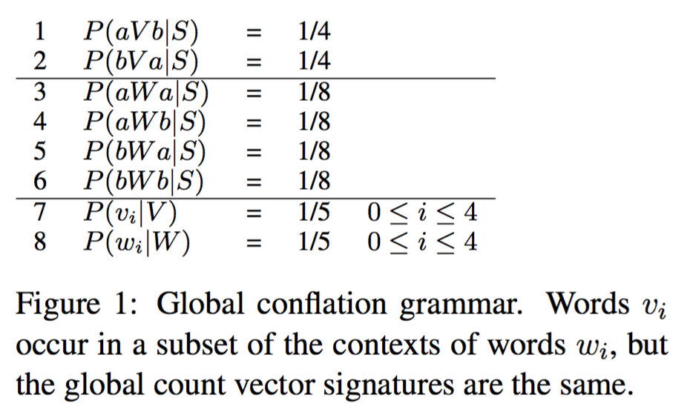
Model and results (1)
Nonconflation
Grammar. Figure 1
Dataset. We generated a corpus of 100,000 sentences. Words that can occur in a-a and b-b contexts constitute the positive class, all other words the negative class. The words v₃, v₄, w₃, w₄ were assigned to the test set, all other words to the training set.
Results.
PPMI and CBOW : accuracy=50%
LBL, SSKIP, SSKIP and CWIN : 100%

Slide 11
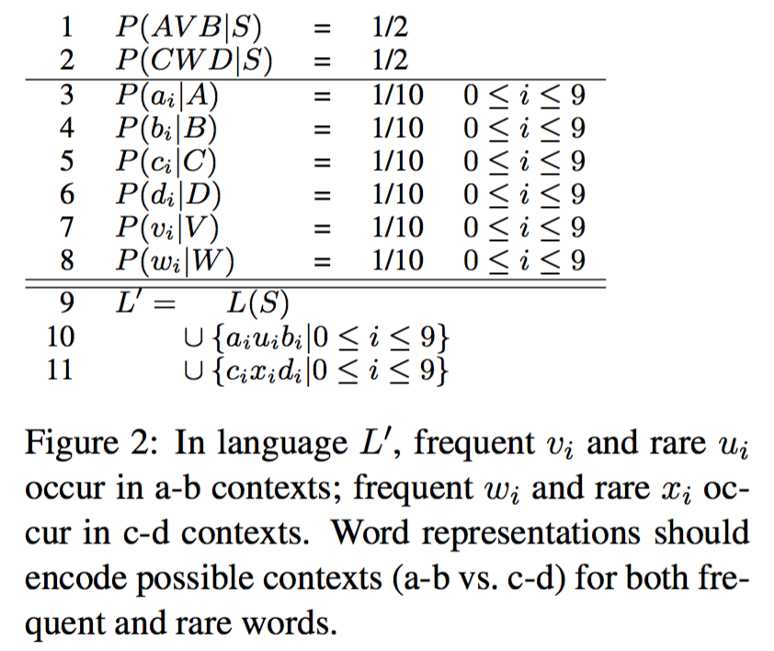
Model and results (2)
Robustness against sparseness
Grammar. Figure 2
Dataset. We generated a corpus of 100,000 sentences using the PCFG (lines 1–8) and added the 20 rare sentences (lines 9–11). We label all words that can occur in c-d contexts as positive and all other words as negative. The singleton words u_{i} and x_{i} were assigned to the test set, all other words to the training set.
Results.
PPMI : accuracy=50%
learning-based model : 100%

Slide 12
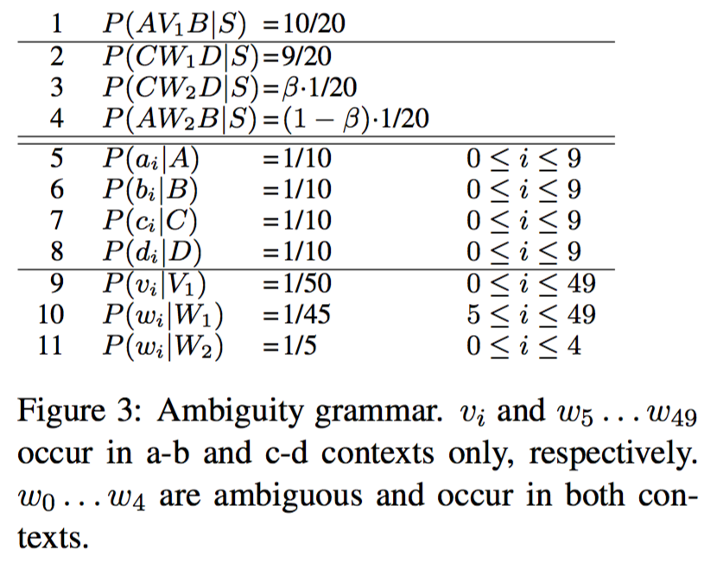
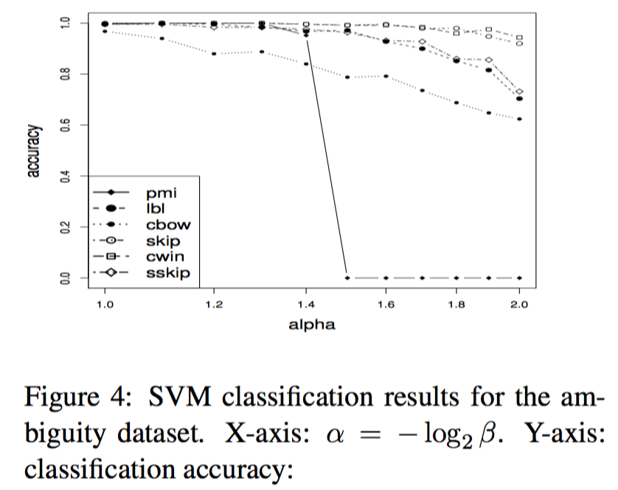
Model and results (3)
Robustness against ambiguity
Grammar. Figure 3
Dataset. The grammar specified in Figure 3 was used to generate a training corpus of 100,000 sentences. Label criterion: A word is labeled positive if it can occur in a c-d context, as negative otherwise. The test set consists of the five ambiguous words w₀ . . . w₄. All other words are assigned to the training set.
Results. Figure 4
All models perform well for balanced sense frequencies; e.g., for α=1.0, β=0.5, the SVMs were all close to 100% accurate in predicting that the w_{i} can occur in a c-d context. PPMI accuracy falls steeply when α is increased from 1.4 to 1.5. It has a 100% error rate for α≥1.5. Learning-based models perform better in the order CBOW (least robust), LBL, SSKIP, SKIP, CWIN (most robust). Even for α = 2.0, CWIN and SKIP are still close to 100% accurate.

Slide 13
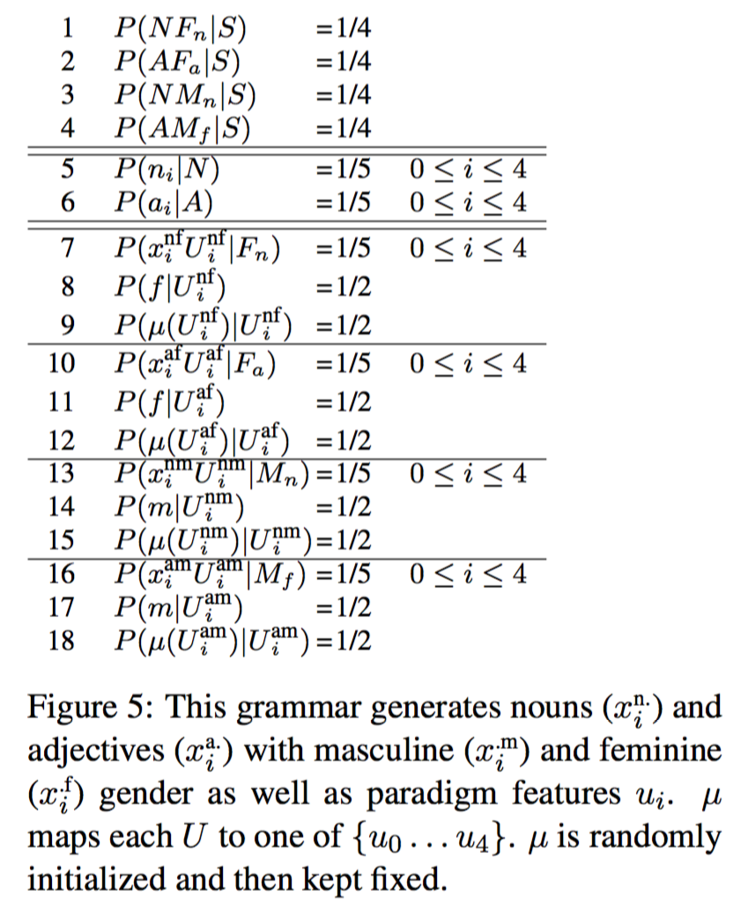
Model and results (4)
Accurate and consistent representation of multifacetedness
Grammar. Figure 5
Dataset. We perform 10 trials. In each trial, μ is initialized randomly and a corpus of 100,000 sentences is generated. The train set consists of the feminine nouns (x_{i}^{nf}, line 7) and the masculine nouns (x_{i}^{nm}, line 13). The test set consists of the feminine (x_{i}^{af}) and masculine (x_{i}^{am}) adjectives.
Results. Embeddings have been learned, SVMs are trained on the binary classification task feminine vs. masculine and evaluated on test. There was not a single error: accuracy of classifications is 100% for all embedding models.

Slide 14
Analysis
(i) Two words with clearly different context distributions should receive different representations. Aggregation models fail to do so by calculating global statistics.
(ii) Embedding learning can have different effectiveness for sparse vs. non-sparse events. Thus, models of representations should be evaluated with respect to their ability to deal with sparseness; evaluation data sets should include rare as well as frequent words.
(iii) Single-representation approaches can indeed represent different senses of a word. However, even though single-representations do well on balanced senses, they can pose a challenge for ambiguous words with skewed senses.
(iv) Lexical information is complex and multi-faceted. In point-based tests, all dimensions are considered together and their ability to evaluate specific facets or properties of a word is limited. Any good or bad result on these tasks is not sufficient to conclude that the representation is weak. The valid criterion of quality is whether information about the facet is consistently and accurately stored.

Slide 15
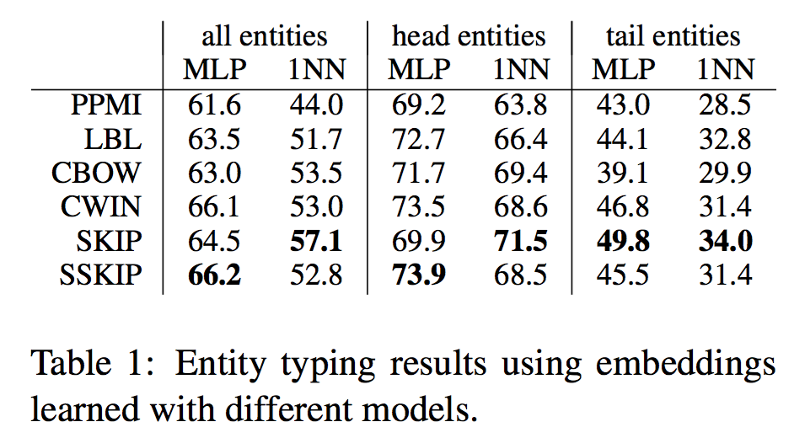
Extrinsic evaluation: entity typing
To support the case for sub-space evaluation and also to introduce a new extrinsic task that uses the embeddings directly in supervised classification, we address a fine-grained entity typing task.

Slide 16
Future work
(i) conducting experiments on real natural language data.
(ii) study the coverage of our four criteria in evaluating word representations.
(iii) modeled the four criteria using one single unified PCFG other than four separate PCFGs.

Slide 17
THE END

