Slide 1
Computer-Assisted Pronunciation Training
Dong Wenwei
2019.1.17

Slide 2
Outline
Introduction
Mispronunciation patterns of non-native speakers
Research approaches
Challenges and research opportunities

Slide 3
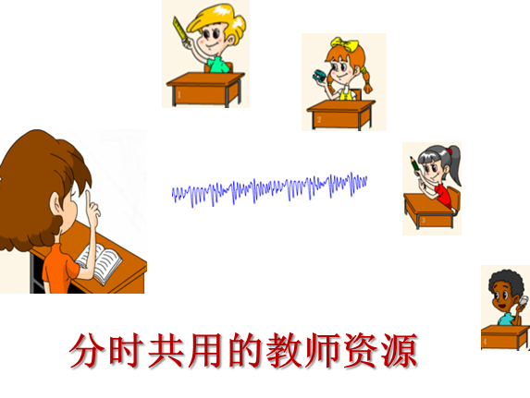
Introduction
With increasing globalization, there has also been a significant increase in the demand for foreign language learning
Notes:
可以随时随地发音练习，可以个性化学习进程

Slide 4
Introduction
CAPT特点
  方便学生进行大量发音练习和测试
  个性化学习进度
  方便教师掌握学生发音情况
  提升发音评测的客观性
Notes:
可以随时随地发音练习，可以个性化学习进程

Slide 5
Introduction
Applications of CAPT can be divided into two areas:
  Pronunciation assessment
  Pronunciation learning/teaching
    Segmental (phonetic)
    Subsegmental (e.g., place of articulation, manner of speech)
    Suprasegmental (prosodic)
Notes:
发音评估：一般就是反馈分数，用母语者的语料作为标准去训练模型
发音教学：反馈具体错误类型，需要大量标注

Slide 6
Mispronunciation patterns of non-native speakers
Pronunciation errors are usually characterized at the phonetic(segmental) or prosodic (suprasegmental) level
  Phonetic Errors
    Substitutions
    Insertions
    Deletions
Notes:
其中删除错误最影响一句话的可懂度，因为信息丢失了

Slide 7
Mispronunciation patterns of non-native speakers
Different phontactic constraints across languages might result in deletion and insertion errors
  Only certain consonants are allowed at syllable final positions
    “face” might be pronounced as “fay”
  Consonant clusters are not allowed in Vietnamese either
    Vowels might be inserted in between consonants when Vietnamese speakers learn English
Notes:
不同的音位结构约束
越南语中

Slide 8
Mispronunciation patterns of non-native speakers
Phonetic substitutions occur because of approximating L2 phonemes with L1 phonemes
  In Mandarin and Spanish, there are no short vowels
    Words like “eat” and “it” might sound similar
Sometimes the non-native phone is neither in L1 or L2. It could be in between
Notes:
不同的音位结构约束
越南语中

Slide 9
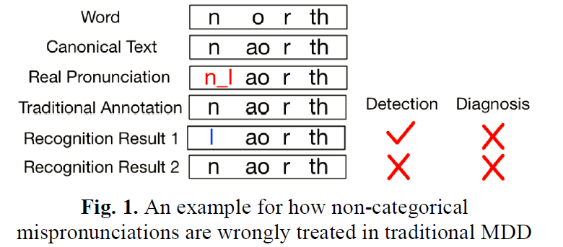
Mispronunciation patterns of non-native speakers
Most existing approaches to modeling L2 speech can only target categorical phoneme error types based on the native phoneme set
Notes:
这里举一个粤语母语者发的英语的例子。发音者发的介语N-L之间，如果按照已有的音素集合中找发音错误，会有两种，直接识别成l或者识别成n
有人会用发音属性来定义这些错误，比如说舌头的位置，清浊音等等这些

Slide 10
Mispronunciation patterns of non-native speakers
In terms of intelligibility, prosody is as important as phonetic accuracy
  Prosodic Errors
    Stress
    Rhythm
    Intonation
Notes:
一个人虽然音都发对了，但是时间啊音高不对，也是很难理解他说了什么的

Slide 11
Mispronunciation patterns of non-native speakers
Stress: the specific emphasis given to a particular syllable or word
Acoustic：greater loudness, higher pitch, and longer duration
The stress placed on syllables within words are called lexical stress or word stress
Stress placed on words within sentences are called sentence stress or prosodic stress
Notes:
其中词重音是人们最常检测的，但是他在不同的语言中有不同的表现
一句话中重音位置的不同，他表达的意思也不同

Slide 12
Mispronunciation patterns of non-native speakers
In Bengali（孟加拉语） is fixed (restricted to the initial syllable of a word)
English has variable stress
Notes:
其中词重音是人们最常检测的

Slide 13
Mispronunciation patterns of non-native speakers
Rhythm: the temporal pattern of how a language is spoken
English and German are stress-timed
  Some syllables are long while others (unstressed syllables) are short
French and Spanish are syllable-based
  Each syllable is spoken at a regular interval
Notes:
一些法语母语者在学习英语的时候，他们的一些口音就来自于时长的问题

Slide 14
Mispronunciation patterns of non-native speakers
Intonation: the variation in pitch
Intonation helps the listener parse the boundaries in speech
Intonation also helps convey the speaker’s attitude and emotions
tonal languages such as Mandarin Chinese and Vietnamese
Variation in pitch can result in words with different meanings
Notes:
同一句话不同的语调可以传递不同的意思，“她吃饭了”

Slide 15
Research approaches
Frameworks for Detecting Phonetic Errors：
  ASR is often a natural component in a CAPT system
  The ASR system can be trained with just native speech or with both non-native speech and native speech
Notes:
整体模型发展语语音识别类似，即使是不用ASR的系统，也需要声学模型提供强制对齐的结果
加入二语者语料能消除一点训练集和测试集的mismatch，通道上的或者说话方式上的

Slide 16
Research approaches
Frameworks for Detecting Phonetic Errors：
  Likelihood-Based Scoring（GOP）
  Classifier-Based Scoring
  Extended Recognition Network（ERN）
  Unsupervised Error Discovery

Slide 17
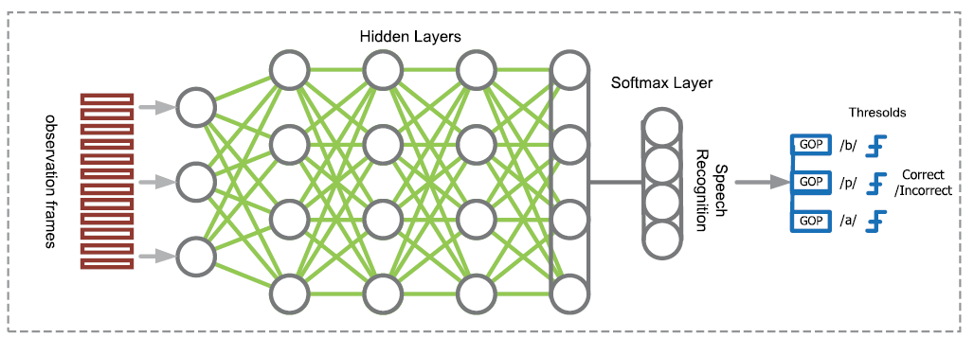
Research approaches
Likelihood-Based Scoring（GOP）
Notes:
这种方法的主要思想是将母语者认为是标准发音，然后计算二语者的发音与母语者的相似度，相似度越高，分数越高

Slide 18
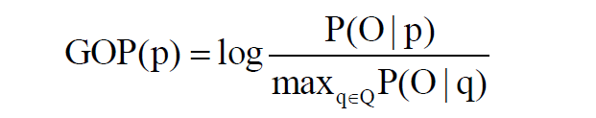

Research approaches
Likelihood-Based Scoring（GOP）
Q为所有音素的集合，p标准phone，O为声学特征
q后验概率最大的phone
Notes:
GOP只能判断发音的对错，不能说明错误类型
这种方法依赖音素边界，将边界内后验概率平均

Slide 19
Research approaches
Classifier-Based Scoring
  Truong et.al used acoustic phonetic features to train binary classifiers to distinguish confusion pairs
  Acoustic phonetic，MFCC, GOP
Notes:
这种易混的对是通过标注提取出来的
直接提取特征，进行分类，可能会用到模型对齐结果

Slide 20
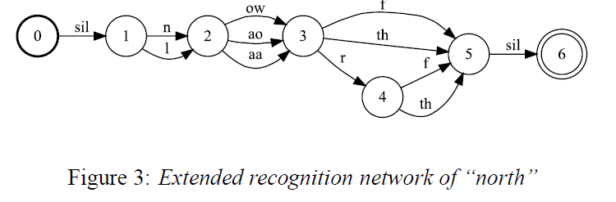
Research approaches
Extended Recognition Networks(ERN)
在解码网格中加入先验知识的约束(Kenworthy, 1987; A. M. Harrison, 2008;Gao, 2015)
Notes:
这种方法需要从大量的二语者语料中找错误规律，需要很大的人力物力

Slide 21
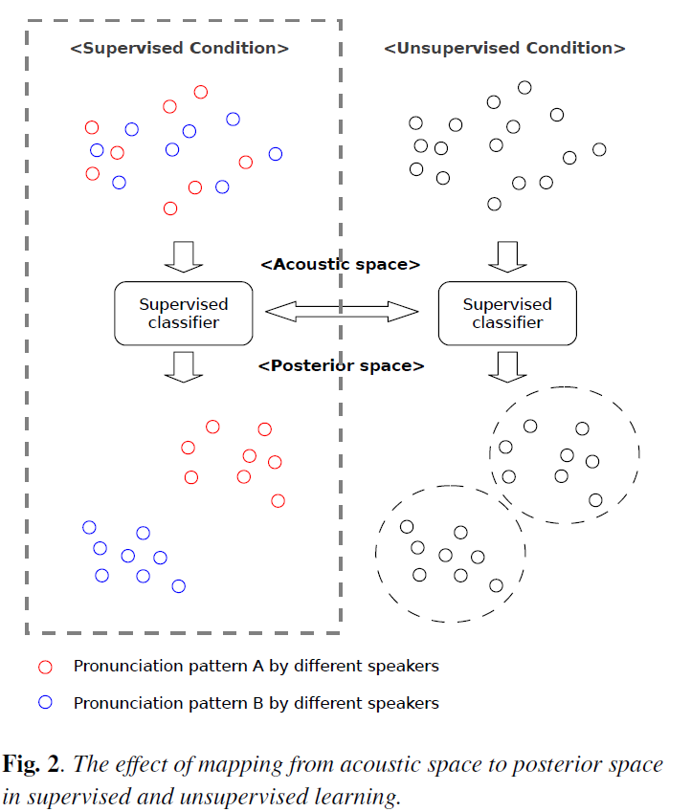
Research approaches
Unsupervised Error Discovery
Need large-scale non-native speech data with human annotations
Notes:
所以有一些学者研究用无监督的方法去找二语者的发音错误
这些错误类型可以用在ERN也可以用在分类里面

Slide 22
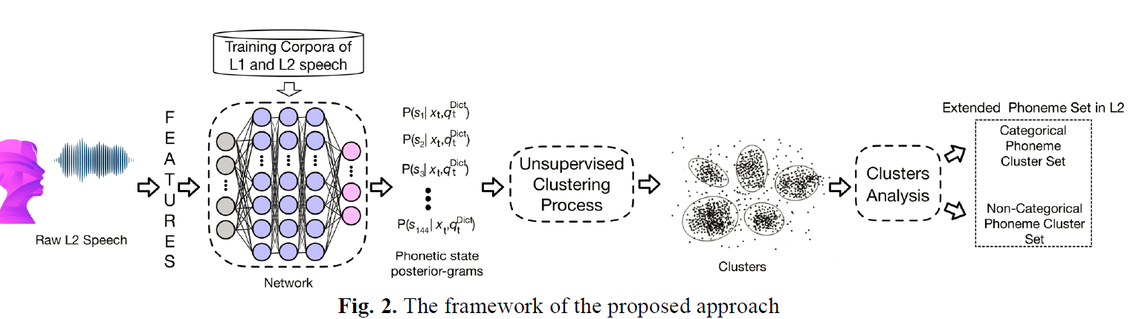
Research approaches
Unsupervised Error Discovery
Notes:
所以有一些学者研究用无监督的方法去找二语者的发音错误
这些错误类型可以用在ERN也可以用在分类里面

Slide 23
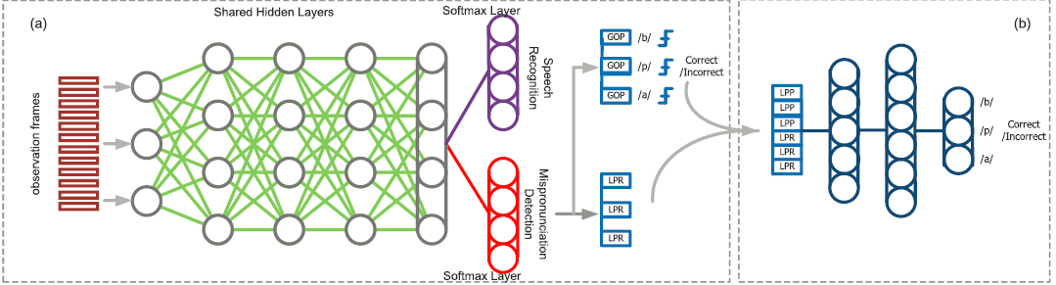
Research approaches
Strategies for Improving Phonetic Error Detection
  Verification/Rescoring
Notes:
为了增加分类或者打分的可信度，通常会增加确认或者重新打分环节
一般认为母语者数据和二语者数据无论是录音条件还是其他方面都有mismatch
LPP log phone posterior LPR log posterior ratio of competitive phone 和canonical phone

Slide 24
Research approaches
Strategies for Improving Phonetic Error Detection
  Deep learning
    DNN-HMM acoustic model better than GMM-HMM baseline
    Convolutional neural networks were used in to automatically extract features
Notes:
CAPT的核心技术就是语音识别，所以整体发展过程和语音识别类似
后面可以接各种分类器

Slide 25
Research approaches
Strategies for Improving Phonetic Error Detection
  Articulatory or Acoustic Phonetic Knowledge
    Landmark-based SVM classifiers for detecting possible English pronunciation
Notes:
Landmark是说音素中最有代表性得信息，类似于区别特征
前提假设是一个音中的信息不是均匀分布的

Slide 26
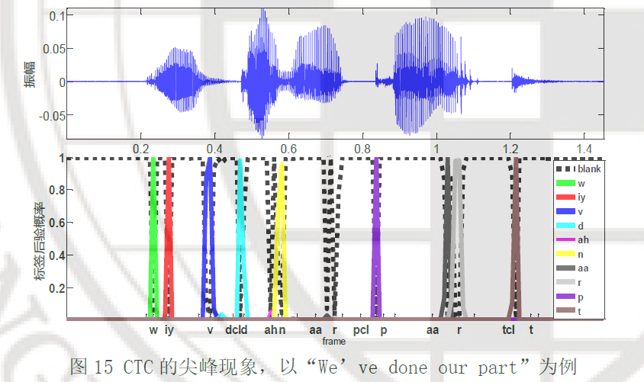
Research approaches
Strategies for Improving Phonetic Error Detection
  Articulatory or Acoustic Phonetic Knowledge
    Landmark-based SVM classifiers for detecting possible English pronunciation

Slide 27
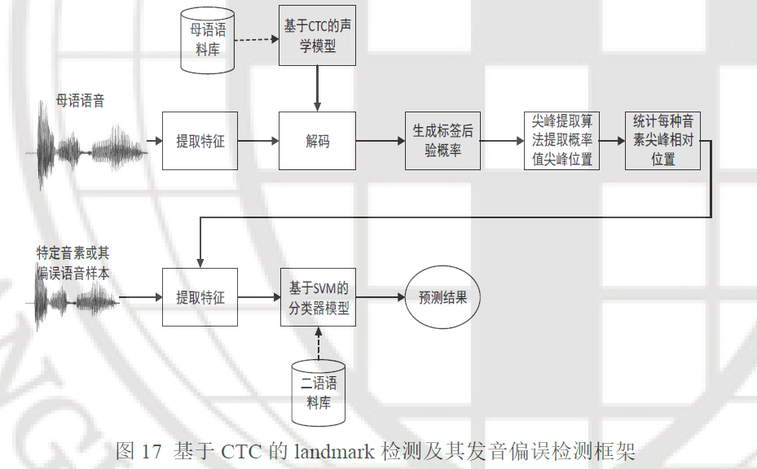
Research approaches
Strategies for Improving Phonetic Error Detection
  Articulatory or Acoustic Phonetic Knowledge
    Landmark-based SVM classifiers for detecting possible English pronunciation

Slide 28
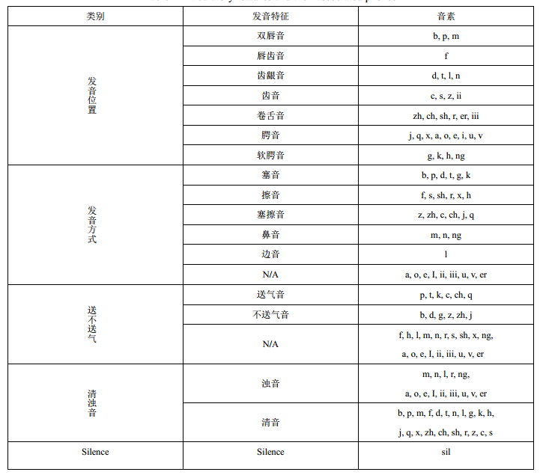
Research approaches
Strategies for Improving Phonetic Error Detection
  Articulatory or Acoustic Phonetic Knowledge
    Landmark-based SVM classifiers for detecting possible English pronunciation
    Acoustic phonetic properties or distinctive features(the place of articulation, the manner of speech, voicing)
Notes:
Landmark是说音素中最有代表性得信息，类似于区别特征
前提假设是一个音中的信息不是均匀分布的

Slide 29
Research approaches
Detecting Prosodic Errors
  Lexical Stress
    Gaussian mixture models perform the best compared to decision trees and neural networks
    Duration and pitch estimates are the most important features
Notes:
大多数的工作重心都在比较不同的特征以及不同的分类器的性能
Unstressed vowels, primary stress on vowels, and secondary stress on vowels

Slide 30
Research approaches
Detecting Prosodic Errors
  Lexical Tones
    Lexical tones are primarily characterized by the pitch contour (e.g., Mandarin), sometimes the pitch height (e.g., Cantonese)
    ASR framework for Tones Recognition
    Syllable boundaries+classifier
Notes:
有声调语言里面，词重音看作声调
1从升学上看
2音系上看

Slide 31
Research approaches
Detecting Prosodic Errors
  Lexical Tones
    Segment the F0 contour to tone nucleus
    Goodness of Tone (GOT)
    The GOT features were modeled by an SVM classifier
    Pitch related features could be inferred from a DNN system trained by 40-dimension MFCC features
Notes:
大多数工作都在做母语者声调识别，很少做二语者声调偏误检测

Slide 32
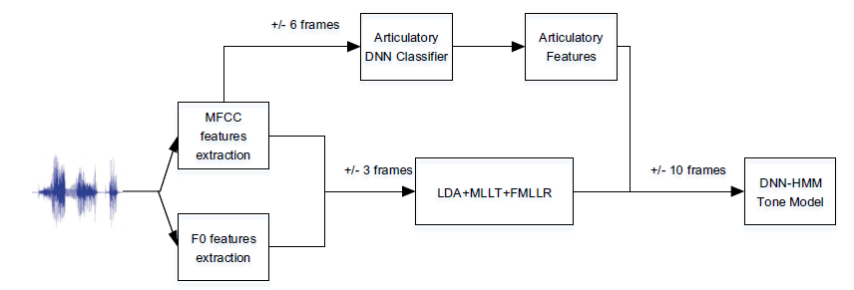
Research approaches
Detecting Prosodic Errors
  Lexical Tones
    Segment the F0 contour to tone nucleus
    goodness of tone (GOT)
    The GOT features were modeled by an SVM classifier
    Pitch related features could be inferred from a DNN system trained by 40-dimension MFCC features
Notes:
大多数工作都在做母语者声调识别，很少做二语者声调偏误检测

Slide 33
Research approaches
Automatic Fluency Scoring
    Cucchiarini et.al found that rate of speech correlates highest with perceptual fluency
    The number of silent pauses and the rate of articulation
Notes:
一些学者也在研究怎么自动检测二语者发音的流利度

Slide 34
Challenges And Research Opportunities
Scarcity of Large-Scale Linguistic Resources
    Lack of Non-Native Speech Data
      Substitution phonemic errors by artificially introducing them in a native corpus
    Lack of Human Annotations
      Phonetic transcriptions require lots of cost, time, and labor (linguistic expertise)
      Prosody labeling and fluency scoring can be much more subjective and harder to achieve inter-rater agreement
Notes:
找大量二语者去录音很难找
人工替换语音中的音，当成替换错误，如果替换的音是二语者经常发错的，效果就会比原来好，这种做法也是假设二语者的错误发音也是属于二语音素的一种，一般不太可能。
这种方法不适用于韵律偏误检测，韵律很难单独做替换

Slide 35
Challenges And Research Opportunities
Common Modeling Assumptions
    Text dependence
      The even higher cost of human annotation of datasets if a CAPT system is text-independent
    Mispronunciations are Categorical
      Nonnative pronunciations might frequently fall out of the native phonemic or lexical tone categories

Slide 36
Challenges And Research Opportunities
Metrics for Evaluation
    Information retrieval task
      Precision
      Recall
    Mispronunciation detection error
      False acceptance rate
      False rejection rate
Notes:
FAR，错误发音里面有多少没检测出来
FRR 有多少正确发音被检测为错误发音

Slide 37
References
    Silke M Witt, “Automatic error detection in pronunciation training:Where we are and where we need to go,” in IS ADEPT, 2012, vol. 6
    Xiaojun Qian, Helen M Meng, and Frank K Soong, “The use of dbnhmms for mispronunciation detection and diagnosis in l2 english to support computer-aided pronunciation training.,” in INTERSPEECH,2012, pp. 775–778.
    Wenping Hu, Yao Qian, Frank K Soong, and Yong Wang, “Improved mispronunciation detection with deep neural network trained acoustic models and transfer learning based logistic regression classifiers,” Speech Communication, vol. 67, pp. 154–166, 2015.
    Nancy F Chen, Rong Tong, Darren Wee, Peixuan Lee, Bin Ma, and Haizhou Li, “iCALL Corpus: Mandarin Chinese Spoken by Non-Native Speakers of European Descent,” in Sixteenth Annual Conference of the International Speech Communication Association, 2015
    Khiet Truong, Ambra Neri, Catia Cucchiarini, and Helmer Strik, “Automatic pronunciation error detection: an acoustic-phonetic approach,” in InSTIL/ICALL Symposium 2004, 2004
    Yanlu Xie, Mark Hasegawa-Johnson, Leyuan Qu, and Jinsong Zhang, “Landmark of mandarin nasal codas and its application in pronunciation error detection,” in 2016 IEEE International Conference on Acoustics, Speech and Signal Processing (ICASSP). IEEE, 2016, pp. 5370–5374.

Slide 38
References
    Niu C, Zhang J, Yang X, et al. A study on landmark detection based on CTC and its application to pronunciation error detection[C]//Asia-Pacific Signal and Information Processing Association Annual Summit and Conference (APSIPA ASC), 2017. IEEE, 2017: 636-640.
    Lin J , Li W , Gao Y , et al. Improving Mandarin Tone Recognition Based on DNN by Combining Acoustic and Articulatory Features Using Extended Recognition Networks[J]. Journal of Signal Processing Systems, 2018.

Slide 39
谢谢
请大家批评指正

