Slide 1
Report
Yang Zhang

Slide 2
Content
VAE
01
02
My code and Some Experiments
03
Tied VAE for SRE
Notes:
PPT由四个部分组成，分别是项目灵感和简介，系统工作流程，当前工作进度与未来计划。

Slide 3
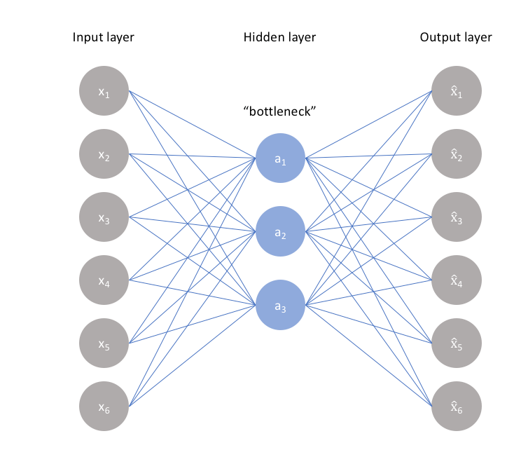
00
Auto Encoder

Slide 4
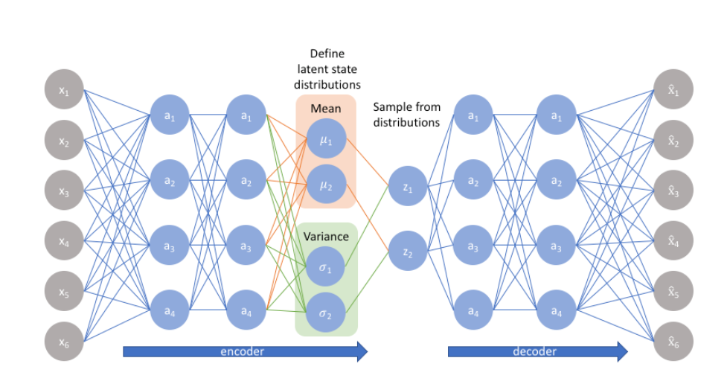
01
Variational Auto Encoder

Slide 5
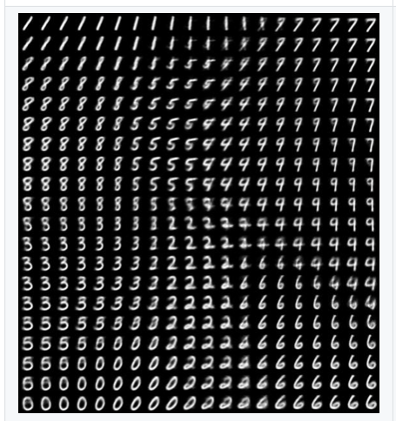
Generative modeling
“Generative modeling” is a area of machine learning which deals with models of distributions P(X).
For instance, image(pixels)…
We can formalize this setup by saying that we get examples X distributed according to some unknown distribution Pgt(X), and our goal is to learn a model P which we can sample from, such that P is as similar as possible to Pgt

Slide 6
How to train it?
How to train a generative model is a long-standing problem in machine learning, most approaches have one of three serious drawback:
Might require strong assumptions about the structure in the data
they might make severe approximations, leading to suboptimal models.
they might rely on computationally expensive inference procedures like Markov Chain Monte Carl
VAE is a popular frame work to solve those problems

Slide 7
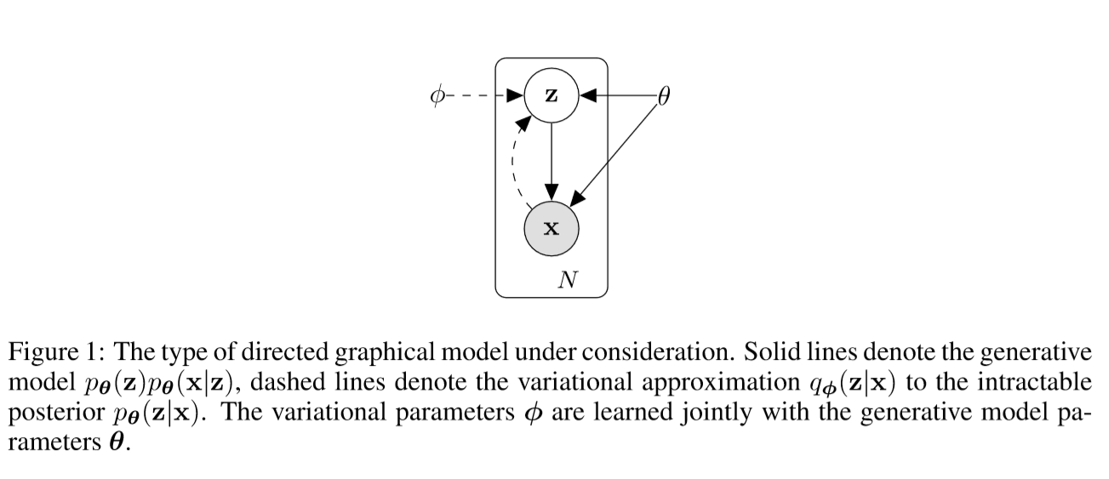
Latent Variable
Latent Variable helps if the model first decides which character to generate before it assigns a value to any specific pixel. This kind of decision is formally called a latent variable

Slide 8
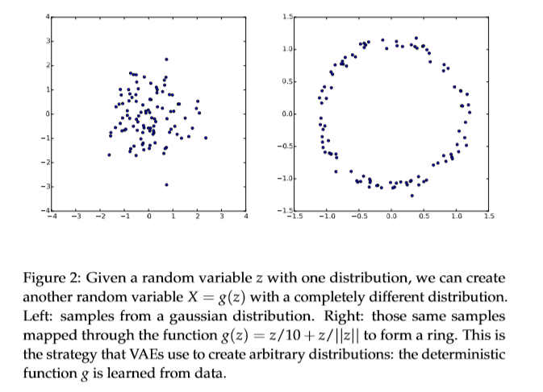
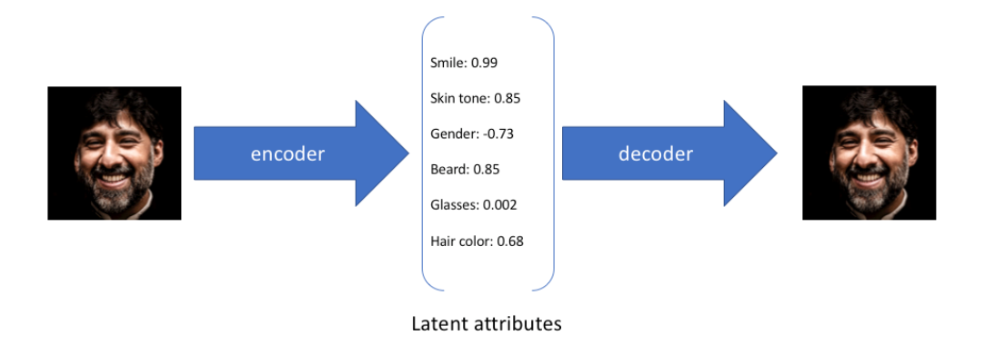
Latent Variable

Slide 9
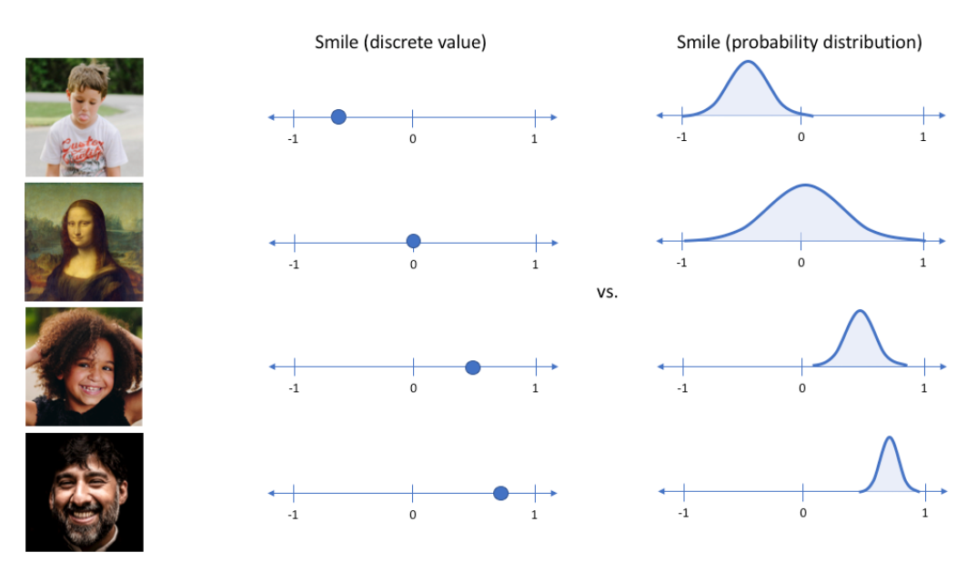
Latent Variable

Slide 10
Network structure

Slide 11
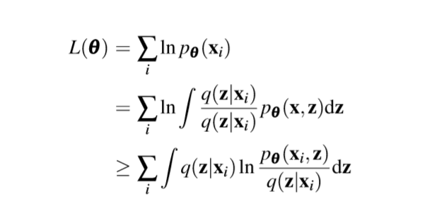
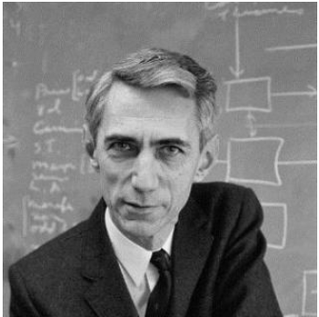
Optimize
Computing p(x) is quite difficult.
So，the right hand side of Equation 5 is a lower bound to P(x). Our goal is changed to optimize the lower bound to P(x)
And, many predecessors look at it in terms of information-theory…

Slide 12
Optimize
Reconstruction error
KL: encourages our learned distribution q(z|x) to be similar to the
true prior distribution p(z)

Slide 13
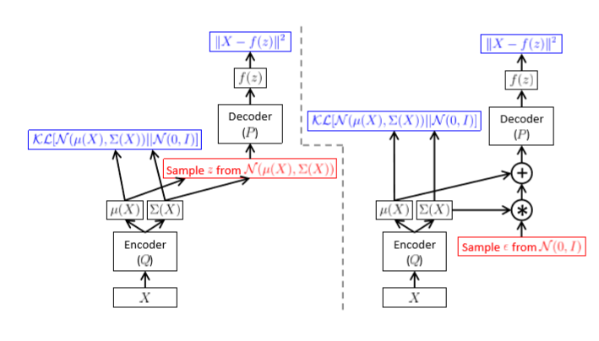
reparameterization trick
Backpropagation can be applied only to the right network.

Slide 14
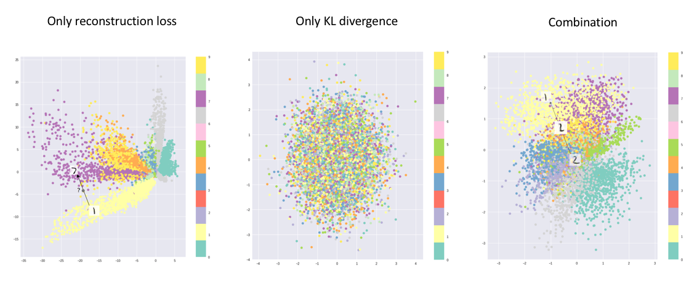
Visualization of latent space
we're capable of learning smooth latent state representations of the input data

Slide 15
02
some experiments
Notes:
接下来是第三部分，我们当前完成的工作进度。

Slide 16
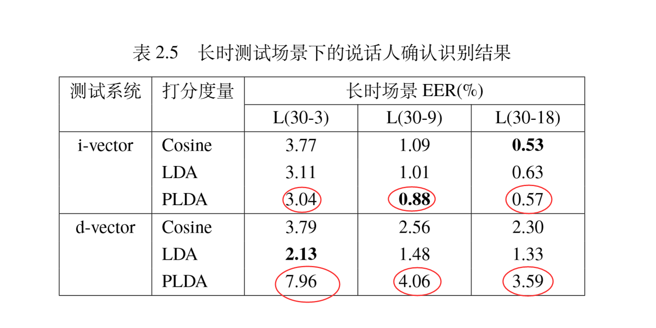
VAE for SRE
i-vector模型完美地符合PLDA模型的高斯假 设。而对于d-vector模型，无论是句子级别还是说话人级别，其呈现出明显的非高 斯性。显然，d-vector模型不符合PLDA模型的高斯假设，因此其PLDA打分结果 并不理想

Slide 17
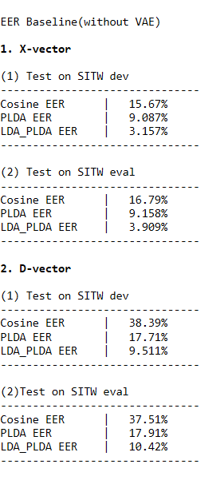
VAE for SRE
D-vector & VAE encoder
Test on SITW dev:
Cosine EER | 31.77%
PLDA EER | 17.4%
LDA_PLDA_EER | 14.52%
Test on SITW eval
Cosine EER | 32.5%
PLDA EER | 18.75%
LDA_PLDA_EER | 15.28%

Slide 18
03
Tied VAE for SRE
Notes:
接下来是最后一个部分，我们的未来计划

Slide 19
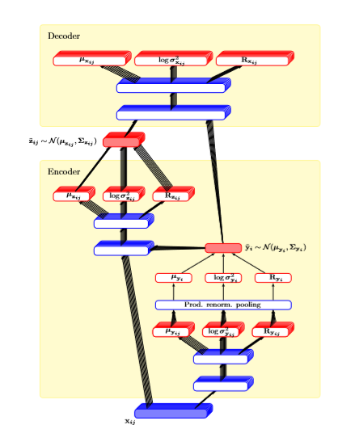
Tied VAE
This paper generalize the PLDA model to let i-vectors depend non-linearly on the latent factors.
Using Tied variational autoencoder as i-vector back-end.
VAE framework assume an approximate posterior that belongs a parametric family of distributions.
This is an extension of the original VAE formulation, where we added the speaker factor variable yi which is tied across samples of the same speaker

Slide 20
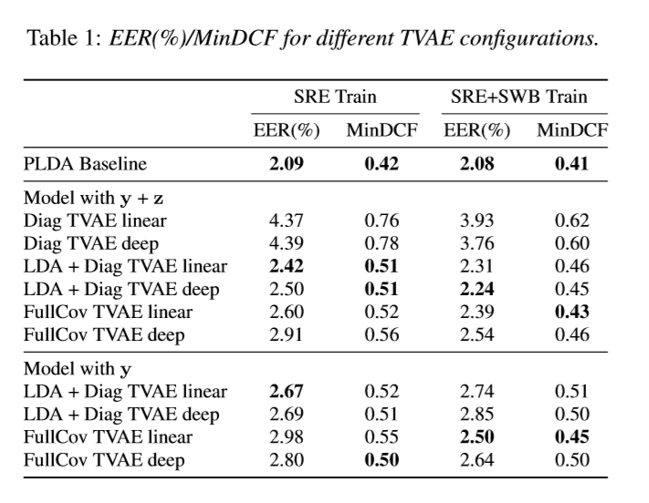
Tied VAE

Slide 21
reference
[0] https://www.jeremyjordan.me/autoencoders/
[1] https://www.jeremyjordan.me/variational-autoencoders/
[2] https://arxiv.org/pdf/1606.05908.pdf
[3] https://arxiv.org/pdf/1312.6114.pdf
…………..

Slide 22
That’s all, thank you!
Notes:
谢谢老师，我们的介绍结束了！

